Slide 1
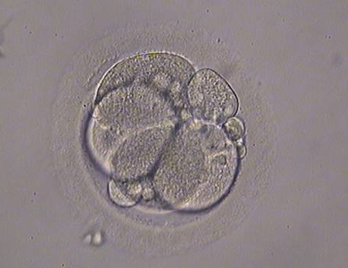
A 4-cell embryo with four evenly sized blastomeres each one containing one nucleus.
A 4-cell embryo with 15–20% fragmentation,

Slide 2
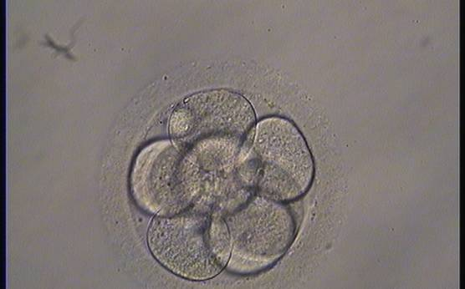
An 8-cell embryo with evenly sized blastomeres
A 6-cell embryo with 30–40% fragmentation

Slide 3
A 5-cell embryo with 15–20% scattered fragmentation and unevenly sized blastomeres
An 8-cell embryo showing signs of moderate compaction

Slide 4
A morula of good quality. All blastomeres have been included in the compaction process and individual cells are no longer evident.
A morula of good quality. All blastomeres have been included in the compaction process and individual cells are no longer evident.

Slide 5
An early blastocyst with a cavity occupying < 50% of the volume of the embryo. Note the ﬂattened squamous-like trophectoderm (TE) cells lining the right half of the cavity in this view.
A very early blastocyst.

Slide 6
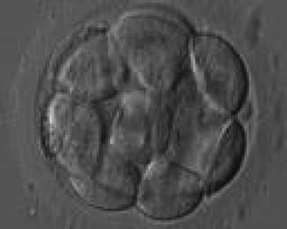
An early blastocyst with a cavity occupying < 50% of the volume of the embryo. Note the early formation of the outer TE cells that are beginning to be ﬂattened against the zona pellucida (ZP).
An early blastocyst with a cavity occupying almost 50% of the volume of the embryo. Note the large ﬂattened TE cells lining the initial blastocoel cavity.

Slide 7
An early blastocyst with the cavity clearly visible and occupying half the volume of the embryo.
An early blastocyst with the cavity occupying > 50% of the volume of the embryo. The overall volume of the blastocyst remains unchanged with no thinning of the ZP. The early ICM can be seen on the left half of the blastocyst in this view.

Slide 8
Blastocyst (Grade 3:A:A) showing a compact ICM.
Blastocyst (Grade 3:B:A) showing a cavity occupying the total volume of the embryo. The ICM can be seen at the 11o’clock position.

Slide 9
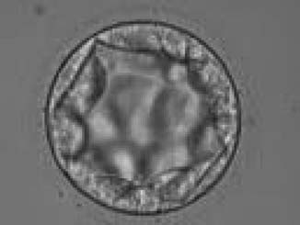
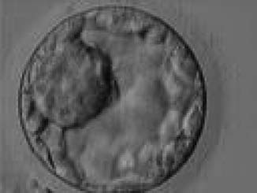
Blastocyst (Grade 3:C:B) with no clearly identiﬁable ICM and TE cells that in places are quite large and stretch over great distances to reach the next cell
Blastocyst (Grade 3:A:A) showing a very large ICM at the 10 o’ clock position in this view. The ICM is made up of many cells that are tightly compacted.

