Slide 1
Notes:
All image credits courtesy of Morgue File and/or FreeImages.com unless otherwise specified

Slide 2
COSTS, BENEFITS, AND PROFITS
Our decisions depend on comparing costs to benefits…
And the quality of our decisions depends on how well we understand costs and benefits.
Notes:
All image credits courtesy of Morgue File and/or FreeImages.com unless otherwise specified

Slide 3
EXPLICIT AND IMPLICIT COSTS
An explicit cost is a cost that requires an outlay of money (cost of books).
An implicit cost does not require an outlay of money; it is measured by the value, in dollar terms, of benefits that are forgone (e.g., wages forgone because of being a full-time student).
Notes:
All image credits courtesy of Morgue File and/or FreeImages.com unless otherwise specified

Slide 4
DEFINITIONS OF PROFIT: ACCOUNTING VS. ECONOMIC PROFIT
Accounting profit = revenue – explicit cost.
Economic profit:
equals revenue minus the opportunity cost of all resources used.
is usually less than accounting profit.
shows a more complete picture of costs.
helps businesses and individuals make better-informed decisions.
is the measure economists prefer.
Economic profit = revenue – explicit cost – implicit cost.

Slide 5
THE IMPLICIT COST OF CAPITAL
Capital is the total value of assets owned by an individual or firm—physical assets plus financial assets.
The implicit cost of capital is the opportunity cost of the use of one’s own capital:
the income earned if the capital had been employed in its next best alternative use (e.g., forgone interest income).
Notes:
All image credits courtesy of Morgue File and/or FreeImages.com unless otherwise specified

Slide 6
DECISION MAKING
There are different types of decisions:
A choice between two alternatives (“either–or”)
A more complex choice that requires us to choose at the margin (“how much?”)
Notes:
All image credits courtesy of Morgue File and/or FreeImages.com unless otherwise specified

Slide 7
MAKING “EITHER–OR” DECISIONS
Principle of “either–or” decision making:
when faced with an “either–or” choice between two activities (all else equal) choose the one with the positive economic profit.
Notes:
All image credits courtesy of Morgue File and/or FreeImages.com unless otherwise specified

Slide 8
MAKING “HOW MUCH” DECISIONS: THE ROLE OF MARGINAL ANALYSIS
To make good “how much?” decisions requires weighing the additional costs and benefits of each increase.
Marginal cost: the additional cost incurred by producing one more unit of that good or service.
Notes:
All image credits courtesy of Morgue File and/or FreeImages.com unless otherwise specified

Slide 9
THE SHAPE OF MARGINAL COST
The marginal cost curve shows how the cost of producing one more unit depends on the quantity that has already been produced.
Each product has a unique marginal cost. Some basic shapes:
Increasing marginal cost: Each additional unit costs more to produce than the previous one.
Constant marginal cost: Each additional unit costs the same to produce as the previous one.
Decreasing marginal cost: Each additional unit costs less to produce than the previous one.

Slide 10
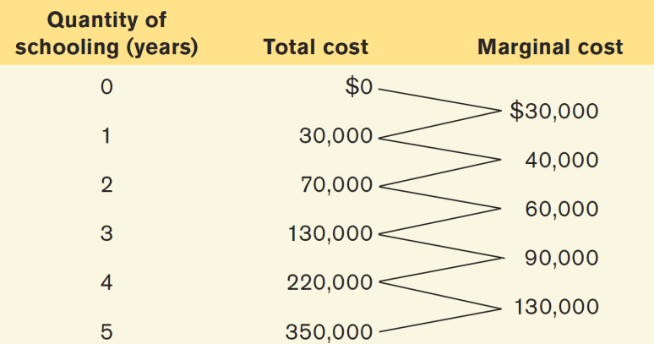
MARGINAL COST OF ALEX’S SCHOOLING
Marginal cost
$300,000
200,000
Marginal cost curve, MC
100,000
0
1
2
3
4
5
Quantity of schooling (years)

Slide 11
MARGINAL BENEFIT
Marginal benefit: the additional benefit derived from producing one more unit of a good or service.
Notes:
All image credits courtesy of Morgue File and/or FreeImages.com unless otherwise specified

Slide 12
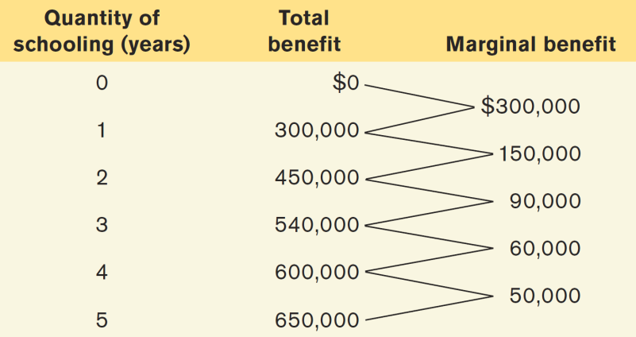
MARGINAL BENEFIT OF ALEX’S SCHOOLING
Marginal benefit
$300,000
200,000
100,000
Marginal benefit curve, MB
0
1
2
3
4
5
Quantity of schooling (years)

Slide 13
MARGINAL ANALYSIS
Profit-maximizing principle of marginal analysis:
For a profit-maximizing “how much” decision, the optimal quantity is the largest quantity at which the marginal benefit is greater than or equal to marginal cost.
Notes:
All image credits courtesy of Morgue File and/or FreeImages.com unless otherwise specified

Slide 14
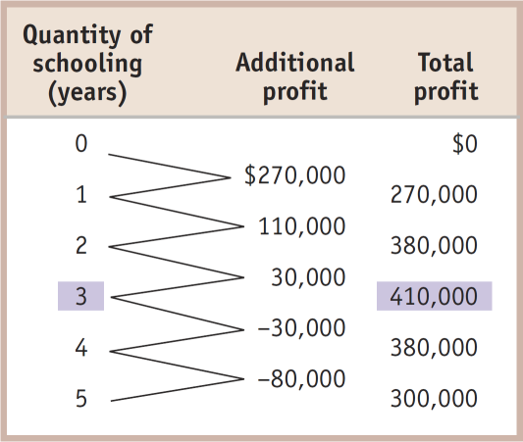
MARGINAL ANALYSIS
Marginal cost, Marginal benefit
$300,000
200,000
MC
Optimal point
100,000
MB
0
1
2
0
3
4
5
Quantity of schooling (years)

Slide 15
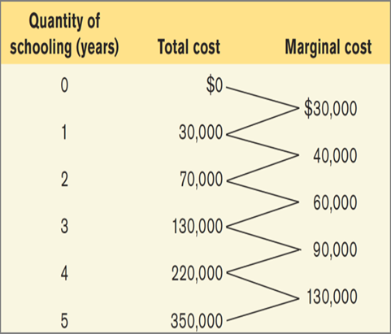
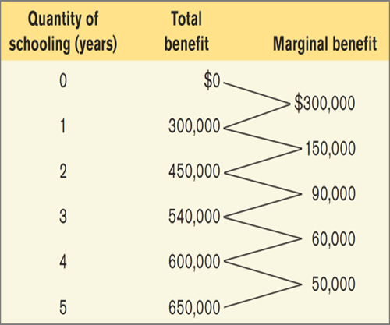
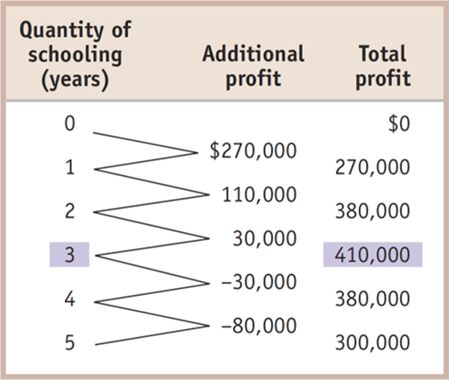
Marginal cost, Marginal benefit
$300,000
200,000
MC
Optimal point
100,000
MB
0
1
2
0
3
4
5
Quantity of schooling (years)

Slide 16
SUNK COSTS
Sunk cost: a cost that has already been incurred and is not recoverable.
A sunk cost should be ignored in decisions about future actions (but this is sometimes hard to do).
Notes:
All image credits courtesy of Morgue File and/or FreeImages.com unless otherwise specified

Slide 17
BEHAVIORAL ECONOMICS
We assume humans are mostly rational…
A rational decision maker always chooses the available option that leads to the outcome he or she most prefers.
Are there limits to human rationality?
Notes:
All image credits courtesy of Morgue File and/or FreeImages.com unless otherwise specified

Slide 18
RATIONAL, BUT HUMAN, TOO
Three reasons people might rationally choose a worse payoff:
Concerns about fairness: Providing for others sometimes trumps self-interest.
Bounded rationality—“good enough”: Making a choice that is close to (but not exactly) the highest possible profit MAY MAKE SENSE because the effort of finding the best payoff is too costly.
Risk aversion: Willingness to sacrifice some economic payoff in order to avoid a potential loss IS FAIRLY COMMON.

Slide 19
IRRATIONALITY: AN ECONOMIST’S VIEW
There are known (and predictable) holes in our rationality that stem from six established decision-making mistakes:
Misperceiving opportunity costs
Being Overconfident
Having unrealistic expectations about future behavior
Counting dollars unequally
Being loss-averse
Having a bias toward the status-quo
Notes:
All image credits courtesy of Morgue File and/or FreeImages.com unless otherwise specified

Slide 20
IRRATIONALITY: AN ECONOMIST’S VIEW
1. Misperceptions of opportunity costs:
If we don’t understand all of the costs, we cannot make a rational choice.
Notes:
All image credits courtesy of Morgue File and/or FreeImages.com unless otherwise specified

Slide 21
IRRATIONALITY: AN ECONOMIST’S VIEW
2. Overconfidence:
Nonprofessional investors who engage in speculative investing have significantly worse results than professional brokers because of their misguided faith in their ability to spot a winner.
Notes:
All image credits courtesy of Morgue File and/or FreeImages.com unless otherwise specified

Slide 22
IRRATIONALITY: AN ECONOMIST’S VIEW
3. Unrealistic expectations about future behavior:
Most of us are overly optimistic about our future behavior and level of discipline.
Notes:
All image credits courtesy of Morgue File and/or FreeImages.com unless otherwise specified

Slide 23
IRRATIONALITY: AN ECONOMIST’S VIEW
4. Counting dollars unequally
Mental accounting: the habit of mentally assigning dollars to different accounts so that some dollars are worth more than others.
(E.g., spending more with credit cards than cash)
Notes:
All image credits courtesy of Morgue File and/or FreeImages.com unless otherwise specified

Slide 24
Remember those concert tickets?
If you lost your $80 concert tickets, would you replace them?
Yes
No
To Next
Active Learning
Notes:
All image credits courtesy of Morgue File and/or FreeImages.com unless otherwise specified

Slide 25
IRRATIONALITY: AN ECONOMIST’S VIEW
5. Loss aversion: an oversensitivity to loss that leads to unwillingness to recognize a loss and move on.
Notes:
All image credits courtesy of Morgue File and/or FreeImages.com unless otherwise specified

Slide 26
IRRATIONALITY: AN ECONOMIST’S VIEW
6. Status quo bias: the tendency to avoid making a decision altogether.
In Austria, almost 100% choose voluntary organ donation. In neighboring (and culturally similar) Germany: 12%. Sweden: 86%. Denmark: 4%.
The common thread: in Sweden and Austria the form contains an “opt-out” box for donation. In Germany and Denmark you must check a box to opt in to the program.

