Slide 1
Notes:
All image credits courtesy of Morgue File and/or FreeImages.com unless otherwise specified

Slide 2
TYPES OF MARKET STRUCTURE
In order to develop models and make predictions about how producers will behave, we have developed four principal models of market structure:
perfect competition
monopoly
oligopoly
monopolistic competition

Slide 3
TYPES OF MARKET STRUCTURE
Are products differentiated?
No
Yes
Not applicable
One
Monopoly
How many producers are there?
Few
Oligopoly
Perfect competition
Monopolistic competition
Many

Slide 4
THE MEANING OF MONOPOLY
Monopolist: a firm that is the only producer of a good with no close substitutes.
(An industry controlled by a monopolist is known as a monopoly)
Market power: the ability of a firm to raise prices.
Notes:
All image credits courtesy of Morgue File and/or FreeImages.com unless otherwise specified

Slide 5
WHAT A MONOPOLIST DOES
A monopolist reduces the quantity supplied to Q_{M} and moves up the demand curve from C to M, raising the price to P_{M}.
Price
P_{M}
M
S
2. … and raises price.
C
P_{C}
D
Q_{M}
Q_{C}
Quantity
1. Compared to perfect competition, a monopolist reduces output…

Slide 6
WHY DO MONOPOLIES EXIST?
How do they get away with this and protect their profit from new firms?
Profits will not persist in the long run unless there is a barrier to entry.
Notes:
All image credits courtesy of Morgue File and/or FreeImages.com unless otherwise specified

Slide 7
BARRIERS TO ENTRY
Barriers to entry are essential for monopolies. They generate profit for the monopolist in the short run and long run.
This can take the form of:
control of natural resources or inputs.
increasing returns to scale.
technological superiority.
government-made barriers, including patents and copyrights.

Slide 8
1. CONTROL OF A SCARCE RESOURCE OR INPUT
For many years De Beers was a monopolist in the production of diamonds
The discovery of new diamonds mines in Russia and Australia caused a reduction of market power of De Beers
Notes:
Image courtesy of Corbis

Slide 9
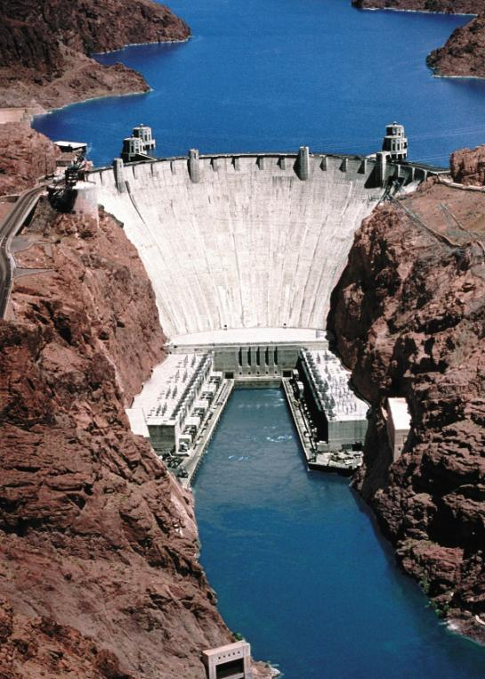
2. INCREASING RETURNS TO SCALE
- Increasing returns to scale: average total cost falls as output increases. In this case firms tend to grow larger.
- In an industry characterized by increasing returns to scale larger companies are more profitable and drive out smaller ones.
- A monopoly created and sustained by increasing returns to scale is called a natural monopoly
- The source of this condition is large fixed costs: when large fixed cost are required to operate, a given quantity of output is produced at lower average total cost by one large firm than by two or more smaller firms.
Hoover Dam, a natural monopoly

Slide 10
2. INCREASING RETURNS TO SCALE
A given quantity of output is produced more cheaply by one large firm than by two or more smaller firms.
Price, cost
Natural monopoly. Average total cost is falling over the relevant output range
Natural monopolist’s break-even price
ATC
D
Quantity
Relevant output range

Slide 11
3. TECHNOLOGICAL SUPERIORITY
A firm that maintains a consistent technological advantage over potential competitors can establish itself as a monopolist.
Notes:
All image credits courtesy of Morgue File and/or FreeImages.com unless otherwise specified

Slide 12
4. NETWORK EXTERNALITY
Network externality: the value of a good or service to an individual increasing as more others use the same good or service.
Notes:
All image credits courtesy of Morgue File and/or FreeImages.com unless otherwise specified

Slide 13
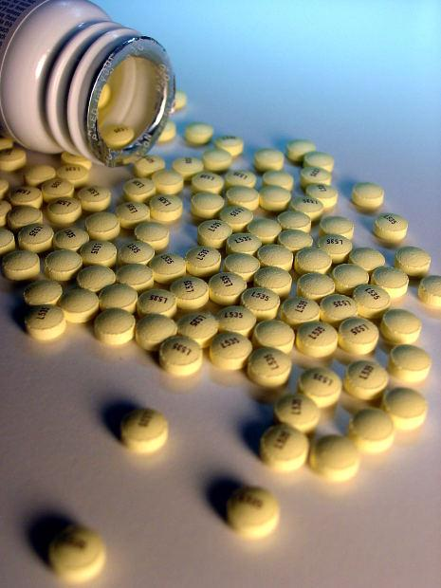
5. GOVERNMENT-CREATED BARRIER
A patent gives an inventor a temporary monopoly in the use or sale of an invention.
A copyright gives the creator of a literary or artistic work sole rights to profit from that work.
Notes:
All image credits courtesy of Morgue File and/or FreeImages.com unless otherwise specified

Slide 14
HOW A MONOPOLIST MAXIMIZES PROFIT
Competitive firms cannot choose price.
Monopolists can.
Demand curve of a monopolist
Price
D_{M}
Quantity

Slide 15
HOW A MONOPOLIST MAXIMIZES PROFIT
All firms face the same rule: Profit is maximized at the Q where MR = MC.
So what does MR look like?
MR = ∆TR/ ∆Q.
Demand curve: P=a-bQ
TR=P(Q)*Q=aQ-bQ²
MR=a-2bQ
Same vertical intercept of the demand curve but double slope!!
Notes:
All image credits courtesy of Morgue File and/or FreeImages.com unless otherwise specified

Slide 16
HOW A MONOPOLIST MAXIMIZES PROFIT
An increase in production by a monopolist has two opposing effects on revenue:
A quantity effect: One more unit is sold, increasing total revenue by the price at which the unit is sold.
A price effect: To sell the last unit, the monopolist must cut the market price on all units sold. This decreases total revenue.

Slide 17
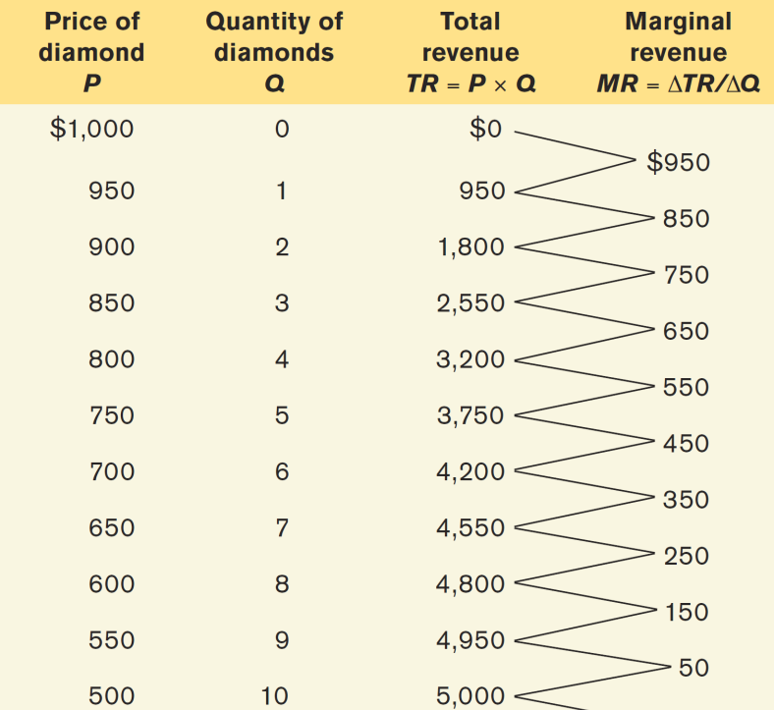
DEMAND, TOTAL REVENUE, AND MARGINAL REVENUE

Slide 18
A MONOPOLIST’S DEMAND, TOTAL REVENUE, AND MARGINAL REVENUE CURVES
(a)
Demand and marginal revenue
Price, cost, marginal revenue of demand
$1,000
A
Quantity effect =
+$500
550
B
500
Price effect = –$450
50
C
D
0
9
10
20
–200
Marginal revenue = $50
–400
MR
Quantity of diamonds
(b)
Total Revenue
Total Revenue
Quantity effect dominates price effect.
Price effect dominates quantity effect.
$5,000
4,000
3,000
2,000
1,000
TR
0
10
20
Quantity of diamonds

Slide 19
PROFIT MAXIMIZATION FOR A MONOPOLY
Profit maximization consists of two steps:
Choosing a quantity
Rule: Choose Q where MR = MC.
Choosing a price
Choose the highest price you can get away with, which is the highest price consumers will pay for that quantity.
Rule: Once you’ve picked your quantity, follow the graph to the demand curve, which shows you how much consumers will pay.

Slide 20
THE MONOPOLIST’S PROFIT-MAXIMIZING OUTPUT AND PRICE
Price, cost, marginal revenue of demand
$1,000
Monopolist’s optimal point
B
P_{M}
600
Perfectly competitive industry’s optimal point
Monopoly profit
P_{C}
200
MC
=
ATC
A
C
0
D
8
10
16
20
–200
Quantity of diamonds
Q_{M}
Q_{C}
MR
–400
The price De Beers can charge per diamond is found by going to the point on the demand curve directly above point A, (point B here)—$600 per diamond. It makes a profit of $400 × 8 = $3,200.

Slide 21
FINDING THE MONOPOLY PRICE
In order to find the profit-maximizing quantity of output for a monopolist, you look for the point where the MR curve crosses the MC curve.
But this isn’t the price the monopolist will choose. The firm will want to charge as much as it can. Why stop at MR if it can charge up to what the demand curve says people will pay?

Slide 22
THE MONOPOLIST’S PROFIT
As long as the monopoly has strong barriers to entry, profit will stay.
Price, cost, marginal revenue
MC
ATC
B
P_{M}
Monopoly profit
A
D
ATC_{M}
C
MR
Q_{M}
Quantity

Slide 23
IS THERE A MONOPOLY SUPPLY CURVE?
You might be tempted to ask about the supply curve of a monopolist. But this is a meaningless question:
Monopolists don’t have supply curves- since they control prices there is no set relationship between Price and Quantity supplied.

Slide 24
MONOPOLY CAUSES INEFFICIENCY
(a)
Total surplus with perfect competition
(b)
Total surplus with monopoly
Price, cost
Price, cost, marginal revenue
Consumer surplus with perfect competition
Consumer surplus with monopoly
P_{M}
Profit
Deadweight loss
P_{C}
MC =
ATC
MC =
ATC
D
D
MR
Q_{C}
Quantity
Q_{M}
Quantity

Slide 25
MONOPOLY AND PUBLIC POLICY
Monopoly profit comes at consumers’ expense:
When a monopoly raises prices and lowers Q, consumer surplus falls and deadweight loss is created.
To avoid deadweight loss, government policy attempts to prevent monopoly behavior.
The government policies used to prevent or eliminate monopolies are known as antitrust policy.

Slide 26
DEALING WITH NATURAL MONOPOLY
Natural monopolies are a different story: They bring lower costs…
…but there’s no guarantee the firm will voluntarily pass along its cost savings to consumers.
Notes:
All image credits courtesy of Morgue File and/or FreeImages.com unless otherwise specified

Slide 27
DEALING WITH NATURAL MONOPOLY
What can public policy do about this? Two common answers:
Public (government) ownership: But publicly owned companies are often poorly run.
Price regulation: A price ceiling imposed on a monopolist does not create shortages if it is not set too low.

Slide 28
UNREGULATED AND REGULATED NATURAL MONOPOLY
(a)
Total surplus with an unregulated natural monopolist
(
b
)
Total surplus with a regulated natural monopolist
Price, cost, marginal revenue
Price, cost, marginal revenue
Consumer surplus
Consumer surplus
Profit
P_{M}
ATC
P_{R}*
ATC
MC
MC
D
D
MR
MR
Q_{M}
Q_{R}
Quantity
Q_{R}*
Quantity
If the monopoly’s price is regulated at PR, consumer surplus rises (and profits fall).

Slide 29
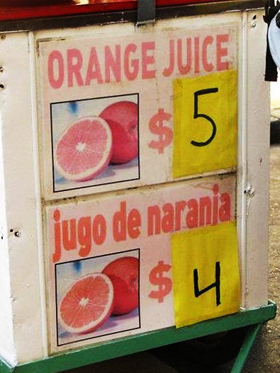
PRICE DISCRIMINATION
¿Qué pasa?
Notes:
All image credits courtesy of Morgue File and/or FreeImages.com unless otherwise specified

Slide 30
PRICE DISCRIMINATION
So far we’ve been assuming our firms is a single-price monopolist: It offers its product to all consumers at the same price.
Some firms practice price discrimination: They charge different prices to different consumers for the same good.

Slide 31
PRICE DISCRIMINATION AND PROFIT MAXIMIZATION
Recall the profit-maximizing rule for firms with monopoly power:
Produce the Q at which MR = MC.
Based on that Q, charge as much as the market will bear (found by the position of the demand curve).
But what if you sell to more than one market, each with its own demand curve?
E.g., senior citizens and young people, business travelers and leisure travelers.

Slide 32
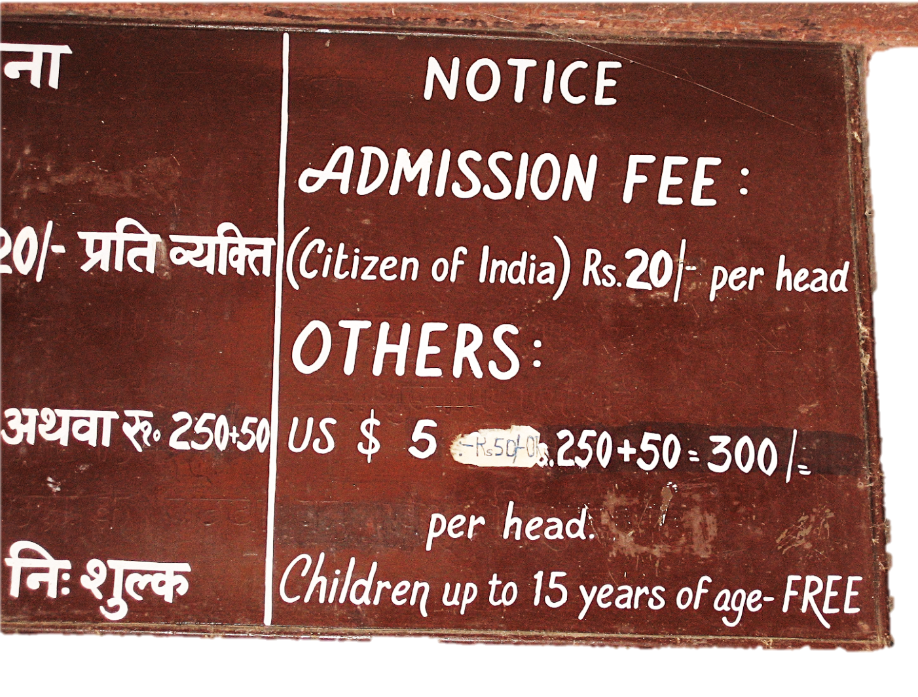
PRICE DISCRIMINATION
Notes:
All image credits courtesy of Morgue File and/or FreeImages.com unless otherwise specified

Slide 33
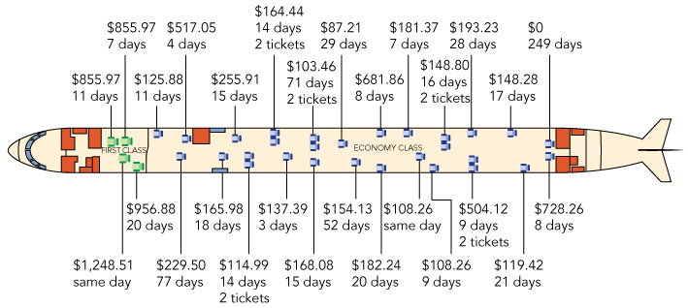
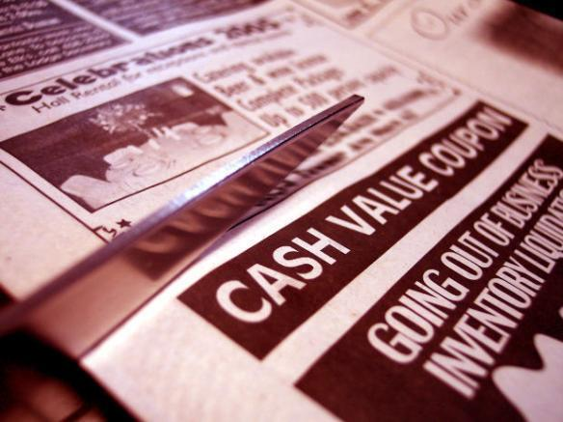
PRICE DISCRIMINATION
Students Get
10% Off!
55+
Discount
Notes:
From the Slate online: L.A. Boutique Opens Only When It Wants To
In a hurry to find that perfect Christmas present? Then don't go to the Never Open Store, an L.A. boutique where the owner sets her hours—and her prices—based on what kind of mood she's in. The Never Open Store doesn't have official hours. The hands have been ripped off the miniature "Will Return At ..." clock on the front door, and owner Stephanie Mata lets people in when she wants to. None of the funky clothing or art is priced, either. Mata says she knows it's "unethical," but she sizes people up and names a price that she thinks fits the client. Hollywood set designers with lavish budgets will pay more for the syringe-studded dartboard or recycled chandelier than students looking to decorate their first apartment. In an era of consumer belt-tightening and retail door-shutting (the Never Open Store is on a street with lots of vacant storefronts), the unorthodox strategy seems to be working. Mata has created a buzz, and she's won't be changing the way she operates. "I'm the boss," Mata says. "And I don't like bad vibes."
Read original story in The Los Angeles Times | Saturday, Dec. 12, 2009.

Slide 34
TWO TYPES OF AIRLINE CUSTOMERS
Price, cost of ticket
If your consumers have low price elasticity, charge them more!
Profit from sales to business travelers
$550
B
Profit from sales to student travelers
150
125
MC
S
D
0
2,000
4,000
Quantity of tickets

Slide 35
PRICE DISCRIMINATION INCREASES SALES AND PROFITS
(a) Discrimination with two prices
(b) Discrimination with three prices
Price, cost
Price, cost
Profit with two prices
P_{high}
Profit with three prices
P_{high}
P_{medium}
P_{low}
P_{low}
MC
MC
D
D
Quantity
Quantity
Sales to consumers with a high willingness to pay
Sales to consumers with a low willingness to pay
Sales to consumers with a high willingness to pay
Sales to consumers with a medium willingness to pay
Sales to consumers with a low willingness to pay

Slide 36
PERFECT PRICE DISCRIMINATION
When perfect price discrimination can be employed, a firm will charge each customer a different price, the maximum price each is willing to pay.
Under perfect price discrimination, the firm captures all consumer surplus as profit.
Notes:
All image credits courtesy of Morgue File and/or FreeImages.com unless otherwise specified

Slide 37
PRICE DISCRIMINATION
There is no deadweight loss, because all mutually beneficial transactions are exploited.
There is zero consumer surplus: The entire surplus is captured by the monopolist in the form of profit.
Price, cost
(c)
Perfect price discrimination
Profit with perfect price discrimination
MC
D
Quantity

Slide 38
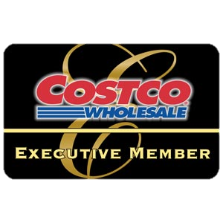
PRICE DISCRIMINATION
Common techniques for price discrimination:
Advance purchase restrictions
Volume discounts
Two-part tariffs
Your Costco card: a two-part tariff
Notes:
All image credits courtesy of Morgue File and/or FreeImages.com unless otherwise specified

