Slide 1
Notes:
All image credits courtesy of Morgue File and/or FreeImages.com unless otherwise specified

Slide 2
OUTLINE
The importance of the firm’s production function, the relationship between quantity of inputs and quantity of output
The various types of costs a firm faces and how they generate the firm’s marginal and average cost curves
Why a firm’s costs may differ in the short run versus the long run
How the firm’s technology of production can generate increasing returns to scale

Slide 3
PRODUCTION IN THE SHORT RUN
Production is the process of turning inputs into outputs.
The cost structure of a firm depends on the nature of the production process.
The firm’s production function underlies its cost curves.
Notes:
All image credits courtesy of Morgue File and/or FreeImages.com unless otherwise specified

Slide 4
THE PRODUCTION FUNCTION
A production function is the relationship between the quantity of inputs a firm uses and the quantity of output it produces.
A fixed input is an input whose quantity is fixed for a period and cannot be varied (land, costly machinery, etc.)
A variable input is an input whose quantity the firm can vary at any time (labor force in flexible labor markets)

Slide 5
INPUTS AND OUTPUT
In reality, whether or not the quantity of an input is fixed depends on the time horizon.
The long run is the period in which all inputs can be varied.
The short run is the period in which at least one input is fixed.
The total product curve shows how the quantity of output depends on the quantity of the variable input for a given quantity of the fixed input.

Slide 6
PRODUCTION FUNCTION AND TP CURVE
Quantity of wheat (bushels)
Adding a 7th worker leads to an increase in output of only 7 bushels.
Quantity of labor
Quantity
of wheat
MP of labor
MPL
=
D_{Q}
/
D_{L}
(worker)
(bushels)
(bushels per worker)
100
Adding a 2nd worker leads to an increase in output of only 17 bushels.
Total product, TP
0
0
1
19
19
2
36
17
80
15
3
51
13
60
4
64
5
75
11
40
6
84
9
7
91
7
20
8
96
5
0
1
2
3
4
5
6
7
8
Quantity of labor (workers)
The relationship between inputs and output is positive but not constant: marginal product of labor changes along the production function.

Slide 7
PRODUCTION IN THE SHORT RUN
Marginal product is the change in output resulting from a one-unit increase in the amount of labor input (ΔQ/ΔL)
Marginal product initially rises as more workers are hired; then it declines.
In general, there are diminishing returns to an input when an increase in the quantity of that input, holding the quantity of all other inputs fixed, reduces that input’s marginal product.
Due to diminishing returns to labor, the MPL curve is negatively sloped.
Notes:
All image credits courtesy of Morgue File and/or FreeImages.com unless otherwise specified

Slide 8
What’s a unit?
The MPL is defined as the increase in the quantity of output when you increase the quantity of that input by one unit.
What do we mean by a unit of labor? Is it an additional hour of labor, an additional week, or a person-year?
The answer is that it doesn’t matter, as long as you are consistent.
Notes:
All image credits courtesy of Morgue File and/or FreeImages.com unless otherwise specified

Slide 9
TOTAL PRODUCT, MARGINAL PRODUCT, AND FIXED INPUT
With more land (fixed input) each worker can produce more. This shifts the total product curve up.
So the MPL of each worker is higher when the farm is larger; the MPL curve shifts up also.
Quantity of wheat
(bushels)
Marginal product of labor
(bushels per worker)
160
30
140
TP₂₀
120
25
100
TP₁₀
20
80
15
60
10
40
MPL₂₀
20
5
MPL₁₀
0
1
2
3
4
5
6
7
8
0
1
2
3
4
5
6
7
8
Quantity of labor (workers)
Quantity of labor (workers)
(a) Total product curves
(b) Marginal product curves

Slide 10
FROM THE PRODUCTION FUNCTION TO COST CURVES
A fixed cost is a cost that does not depend on the quantity of output produced. It is the cost of the fixed input.
A variable cost is a cost that depends on the quantity of output produced. It is the cost of the variable input.

Slide 11
TOTAL COST CURVE
The total cost of producing a given quantity of output is the sum of the fixed cost and the variable cost of producing that quantity of output.
TC = FC + VC
The total cost curve becomes steeper as more output is produced, a result of diminishing returns.

Slide 12
TOTAL COST CURVE
Cost
Total cost, TC
$2,000
I
1,800
H
1,600
G
1,400
F
1,200
E
1,000
D
800
C
600
B
400
A
200
0
19
36
51
64
75
84
91
96
Quantity of wheat (bushels)
Point on graph
Quantity of labor
Quantity of wheat
Variable cost
(VC)
Fixed Cost (FC)
Total cost
(worker)
(bushels)
(TC = FC + VC)
A
0
0
$
0
$400
$
400
B
1
19
200
400
600
C
2
36
400
400
800
D
3
51
600
400
1,000
E
4
64
800
400
1,200
F
5
75
1,000
400
1,400
G
6
84
1,200
400
1,600
H
7
91
1,400
400
1,800
I
8
96
1,600
400
2,000

Slide 13
MARGINAL COST AND AVERAGE COST
The next step is to define the marginal cost and the average cost.
Important relationship between marginal cost and average cost curves.
Extremely important to analyze the firm’s output decision and the market supply curve.

Slide 14
MARGINAL COST
The marginal cost is the change in total cost generated by one additional unit of output.
MC = ΔTC/ΔQ
Where Δ = change, TC = total cost and Q = quantity of output

Slide 15
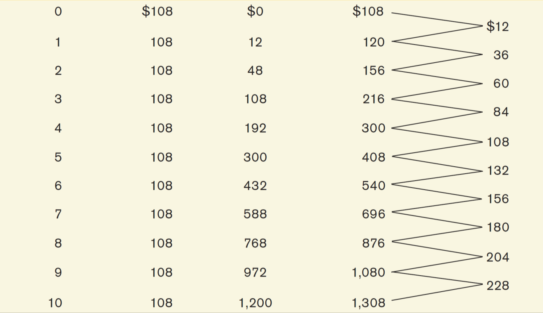
COSTS OF SELENA’S GOURMET SALSAS

Slide 16
TOTAL COST AND MARGINAL COST CURVES
(a) Total cost
(b) Marginal cost
Cost
Cost of case
8th case of salsa increases total cost by $180.
$1,400
TC
$250
MC
1,200
200
1,000
2nd case of salsa increases total cost by $36.
800
150
600
100
400
200
50
0
1
2
3
4
5
6
7
8
9
10
0
1
2
3
4
5
6
7
8
9
10
Quantity of salsa (cases)
Quantity of salsa (cases)

Slide 17
WHY IS THE MARGINAL COST CURVE UPWARD SLOPING?
Because there are diminishing returns to inputs in this example. As output increases, the marginal product of the variable input declines.
This implies that more and more of the variable input must be used to produce each additional unit of output as the amount of output already produced rises.
And since each unit of the variable input must be paid for, the cost per additional unit of output also rises.

Slide 18
AVERAGE COST
Average total cost (often referred to simply as average cost) = total cost per unit of output produced
ATC = TC/Q
Average fixed cost = fixed cost per unit of output produced
AFC = FC/Q
Average variable cost = variable cost per unit of output produced
AVC = VC/Q

Slide 19
AVERAGE TOTAL COST CURVE
Increasing output has two opposing effects on average total cost:
The spreading effect: The larger the output, the more output over which fixed cost is spread, leading to lower average fixed cost.
The diminishing returns effect: The larger the output, the more variable input required to produce additional units, which leads to higher average variable cost.

Slide 20
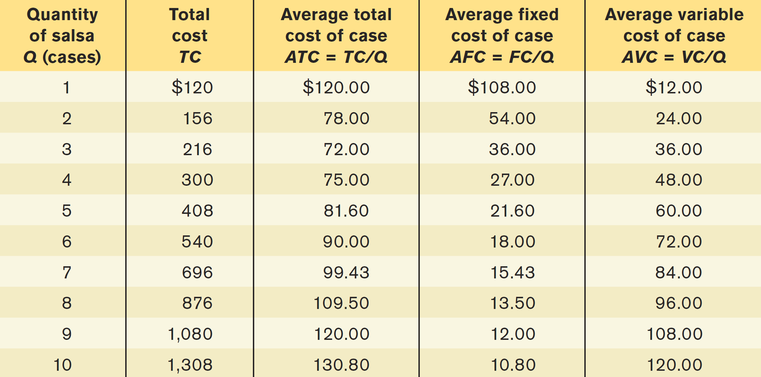
AVERAGE COSTS FOR SELENA’S GOURMET SALSAS

Slide 21
AVERAGE TOTAL COST CURVE FOR SELENA’S GOURMET SALSAS
Cost of case
$140
Average total cost, ATC
Minimum average total cost
120
100
80
M
60
40
20
0
1
2
3
4
5
6
7
8
9
10
Quantity of salsa (cases)
Minimum-cost output
Notes:
.

Slide 22
PUTTING THE FOUR COST CURVES TOGETHER
Note that:
marginal cost is upward sloping because of diminishing returns.
Average variable cost also is upward sloping but is flatter than the marginal cost curve.
Average fixed cost is downward sloping because of the spreading effect.
The marginal cost curve intersects the average total cost curve from below, crossing it at its lowest point.

Slide 23
MC AND AVERAGE COST CURVES FOR SELENA’S GOURMET SALSAS
Cost of case
$250
MC
200
150
ATC
AVC
100
50
AFC
0
1
2
3
4
5
6
7
8
9
10
Quantity of salsa (cases)
Minimum-cost output

Slide 24
THE RELATIONSHIP BETWEEN THE ATC AND MC CURVES
Cost of unit
MC
If marginal cost is above average total cost, average total cost is rising.
MC_{H}
ATC
B₂
A₁
A₂
M
B₁
MC_{L}
If marginal cost is below average total cost, average total cost is falling.
Quantity

Slide 25
MORE REALISTIC COST CURVES – U-shaped CURVES
Cost of unit
2. … but diminishing returns set in once the benefits of specialization are exhausted and marginal cost rises.
MC
ATC
AVC
1. Increasing specialization leads to lower marginal cost…
Quantity

Slide 26
SHORT-RUN VERSUS LONG-RUN COSTS
All inputs are variable in the long run. This means that in the long run, fixed cost (like factory size) may also vary.
The firm will choose its fixed cost in the long run based on the level of output it expects to produce.
Notes:
All image credits courtesy of Morgue File and/or FreeImages.com unless otherwise specified

Slide 27
CHOOSING THE LEVEL OF FIXED COST
Cost of case
At low Q, low fixed cost yields a lower average total cost.
At high Q, high fixed cost yields a lower average total cost.
$250
200
150
Low fixed cost
ATC₁
100
There is a trade-off between higher fixed cost and lower variable cost for any given output level and vice versa.
ATC₂
50
High fixed cost
0
1
2
3
4
5
6
7
8
9
10
Quantity of salsa (cases)
Low fixed cost (FC = $108)
High fixed cost (FC = $216)
Quantity of salsa
High variable cost
ATC of case
Low variable cost
ATC of case
Total cost
Total cost
(salsa)
ATC₁
ATC₂
1
$
12
$
120
$120.00
$
6
$222
$222.00
2
48
156
78.00
24
240
120.00
3
108
216
72.00
54
270
90.00
4
192
300
75.00
96
312
78.00
5
300
408
81.60
150
366
73.20
6
432
540
90.00
216
432
72.00
7
588
696
99.43
294
510
72.86
8
768
876
109.50
384
600
75.00
9
972
1,080
120.00
486
702
78.00
10
1,200
1,308
130.80
600
816
81.60

Slide 28
THE LONG-RUN AVERAGE TOTAL COST CURVE
What is the relationship between short run and long run average total cost curve?
The long-run average total cost curve shows the relationship between output and average total cost when fixed cost has been chosen to minimize average total cost for each level of output.
(We assume the firm has chosen the cheapest plant size for each output level.)
Notes:
All image credits courtesy of Morgue File and/or FreeImages.com unless otherwise specified

Slide 29
SHORT-RUN AND LONG-RUN AVERAGE TOTAL COST CURVES
Cost of case
Constant returns to scale
Increasing returns to scale
Decreasing returns to scale
ATC₃
ATC₆
ATC₉
LRATC
B
Y
A
C
X
0
3
4
5
6
7
8
9
Quantity of salsa (cases)
Cheaper to switch to larger plant

Slide 30
RETURNS TO SCALE
There are increasing returns to scale (economies of scale) when long-run average total cost declines as output increases.
There are decreasing returns to scale (diseconomies of scale) when long-run average total cost increases as output increases.
There are constant returns to scale when long-run average total cost is constant as output increases.
Notes:
image courtesy of Egmont Strigl/Westend61/Superstock

