Slide 1
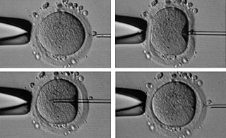
MAIN TOPICS
- ASSISTED REPRODUCTIVE TECHNIQUES
The oocyte retrieval (Pick-Up);
In-vitro insemination;
Intracytoplasmatic Sperm Injection (ICSI);
Assisted zona hatching;
Blastocyst biopsy;
Pre-implantation genetic diagnosis and embryo screening;
Vitrification of oocytes and embryos;
THEROICAL LESSON

Slide 2
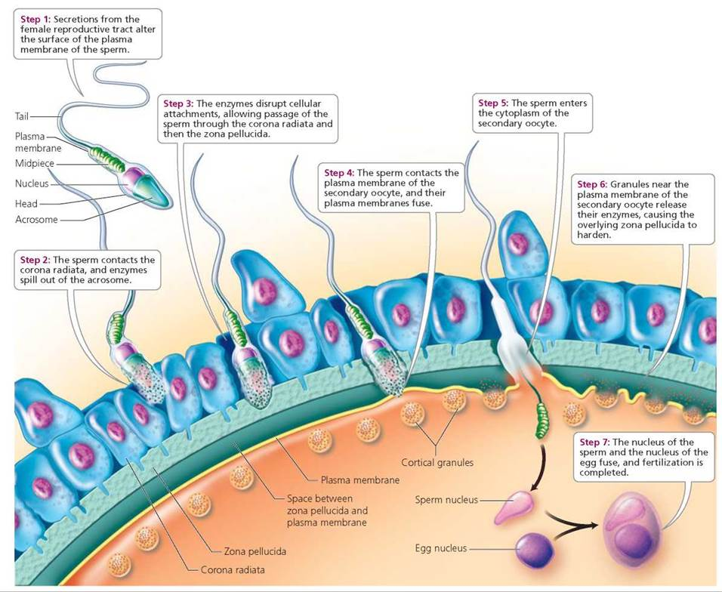
ASSISTED ZONA HATCHING
ZONA PELLUCIDA: acellular matrix composed of sulfated glycoproteins (ZP1, ZP2, ZP3)
BINDING OF REACTED SPZ
DURING FERTILIZATION
PREVENTION OF
POLYSPERMIC FERTILIZATION
PROTECTION OF THE EMBRYO
AND INTEGRITY MAINTENANCE
PREVENTION OF
ECTOPIC PREGNANCY

Slide 3
ZP SIZE AND SHAPE
MII oocyte normal in shape
MII oocyte with a thick and dense ZP
Oocyte with an abnormally shaped ZP and with what appears to be a duplication of the ZP. The oocyte has a regular shape.

Slide 4
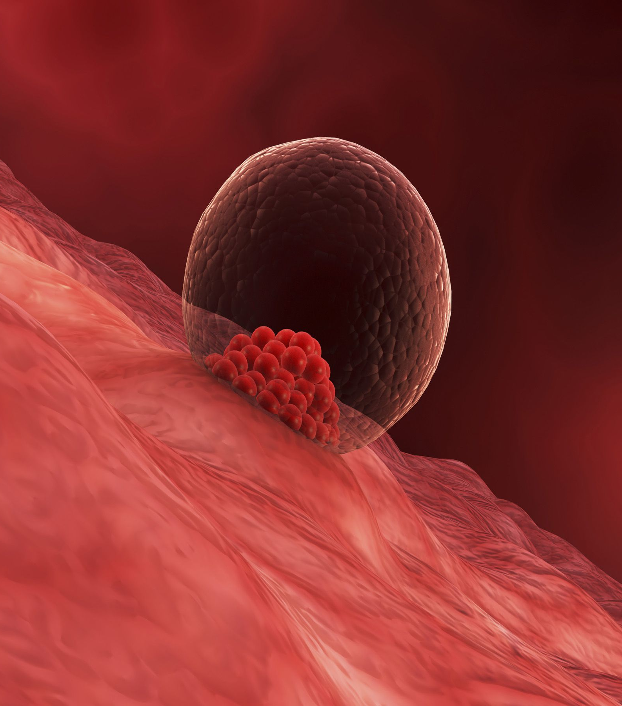
ASSISTED ZONA HATCHING
EMBRYO HATCHING: a spontaneous rupture of the ZP that allow the embryo to interact with the endometrial layer of the uterus. In-vivo, hatching occurs at blastocyst stage and is due to:
In-vivo
CHEMICAL DIGESTION OF ZP (principal hypotesis): lysins from the embryo and/or the uterus are involved;
MECHANICAL LYSIS OF ZP (secondary hypotesis): due to contraction and expansion cycles.

Slide 5
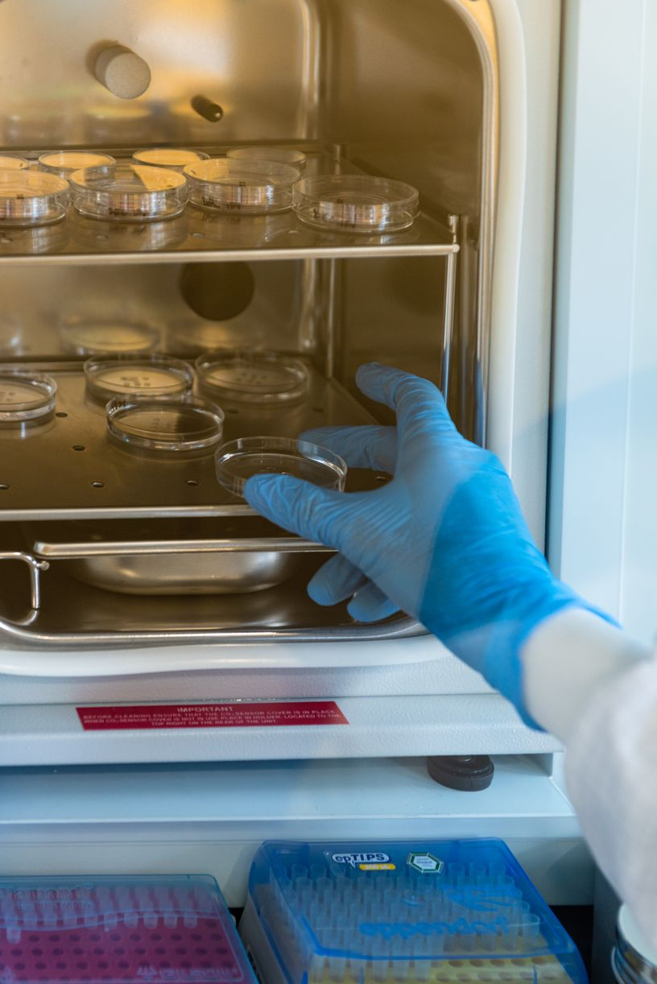
In-vitro
In-vitro generated embryos develop more slowly than the in-vivo ones;
manifest a relative high degree of genetic abnormalities;
undergo cell fragmentation;
hatch and implant at a lower rate than natural.

Slide 6
ASSISTED ZONA HATCHING
SUPEROVULATION
EMBRYO CULTURE
WOMAN’S AGE AND FSH
CRYOPRESERVATION
THAWING
Hardening and thicknessing of the zona
due to crosslinking of protein and/or
abnormal espression.

Slide 7
ASSISTED ZONA HATCHING
In order to help the embryo to implant:
MECHANICAL PARTIAL “ZONA DISSECTION” a) the embryo is held with a holding pipette and b) the ZP is tangentially pierced with a needle (from 1 to 11 o’clock position). c) the embryo is released from the holding pipette and the part of the ZP between the two points is rubbed against the holding d) until a slit is made in the ZP.
(Cohen et al., 1990)
a)
b)
c)
d)
Small hole
Skilled embryologyst
Labour intensive
Expensive
We use this technique for day 3 or day 4 embryos to avoid osmolarity imbalance caused by larger hole
https://www.youtube.com/watch?v=GQVA0xJhre8
Notes:
a

Slide 8
ASSISTED ZONA HATCHING
In order to help the embryo to implant:
CHEMICAL “ZONA DRILLING” a) the embryo is held with a holding pipette and b) an acid solution (Tyrode’s pH 2.2 – 2.6) is gently delivered over a small area of the ZP c) as soon as a hole in the ZP is created c) a suction is applied to avoid damage arisen from toxic solution.
(Cohen et al., 1992)
a)
b)
c)
d)
Large hole
Skilled embryologyst
Labour intensive
Expensive
Toxic effect
We never use this technique due to low pH solution toxicity to the embryos
Notes:
a

Slide 9
ASSISTED ZONA HATCHING
In order to help the embryo to implant:
“LASER ASSISTED” HATCHING a) the embryo is held with a holding pipette and b) four 200 – 450 μs impulses are applied until a hole in the ZP is made. (Obruca et al., 1994)
200°C
100°C
50°C
Large hole
Fast execution
Temperature rise
Notes:
a

Slide 10
MAIN TOPICS
- ASSISTED REPRODUCTIVE TECHNIQUES
The oocyte retrieval (Pick-Up);
In-vitro insemination;
Intracytoplasmatic Sperm Injection (ICSI);
Assisted zona hatching;
Blastocyst biopsy;
Pre-implantation genetic diagnosis and embryo screening;
Vitrification of oocytes and embryos;
THEROICAL LESSON

Slide 11
BLASTOCYST BIOPSY
MOST LOSS OF IMPLANTATION IS CAUSED BY CHROMOSOME ABNORMALITIES
2014. Data from Reprogenetics, our partner in PGS/PGD ˃19000 blastocysts analyzed.

Slide 12
BLASTOCYST BIOPSY
The mean percentage of aneuploid blastocysts is 50%
Aneuploidy increase with maternal age
The error rate of CCS diagnosis is low (˂2%)
Blastocyst biopsy is non detrimental to the embryo
Maternal age is inversely proportional to implantation
CCS: comprehensive chromosome analysis such as aCGH, qPCR, NGS
Genetic diagnosis in blastocyst embryo improve implantation rates and eliminate maternal age effect on implantation (miscarriage; birth defects)

Slide 13
WHEN TO BIOPSY
1-2 cells
~ 6 cells
EFFECT OF DAY 3 AND BLASTOCYST BIOPSY
Implantation rate | cleavage stage |  | blastocyst stage
 | biopsy | not | biopsy | not
 | 31% | 53% | 54% | 41%

Slide 14
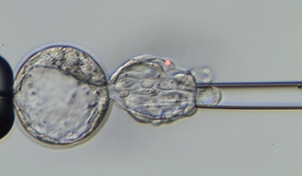
BLASTOCYST BIOPSY
More DNA: less NO results
Less mosaicisms = low error rate
Reduced impact of embryo biopsy
Less embryos to process (only blasts!)
Uterine environment optimized after thaw
The trophoectoderm is representative of ICM (97%)
Not all embryos reach the blast stage and not all the same day
4,5% monozygotic twins after hatching
Advantages:
Disadvantages:

Slide 15
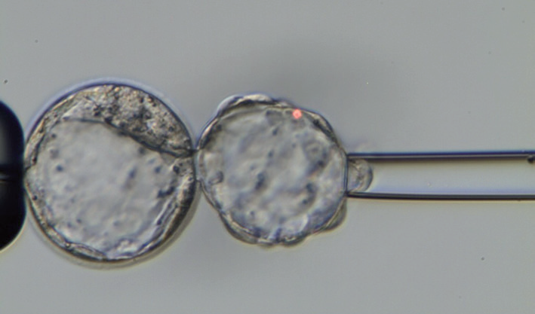
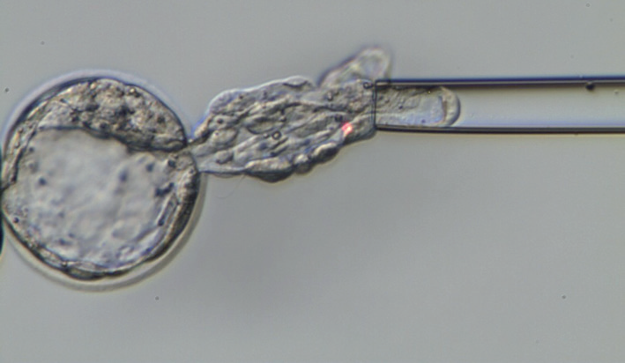
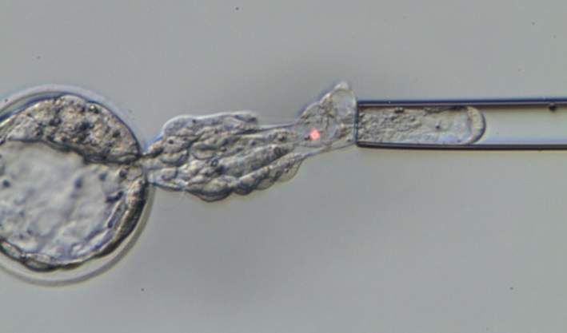
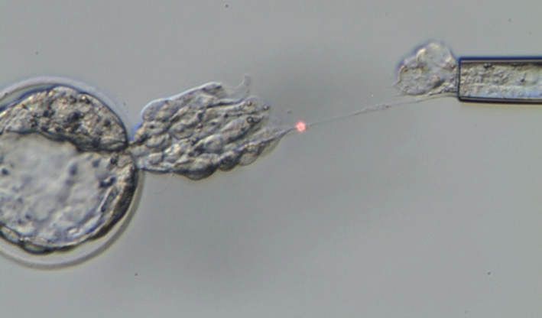
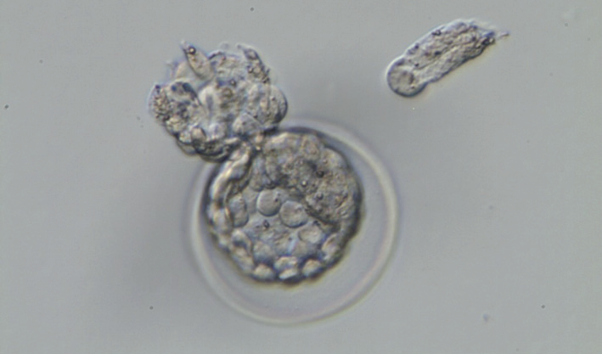
BLASTOCYST BIOPSY
The “PULLING” method: ideal for hatching blastocyst

Slide 16
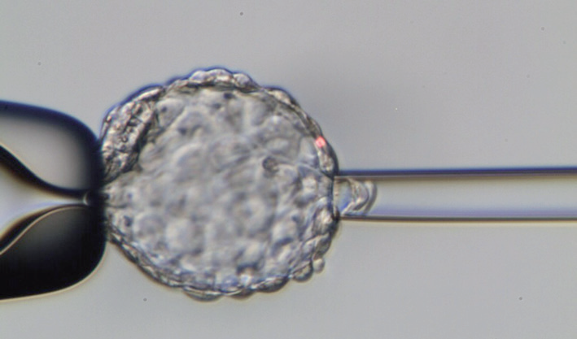
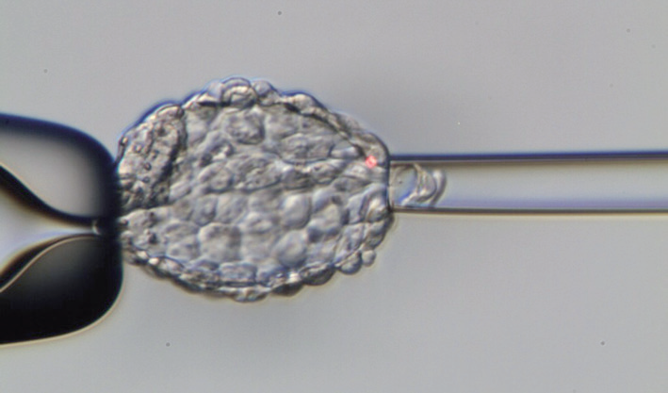
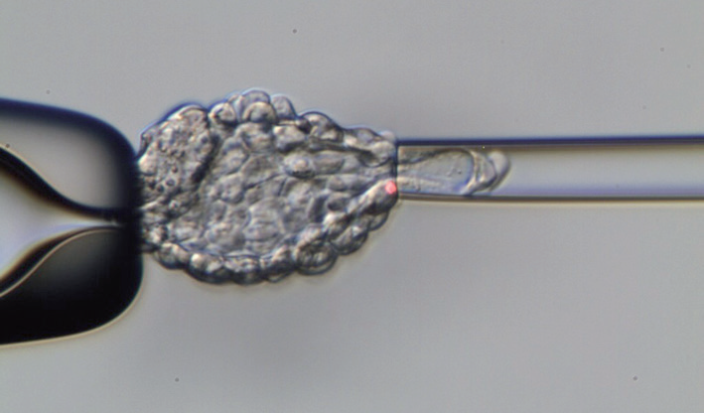
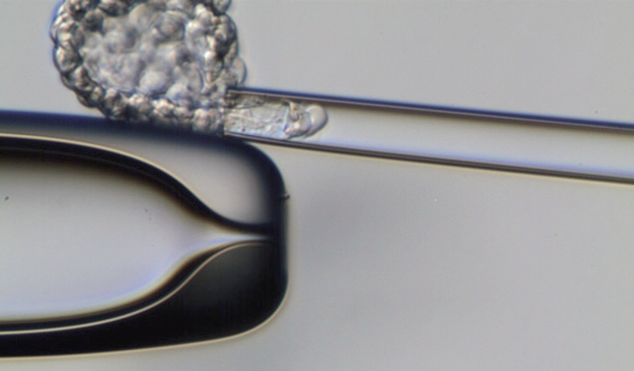
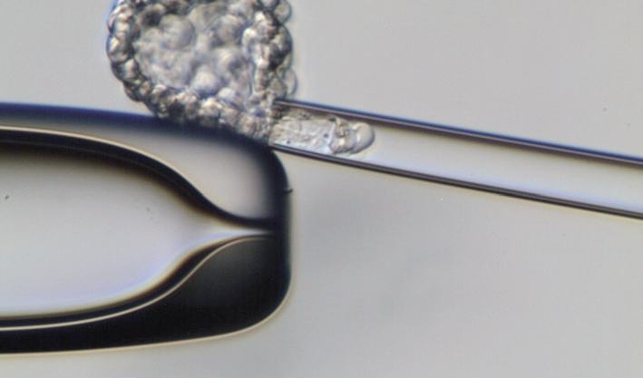
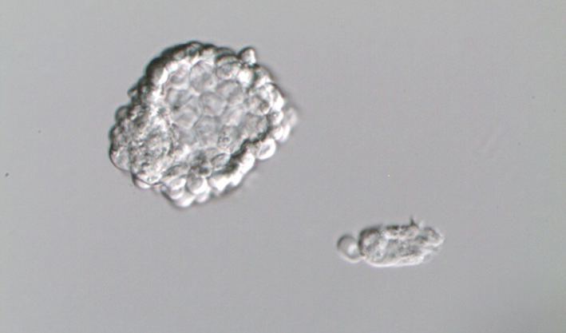
BLASTOCYST BIOPSY
The “FLICKING” method: ideal for fully hatched blastocyst
https://www.youtube.com/watch?v=K2AX3zlYpuE

Slide 17
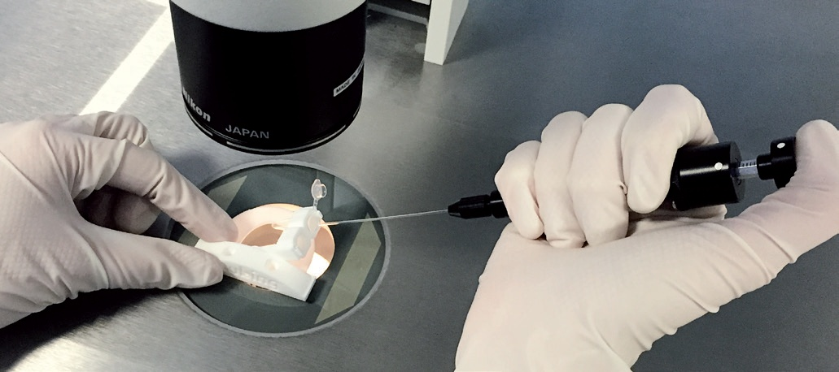
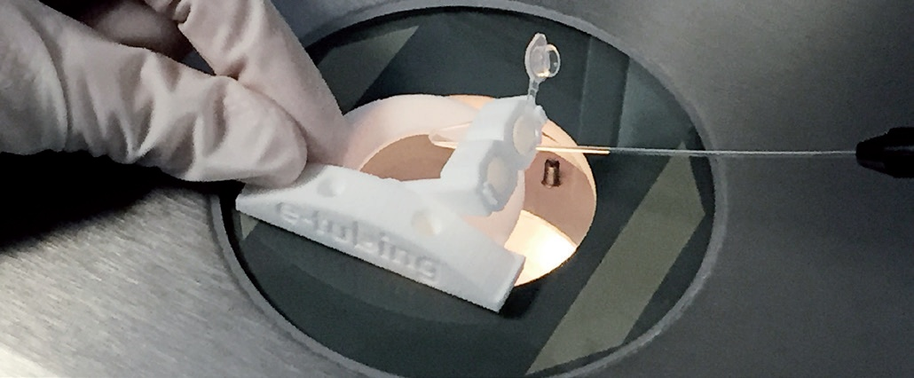
BLASTOCYST BIOPSY
TUBING
https://www.youtube.com/watch?v=zhBxyEVEkIs
050- 2.34

