Slide 1
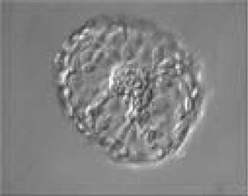
Hatched blastocyst (Grade 6:A:A) that is now completely free of the ZP showing a compact ICM at the 3 o’clock position in this view. The ICM appears to be connected or anchored to the TE by a broad triangular bridge. The TE cells form a cohesive epithelium. The blastocyst is now more than twice the size of the original expanded blastocyst.
Hatched blastocyst (Grade 6:A:A) that is now completely free of the ZP. The ICM positioned centrally at the base of the blastocyst appears to be connected or anchored to the TE by several bridges. There are very many TE cells of similar size forming
a cohesive epithelium..

Slide 2
Hatched blastocyst (Grade 6:A:A) that is now only just free of the ZP. The ICM is large and compact at the base of the blastocyst. The TE is similarly made up of many cells forming a cohesive epithelium. There is some cellular debris discarded in the ZP.
Hatched blastocyst (Grade 6:A:A) that is now completely free of the ZP which can be seen in the same view. Some cellular debris remains behind in the empty ZP. There are many TE cells making up a cohesive epithelium. In this view, it is possible to clearly see the increase in diameter of the blastocyst from the diameter of the original embryo which was accommodated within the ZP

Slide 3
Blastocyst (Grade 3:C:B) with no clearly identiﬁable ICM and with TE cells that in places are quite large and stretch over great distances to reach the next cell.
Hatching blastocyst (Grade 5:B:A) showing a compact ICM at the 9 o’clock position in this view. The ICM is small and ﬂattened and made up of few cells relative to the size of the blastocyst.

Slide 4
Blastocyst (Grade 3:C:C) with no clearly identiﬁable ICM and sparse TE that does not form a cohesive epithelium.
Expanded blastocyst (Grade 4:C:C) with no clearly identiﬁable ICM. TE is made up of a few, sparse cells that do not form a cohesive epithelium.

Slide 5
Hatching blastocyst (Grade 4:C:A) with no clearly identiﬁable ICM but a TE that is made up of many cells forming a cohesive epithelium. Dark, degenerate cells are present toward the 12 o’clock position in this view.
Hatching blastocyst (Grade 5:A:B). The TE cells vary in size with some cells quite large forming a loosely cohesive epithelium. The ICM can be seen at the 3 o’clock position in this view.

Slide 6
Blastocyst (Grade 4:B:C) with a very sparse TE that does not form a cohesive epithelium. The ICM is visible at the 6 o’clock position in this view.
http://atlas.eshre.eu/

