Slide 1
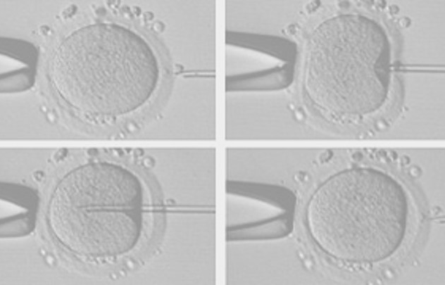
Second-Cycle Degree Course in “REPRODUCTIVE BIOTECHNOLOGIES”
«ICSI Procedure and advanced techniques
in medically-assisted procreation»
A.Y. 2022 - 2023
Ilaria Listorti
Head of Villa MafaldaART lab
ilistorti@unite.it

Slide 2
MAIN TOPICS
HUMAN EMBRYO CULTURE: TIPS AND TRICKS
- QUALITY CONTROL INSIDE A.R.T. LABORATORY
THEROICAL LESSON
virtual educational
and
scientific activities
- MEET THE EXPERT

Slide 3
WHAT IS EMBRYO CULTURE MEDIA?
Embryo culture is a component of in vitro fertilization;
Embryos are cultured in an atrificial medium consinsting of glucose, pyruvate and other energy-providing components;
The addition of amino acids, nucleotides, vitamins, and cholesterol may also improve the performance of embryonic growth and development;
Substances like antioxidants, antibiotics, macromolecules, hormones and growth factors can be added;
Optimization of the culture media is essential by optimizing all other components of the culture system, including the environment and equipment.

Slide 4
WHY CULTURE MEDIA IS SO IMPORTANT?
Culture media is artificial but supports key functions:
Sperm function (motility, capacitation, acrosome reaction..)
Cleavage stage
Genomic actication
Early differentation of cell types

Slide 5
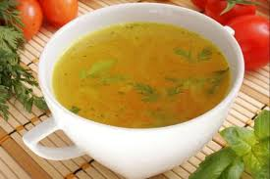
HUMAN EMBRYO CULTURE
1957: calcio lattato
in soluzione salina
1968: calcio lattato e acido
piruvico in soluzione complessa
Whitten, W. K. (1957). Culture of tubal ova. Nature, 179:1081-1082.
Whitten, W.K., Biggers, J.D. (1968). Complete development of in vitro of the pre-implantations stages of the mouse in a simple chemically defined medium. J. Reprod. Fertil. 17:399-401.

Slide 6
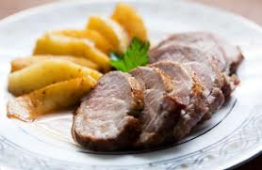
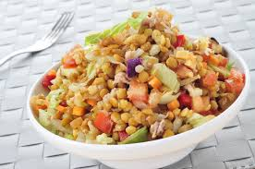
HUMAN EMBRYO CULTURE
1998: “sequential” embryo
culture system
2004: “single-step” embryo
culture system
Gardner DK. 1998 Changes in requirements and utilization of nutrients during mammalian preimplantation embryo development and their significance in embryo culture. Theriogenology 49:83-102
Reed ML, et al., 2010 Challenging traditional embryo culture techniques with a simplified, continuous single medium protocol. J. Clin. Embryol 13:33-41

Slide 7
HUMAN EMBRYO CULTURE
Sequential Culture System: “back to nature”
Step 1: HTF
Non essential aminoacids
glucose
EDTA
Pyruvate
Lactate
Step 2: CLEAVAGE
Non essential aminoacids
Low glucose
EDTA
Pyruvate
Lactate
Step 3: BLATOCYST
Non essential aminoacids
Essential aminoacids
High glucose
Pyruvate
Lactate
Embryo genome
activation
DAY 0
DAY 1
DAY 2
DAY 3
DAY 4
DAY 5
Single-Step Culture System: “let the embryo choose”
Step 1
Non essential aminoacids
Essential aminoacids
Low glucose
EDTA
Pyruvate
Lactate

Slide 8
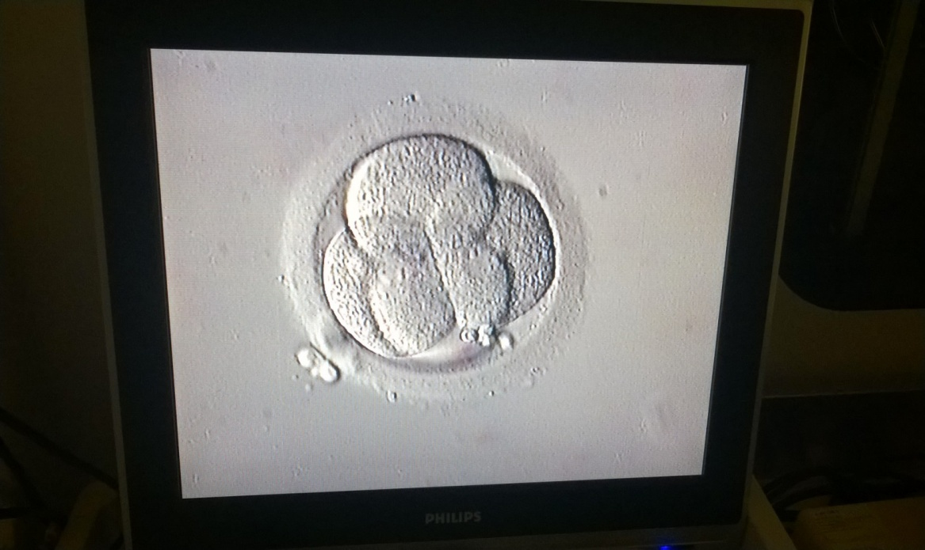
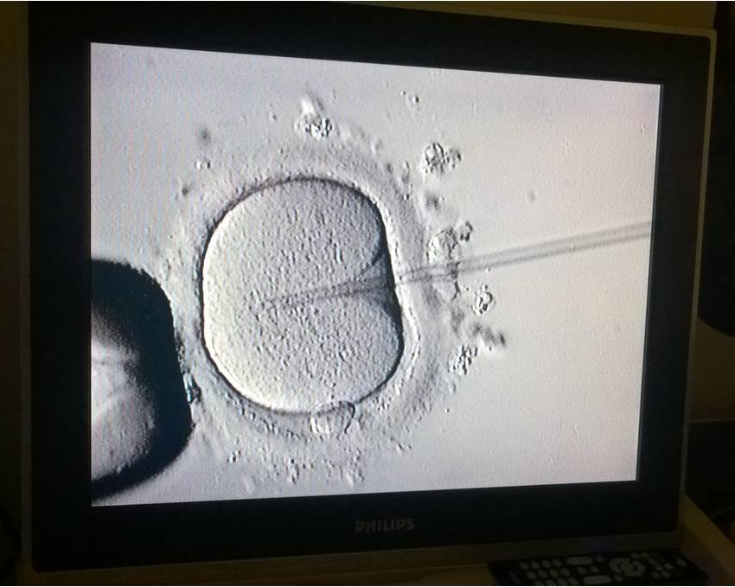
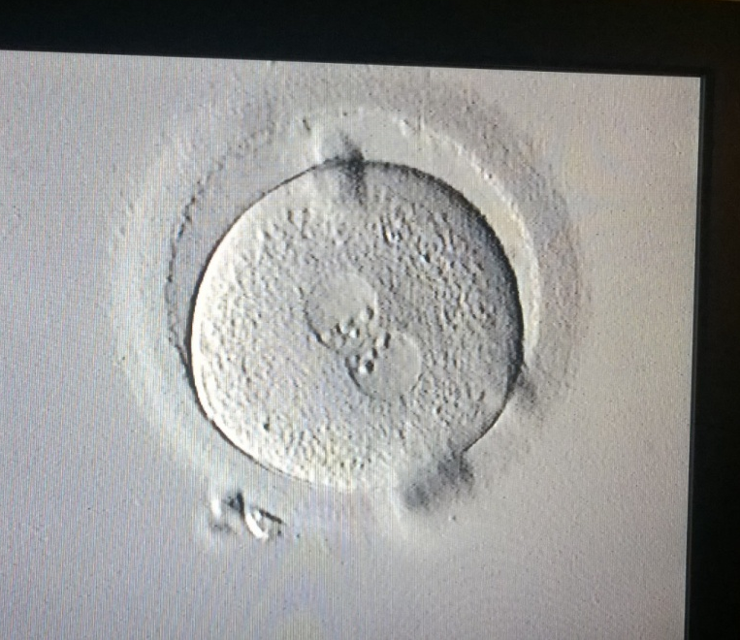
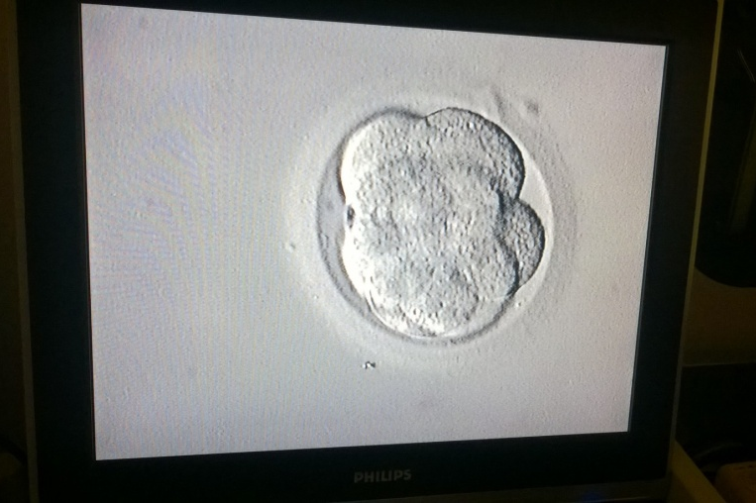
HUMAN EMBRYO CULTURE
4 equal size cells
grade A embryo
2 PN zygote
cleavage medium
ICSI 0 h
16 h P. I.
40 h P. I.
monophasic medium
8 equal size cells compatting
grade A embryo
Embryo genome
activation
blastocyst medium
64 h P. I.
110 h P. I.

Slide 9
HUMAN EMBRYO CULTURE
Sequential media |  | Single-step media
pros | cons | pros | cons
mimic the natural environment | uneconomic culture system | easy to use | EDTA at blast
nutrients replenishment | risk of loosing | economic | ammonium accumulation
oil refreshment | busy management | little burocracy | nutrients depletion
little to no EDTA at blast | culture milieu disruption | autocrine and paracrine factors accumulation | catabolism accumulation
No ammonium accumulation |  | risk of loosing | oil oxidation
 |  | pH fluctuation | pH fluctuation

Slide 10
HUMAN EMBRYO CULTURE
CULTURE STRATEGY
INDIVIDUAL EMBRYO CULTURE
In small volume of culture medium (10-20 μl drop)
- Human is a monovulatory specie
- A bad embryo can be detrimental to the others
- Real traceability of every single embryo during culture
In large volume of culture medium (500 μl well)
- Human is a monovulatory specie
- A bad embryo can be dettrimental to the others
With large volume, the osmolarity increase slowly
GROUP EMBRYO CULTURE
In small volume of culture medium (25-50 μl drop)
- In-vitro conditions are different from the in vivo ones
Positive influence of paracrine factors
- Faster management of the entire embryo culture
In large volume of culture medium (500-1000 μl well)
- In-vitro conditions are different from the in vivo ones
Positive influence of paracrine factors
Faster management of the entire embryo culture
- No need for medium replenishment

Slide 11
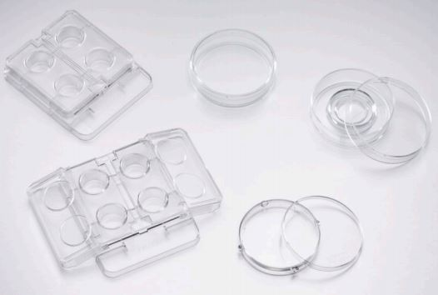
HUMAN EMBRYO CULTURE
CULTURE STRATEGY
Small volume of culture medium
Large volume of culture medium

Slide 12
OPTIMIZING EMBRYO CULTURE SYSTEM
Media and consumables
Media PH and Co2 concentration
Oil and osmolarity

Slide 13
pH
pH PROFOUNDLY IMPACTS OOCYTES AND EMBRYOS
Oocyte mitochondrial localization and development competence, oocyte metabolism (correlated to maturational and developmental status). Denuded oocytes cannot regulate pH.
Embryo metabolic actitvity, intracellular organization, and overall embryo development;
Rate of blastomere division;
Fragmentation rates;
Overall embryo morphology.

Slide 14
pH SET BY %CO₂ + [HCO₃⁻] BUT TARGET UNKNOW
Optimal pH₀ for human embryos is not yet determined
pH_{i} of human embryos is tipically around 7.1
To avoid acidification, the lower level is therefore usually set at 7.2
Studies have suggested poorer embryo development at pH₀ of > 7.4
Most media are used at 7.3 ± 0.1
pH₀ is a function of HCO₃⁻ in media
HCO₃⁻ concentration is set by the manufacturer
%CO₂ can be manipulated in the lab to control pH₀

Slide 15
FACTORS IMPACTING Ph LEVELS
Lenght of equilibration period
Frequency of incubetor door openings
Type of CO2 sensors
Temperature changes within the incubators
Bacterial/ fungal contamination
Altitude
Humidity

Slide 16
CONTROL OF OSMOLARITY IS CRITICAL

Slide 17
OPTIMIZING SYSTEMS: OSMOLARITY
Optimal volume per embryo is not yet determined;
Some labs successfully use 2-5 µl per embryo, more tipically 20-50 µl;
Drop size may affect longer term changes in osmolarity;
More care needed during dish preparation, example...
One dish at a time;
Evaluate type of dish;
Airflow minimized;
Underlay drops;
Use maximum oil volume;
Evaluate type of oil

Slide 18
LOW VS HIGH OXYGEN CONCENTRATIONS FOR EMBRYO CULTURE

Slide 19
OPTIMIZING SYSTEMS: TEMPERATURE
Suggestion that temperatures below 37°C may give better outcomes
Temperature above 37°C NOT reccommended

Slide 20
OPTIMIZING SYSTEMS: ROLES OF OIL
Oil have different roles in optimizing a culture systems:
Minimizes pH shift;
Prevents changes in osmolarity;
Reduces risk of temperature fluctuation;
Protects samples from contamination, paticularity VOCs from gas supply, plastic ware and general lab environment
Use maximum amount of oil in culture dish

Slide 21
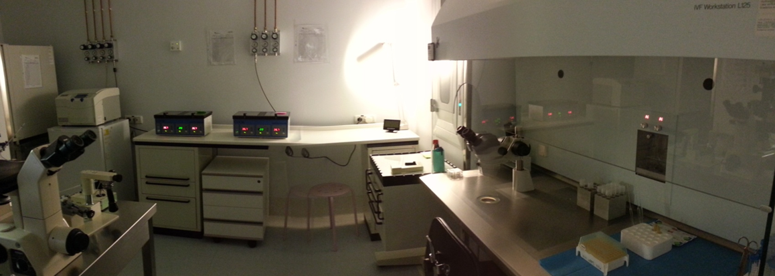
MAIN TOPICS
HUMAN EMBRYO CULTURE: TIPS AND TRICKS
- QUALITY CONTROL INSIDE A.R.T. LABORATORY
THEROICAL LESSON
TARGET: DON’T DO THAT

Slide 22
TARGET: DO THAT
ABSENCE OF
QUALITY CONTROL
PRESENCE OF
QUALITY CONTROL
BIOLOGICAL PROCESS
OUT OF CONTROL
LOW RESULTS
FLUCTUATING RESULTS
NO SECURITY
ECONOMIC IMBALANCE
FRUSTRATION
BIOLOGICAL PROCESS
UNDER CONTROL
HIGH RESULTS
REPEATABLE RESULTS
SECURITY
SAVE MONEY
HAPPINESS - SATISFACTION

Slide 23
LABORATORY FACTORS THAT CAN AFFECT OUTCOME OF IVF
Air quality;
Pipettes/hyaluronidase/denudation;
Warm surfaces/stages;
Microscope light;
Culture medium;
Culture dishes;
Protein supllementation;
Cuture oil;
Incubator gas/temperature;
Incubatore gas partial pressure.

Slide 24
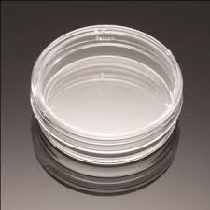
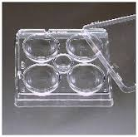
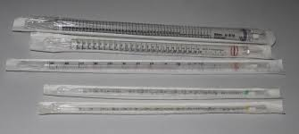
QUALITY CONTROL
“sperm survival test”: donor sperm survival
after 24-48 h of culture inside icubator
“VOC’s test”: inorganic volatile compounds
“LAL test”: endotoxins presence

Slide 26
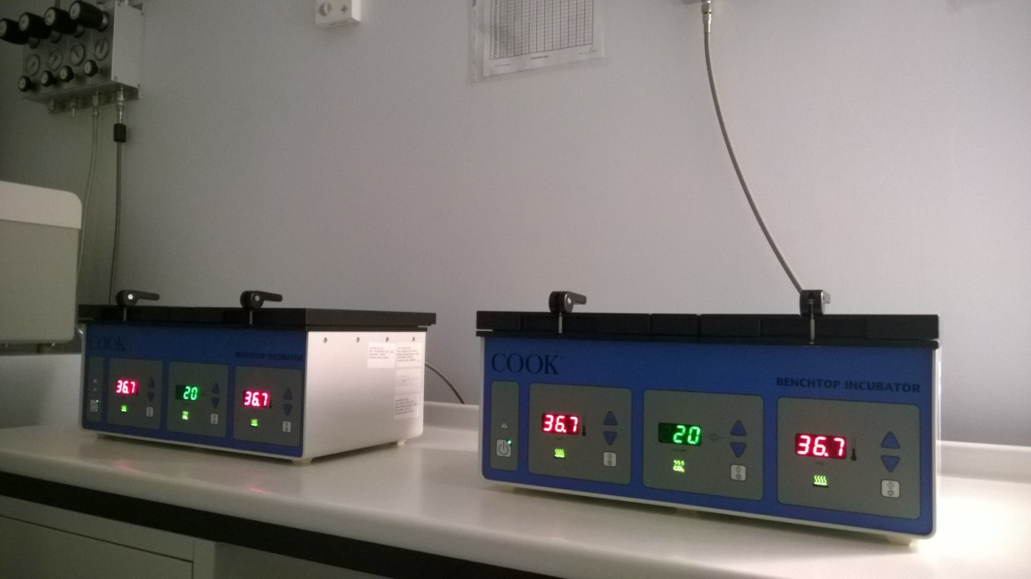
QUALITY CONTROL
1. INCUBATORS
Temperature (it depends on plasticware):
36.5 – 37.5 °C
(check every day)
(calibrate every 2 months)
Gas flow (CO₂ – O₂ – N₂):
15 – 25 kPA/min
(check 1 a year)
CO₂/O₂ (it depends on culture media)
5% - 6%
(check every day)
(calibrate every 2 months)

Slide 27
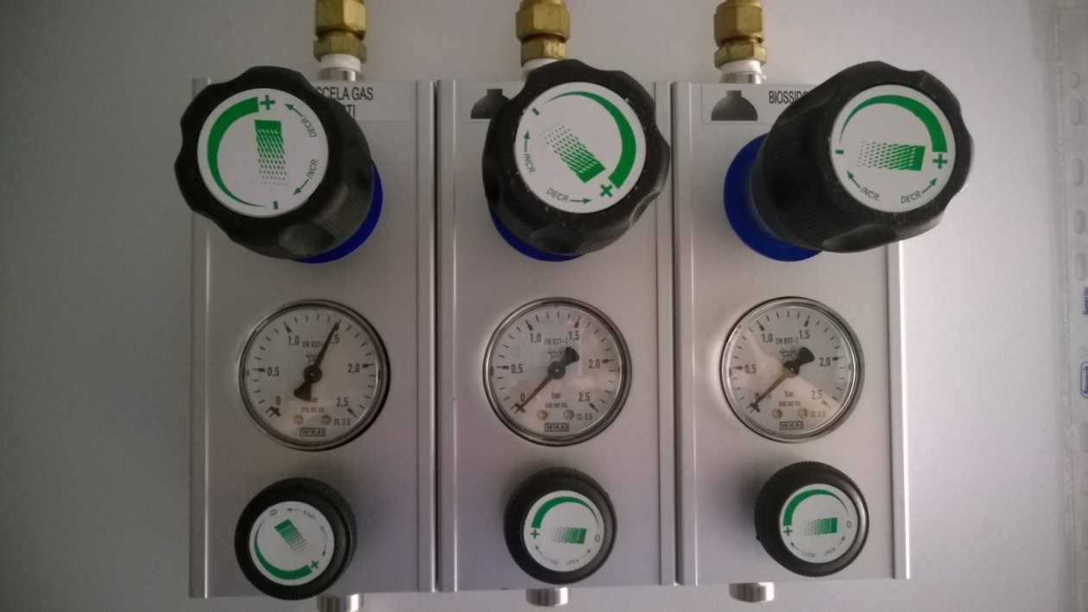
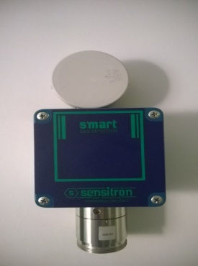
QUALITY CONTROL
2. GAS PLANT
assenza perdite
entrata
assenza perdite
uscita
Temperature:
36.5 – 37.5 °C
Entering pressure:
max 1.5 bar

Slide 28
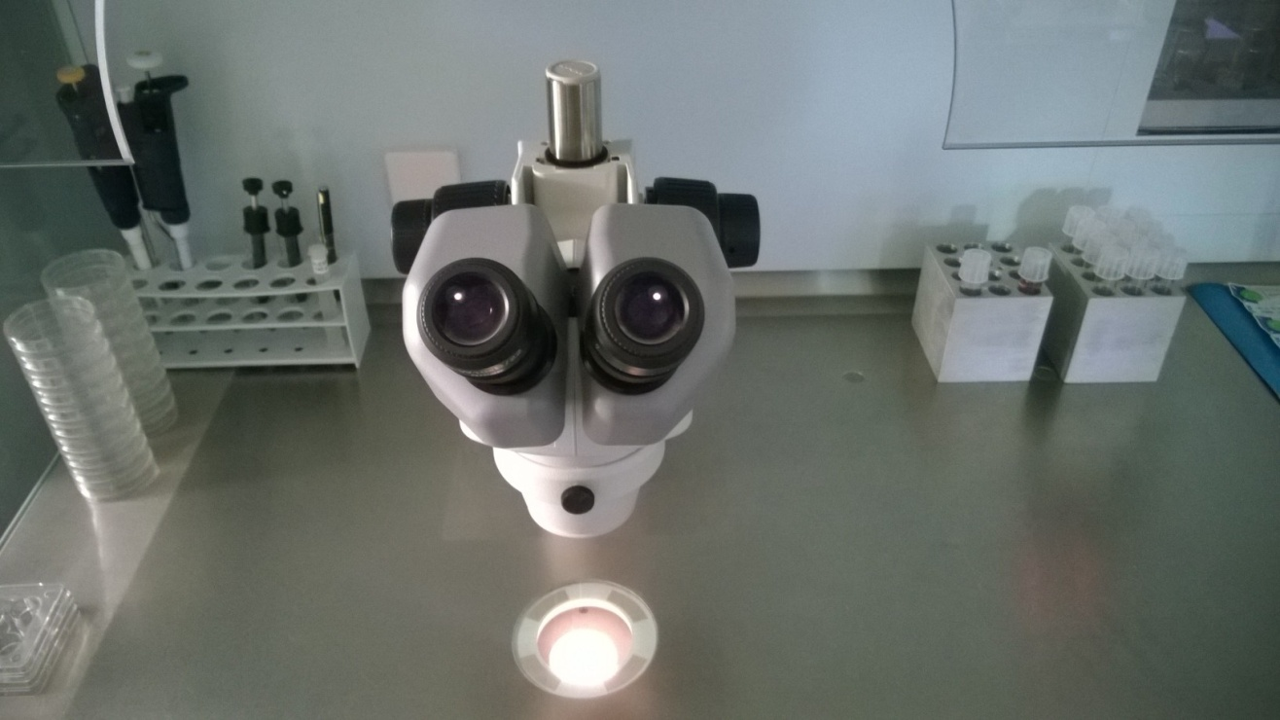
QUALITY CONTROL
3. WORKSTATION
Flow intensity (2 time a year)
Particles count (2 time a year)
Microbic count (2 time a year)
Temperature: 36.5 – 37.5 °C
(check every day)
(calibrate every 2 months)
Light intensity
Light beam condensation
(check every day)

Slide 29
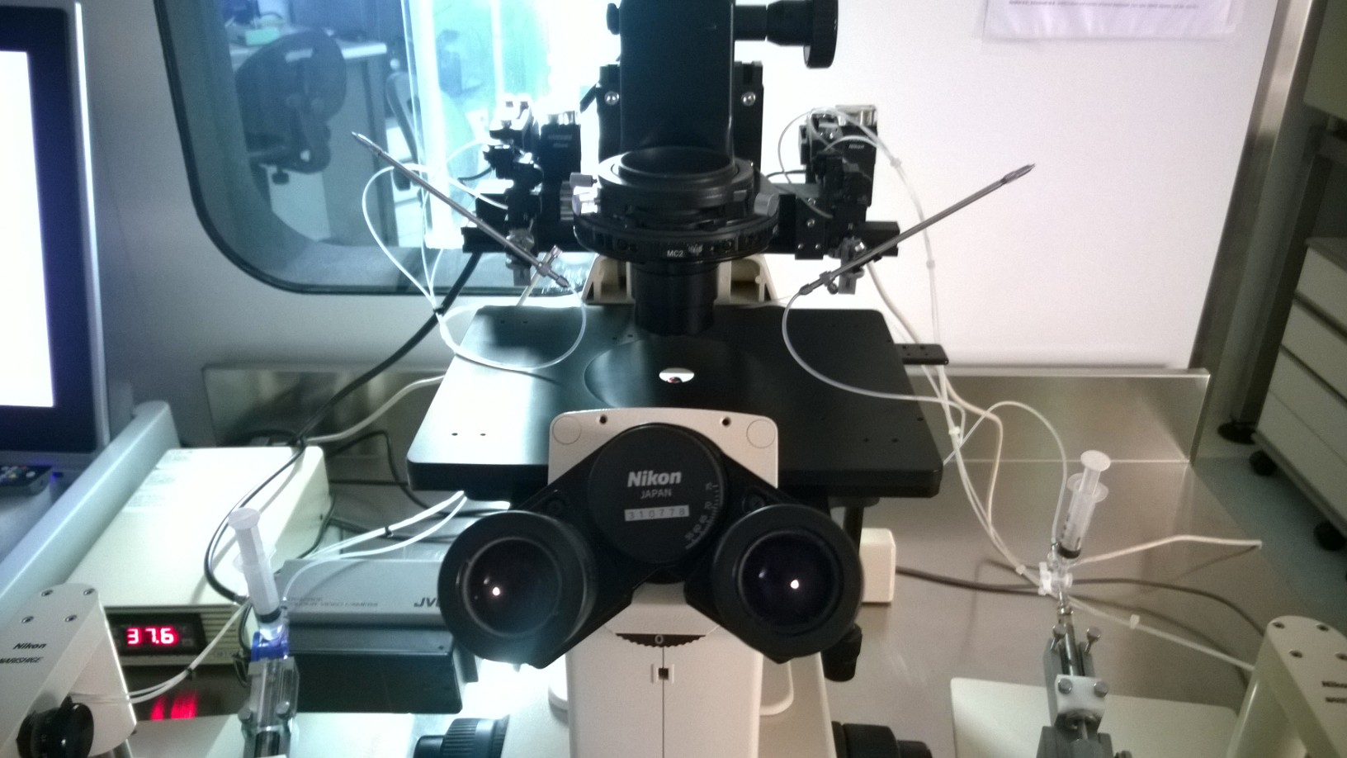
QUALITY CONTROL
4. MICROMANIPOLATION STATION
Temperature
(it depends on plasticware):
36.5 – 37.3 °C
(check every day)
(calibrate every 2 months)
integrity, accuracy,
precision of mincoinjection system
Temperature
(it depends on plasticware):
36.5 – 37.3 °C
(check every day)
(calibrate every 2 months)

Slide 30
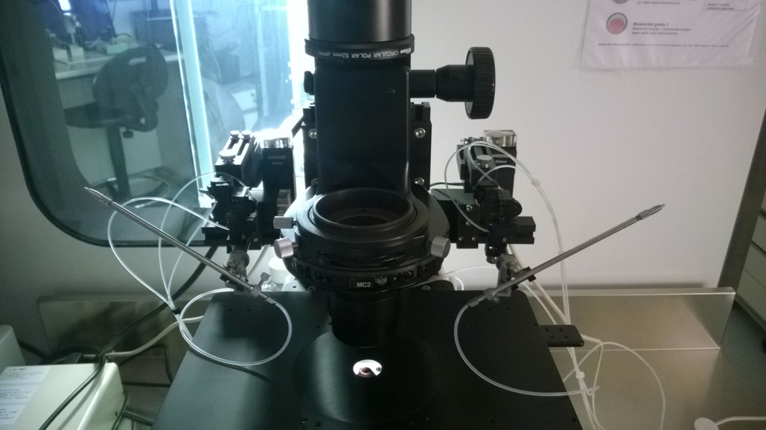
QUALITY CONTROL
integrity, accuracy,
precision of mincoinjection system

Slide 31
QUALITY CONTROL: DEVELOPMENT INDICATORS
ICSI 0 h
16 h P. I.
40 h P. I.
64 h P. I.
110 h P. I.

Slide 32
SUMMARY
To achieve optimal results in an IVF lab. Attention to detail, adherence to protocols and QC are vital!!!
IVF culture media is an integral part of the embryo culture system. Its use must be optimized in every laboratory;
pH, temperature and osmolarity must be carefully monitored and maintained;
Choice and use of oil is critical;
Consumables and equipment should be of the highest quality, tested regulary and maintained, where appropriate

Slide 33
Meet the Expert
All about Intra Cytoplasmic Sperm Injection (ICSI)
https://www.youtube.com/watch?v=i4phDnDuSdY
Trophectoderm biopsy and tubing of cells for preimplantation genetic testing
– part 1
https://www.youtube.com/watch?v=FyBh_814jtI#action=share
– part 2
https://youtu.be/19JUcdISuAM

