Slide 1
3. THE ACTORS AND THE INSTITUTIONS. THE POTENTIALS OF THE STATE IN THE FORMATION OF POLICIES
MANEL BELLÉS, 29/03/2022
Sociology of Administration

Slide 2
INDEX
THE ORGANISATION OF THE SOCIETY
EMPLOYERS’ ASSOCIATIONS
WORKERS’ ASSOCIATIONS
THE ORGANISATION OF THE INTERNATIONAL SYSTEM
THE INTERNATIONAL TRADE REGIME
THE INTERNATIONAL FINANCIAL SYSTEM
THE EFFECTS OF INTERNATIONAL INSTITUTIONS
CONCLUSIONS

Slide 3
THE ORGANISATION OF THE SOCIETY
THE STATE
GROUPS
FRAGMENTATION
UNITY
PETER EVANS, “EMBEDDED AUTONOMY”
INFLUENCE ON THE STATE’S ABILITY TO MAKE POLICIES
EMPLOYERS’ ASS.
WORKERS’ ASS.

Slide 4
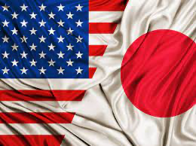
Employers’ associations
The most powerful
Economic system
Financing of political parties
EEUU & Japan

Slide 5
Workers’ associations
Workers’ position< Employer’s position
Structure of the State
Unions
UK, US and Canada : decentralized
Australia, Austria and Scandinavian countries: industry sectors/ national level

Slide 6
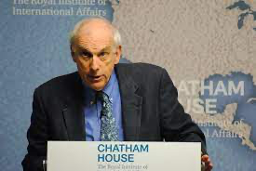
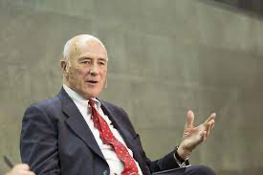
THE ORGANIZATION OF THE INTERNATIONAL SYSTEM
International institutions
Robert Keohane and Joseph Nye

Slide 7
The international trade regime
1947 GATT
1995 WTO

Slide 8
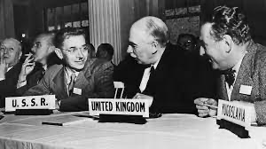
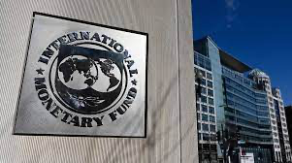
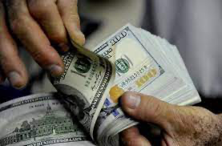
The international financial system
Bretton Woods agreement, 1944
Exchange rates
Current system
International Monetary Fund (IMF)
Foreign Direct Investment (FDI)

Slide 9
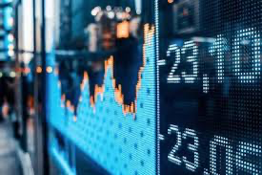
The effects of international institutions
Global economic forces
Countries
Strong state , autonomy and capacity
Weak state

Slide 10
CONCLUSIONS
KEY Actors
National level
International level

