Slide 1
Molecular Markers in Reproduction
Natalia Battista

Slide 2
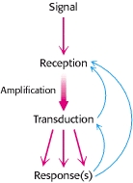
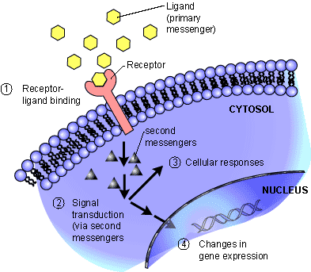
Cell signalling transduction
Notes:
Cells have proteins called receptors that bind to signaling molecules and initiate a physiological response. Different receptors are specific for different molecules.
External signals are specifically recognized by receptors and, when a signaling molecule joins with an appropriate receptor on a cell surface, this binding triggers a chain of events that not only carries the signal to the cell interior, but amplifies it as well. 1)The messenger (that is the molecule) bind to the rec
eptro protein exposed on the cell surface or inside the cytoplasm.
2) Activation of receptors can trigger the synthesis of small molecules called second messengers, which initiate and coordinate intracellular signaling pathways
3&4) Specific biochemical processes (metabolism, cell division activity, morphology and transcription programma) are activates in the cell, representing the endpoint of the signalling pathway

Slide 3
Cell signaling transduction
Allosteric modification
Signalling Activation (e.g. phosphorylation)
Intracellular responses (secondary messengers)
1) Modification of metabolism
2) Activation of gene transcription
Notes:
The major signal transducers are: receptors; signalling enzymes and regulatory GTPases.
In the absence of a signal, the signal transducer exist in an inactive or less active ground state. Upon receipt of the signal, the transducer become activates and transit into the active state.
The major mechanisms for activation of signalling proteins are : Binding of other signalling molecules, conformational transitions, covalent modifications, membrane targeting and compartimentalization.
The mechanisms for inactivation of signalling proteins are: binding of ihibitors, inhibitors modifications and removal of activating modifications.

Slide 4
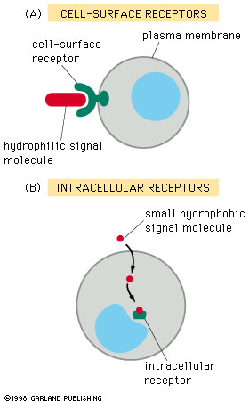
Receptors
Notes:
Although there is a tremendous diversity in extracellular cues , the cell uses just three general mechanisms to transduce those cues through the plasma membrane to the cytosol.
The broad strategy consist of a ligand-binding domain on the extracellular face of the membrane, one or more hydrophobic transmembrane segments, and an intracellular portion that couples the downstream signaling effectors.
In many cases, the intracellular part of the receptor itself has intrinsic catalytic activity, for example a protein kinase domain, which is activated by ligand binding. In other cases, the receptor is associated noncovalently with other effector proteins, which relay the information taht the ligand-binding domain is occupied.
The second major strategy involves membrane channels that are transmembrane pores, assembled from protein subunits, which selectively pass certain classes of small molecules such as ions. Gated channels can be opened and/or closed in response to specific signals, allowing them to function as receptor that transmit information across the membrane.
In few cases the signal itself can passively cross the plasma membrane. This specialized class of signaling molecules includes the membrane-permeable gas nitric oxide and lipid-soluhle hormones including steroid hormones and their relatives. For these signals, no specialized mechanism is required to traverse the membrane, and the cytosolic effectors for these signals can bind them directly.. This way is defintily simplest compare to the others.
Receptors can be also classified by location and function:
Membrane receptors: bind large and polar ligands that cannot cross the lipid bilayer (i.e. insulin)
Intracellular receptors are the main target of small and/or non polar ligands that can diffuse across the non polar phospholipid bilayer of the plasma membrane and enter the celle, such as estrogen.

Slide 5
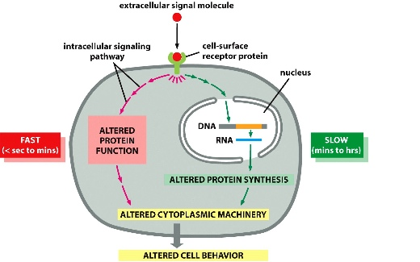
Notes:
The cell response is fast when the receptors are located on the surface, while is slow when the receptors is cytosolic or nuclear.
What are the transduction strategies used by transmembrane receptors?For receptors whose ligand cannot pass through the plasma membrane, information transfer depends on somehow conveying (transmitted) to the intracellular part of the receptor whether or not ligans is bound to the extracellular part. Thisi is not a trivial (insignificant, banale), as the two parts of the receptor are separated by the hydrophobic lipid bilayer. The intracellular and extracellular portions of the receptro, which are hydrophilic, cannot move through the membrane to physically interact with each other, thus any communication must be through the relatively featurelss hydrophobic transmembrane segments.These typically consist of a rodlike alpha helical segment with their hydrophobic side chains projecting outward into the plane of the membrane.
With a few exceptions, in the nature are adopted two general solutions:
Concerted conformational changes for those receptors with multiple membran-spanning segments
Dimerization/oligomerization of receptors that span the membrane nly once (single-pass receptors)

Slide 6
Ligand-gated ion channels
Ligand-gated ion channels
The binding ligand causes the opening of ion channels and the flow of ions through the membrane
Plant and animal cells
In animals signals between neurons and muscle cells, or between two neurons, taking Ca² ⁺
Notes:
A further major class of signaling receptors is the gated ion channels, which respond to ligand or other environmental cues by altering the permeability of the membrane ions or other small molecules. Such gated channels play a fundamental role in neurotransmission, opening in response to neurotransmitters, membrane depolarization, or other stimuli. These channels allow specific ions to flood (inondare) rapidily across the membrane, causing massive and very rapid changes in the electrical propoerties of the membrane, the basis of electical signals. Because of their importance for neurotransmission, such channels are the target of a number of familiar drugs. For example, local anesthetics such as novoainen block voltage-gated ion sodium channels, while calcium channel blockers are used to treat high blood pressure. Gated channels also regulate intracelliular signaling, as in the case of calcium channels on the endoplasmatic reticulum that open when bound to inositol triphosphate, leading to the release of intracellular calcium stores.
The gate opening mechanism is an alteration in the three dimension shape of the channel protein upon interaction with a signal, that may be a lidang as well as changes in voltage across the membrane, changes in temperature, or changes in extracellular pH). These chemical or physical changes must be converted into mechanical energy to drive the conformational changes-

Slide 7
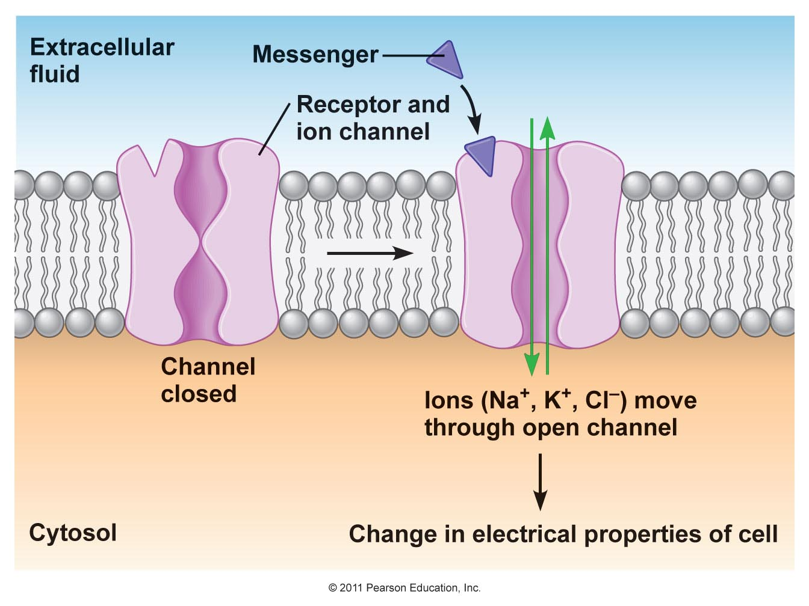
Notes:
An acetylcholine receptor (green) forms a gated ion channel for sodium ions in the plasma membrane. This receptor is a membrane protein with an aqueous pore, meaning it allows soluble materials to travel across the plasma membrane when open. When no external signal is present, the pore is closed. When acetylcholine molecules (blue) bind to the receptor, this triggers a conformational change that opens the aqueous pore and allows ions (red) to flow into the cell.
This channel helps in the regulation of membrane polarity.

Slide 8
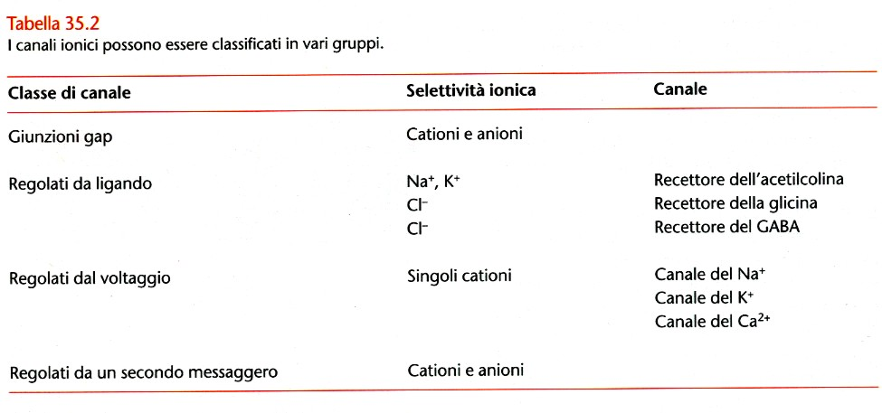
Ligand-gated ion channels
Notes:
Ion channels can be classified in several categories
Each type of ion channel responds to a specific signal, including sensory stimuli such light, sound and electric charge differences across the plasma membrane as well as chemical ligands such as hormones and neurotransmitters.

Slide 9
Enzyme-linked receptors
Enzyme-linked receptors
They are found in all living organisms
The extracellular domain binds the signal
The signal makes the intracellular domain functionally catalytic
Many of them are protein kinases
Signaling for phosphorylation
Notes:
In mammals there are three well-studied categories of cell-surface receptors that are grouped according to their functions:
enzyme-linked receptors or transmembrane receptors associated with enzymatic activity. For many receptors, the enzymatic activity is encoded in the same polypeptide chain as the ligand-binding activity; such receptors are said to have intrinsic enzymatic activity. This class includes for instance protein kinase receptors. Receptors can also be covalently associated with enzymes such as protein kinase and proteases
G protein linked receptros
Ion channel

Slide 10
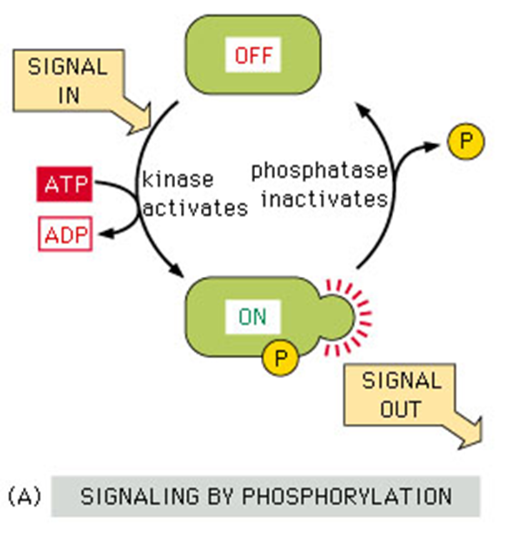
Enzyme-linked receptors
Notes:
When they are activated, they catalyze the phosphorilation of themselves and/ or other proteins, thus changing their shapes and their functions

Slide 11
Enzyme-linked receptors
  1) Receptor serine-threonine kinases
  2) Receptor tyrosine kinases (RTKs )
  3) Tyrosine kinase associated receptor
Notes:
Except for the ion channels, all transmembrane receptors are directly or indirectly linked to intracellular enzyme activities. For many receptors, the enzymatic activity is encoded in the same polypeptide chain as the ligand-binding activity, such receptors are said to have intrinsic enzymatic activity. Receptors can also be noncovalently associated with enzymes such as protein kinases and proteases.
1) Receptor serine-threonine kinases , i.e. transforming growth factor beta receptors (TGS beta)
2) Receptor tyrosine kinases (RTKs ) as the growth factor receptors
3)TYrosine kinase associated receptros e.g. cytokine reeptors

Slide 12
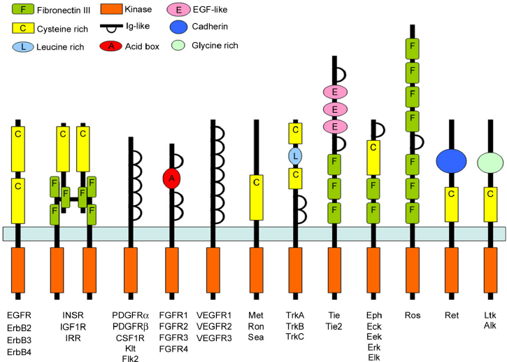
Receptor tyrosine kinases
(RTKs)
Notes:
RTKs are transmembrane receptors with intracellular protein tyrosine kinase domains. In the humane genome, there are almost 50 RTKs which can be divided into families based on their sequence similarities.
These receptors bind polypeptide ligands that regulate cell proliferation, growth, differentiation or migration. Thus they play a critical role in development and tissue homeostasis in multicellular organisms.

Slide 13
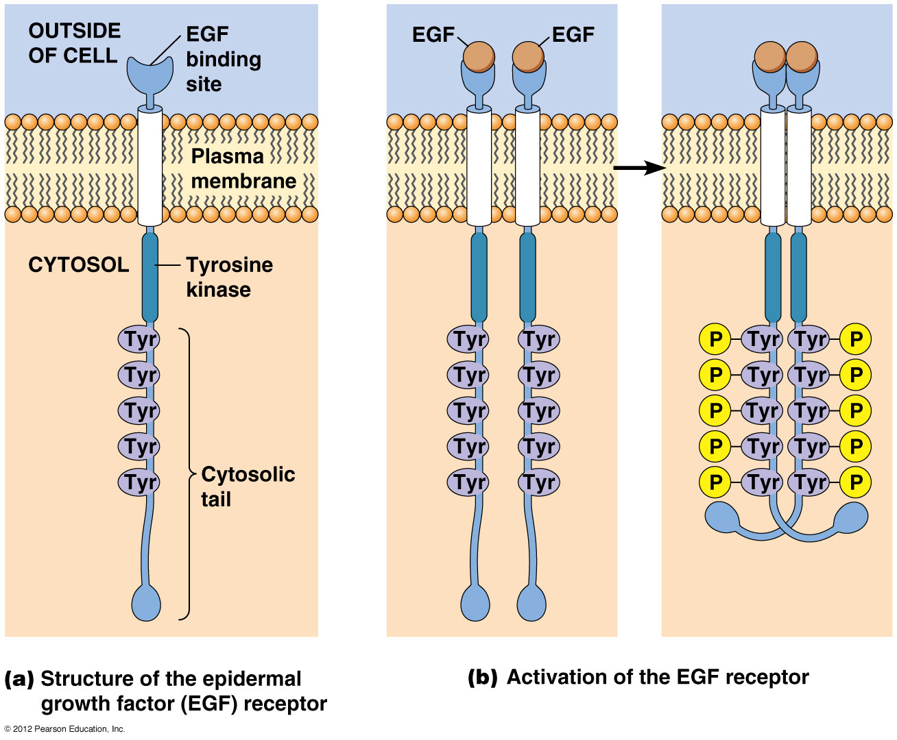
Receptor tyrosine kinases
(RTKs)
Notes:
Most RTK are activated by dimerization induced by ligand binding which allows the tyrosine kinase catalytic domains of the dimerized receptors to transphosphorylate each other on the “activation loop” (on tyrosine résidues ) and this leads to stably activate each other. Phosphotyrosine is a conserved “docking site” for many intracellular signal transduction proteins that contains SH2 domain , which is a clsss of known pTyr – recognition domain
In some cases dimerization can also directly induce allosteric changes that increase kinase activity. The specific details of the catalytic activation mechanism vary among the different RTKs.
EGF and PDGF receptors can autophosphorylate on multiple sites and this is sufficient to recruit effector protains (such as PLC or PIP-3 kinase) to transmit the downstream signals.

Slide 14
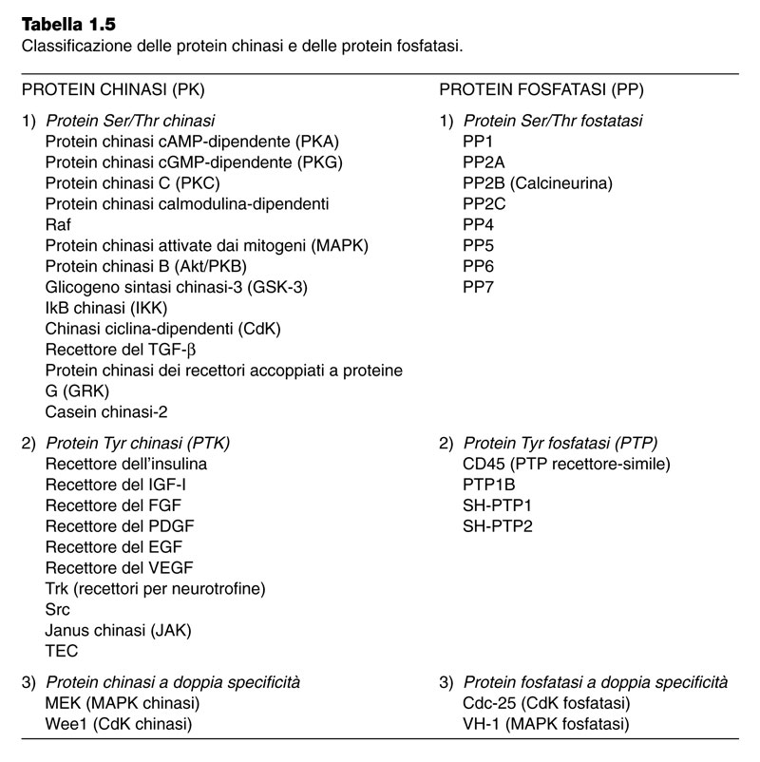
Receptor tyrosine kinases
(RTKs)
Notes:
Classification of the main kinases and phosphatases proteins

Slide 15
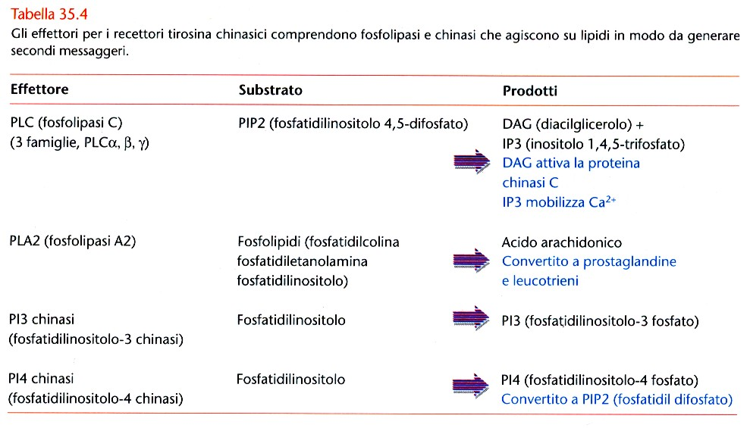
Receptor tyrosine kinases
(RTKs)
Notes:
The effectors of RTKs include phospholipases and kinases that act on lipids in order to generate second messengers

Slide 16
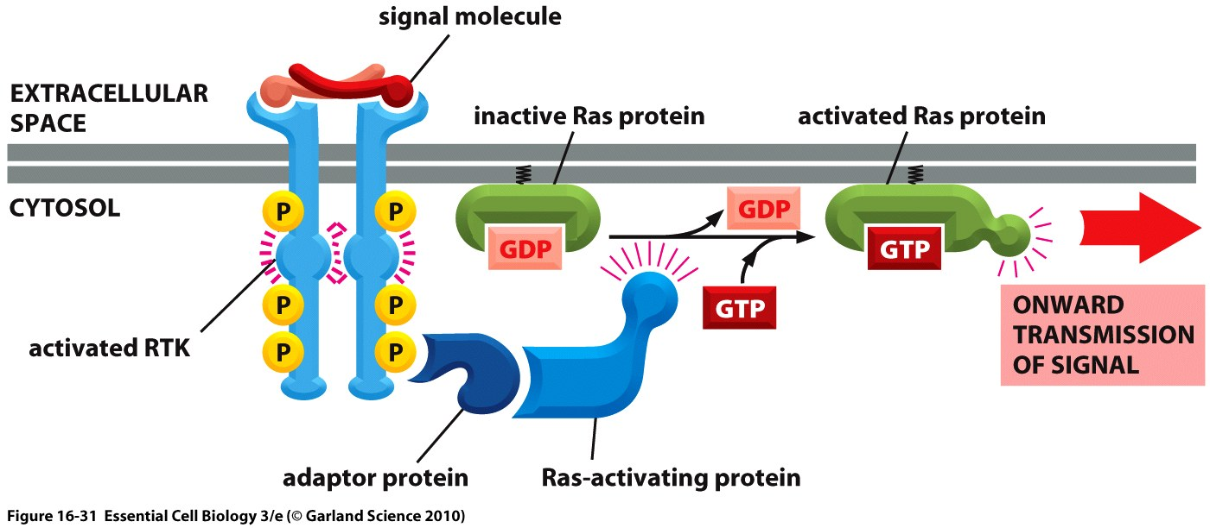
Notes:
Before showing the RTK signalling mechanism, we have to introduce the small G protein Ras.
Ras proteins exist in an inactive GDP bound form and active GTP-bound form. The conversion of inactive form to active one is in response to cell signalling events.
The activation of Ras is due to a guanine nucleotide exchange factor (GEFs) called Sos (in the picture is circled in azure). SOS is a guanylnucleotide release protein (GNRP). When activated, it causes certain G proteins to release GDP and exchange it for GTP, and Ras is one of these proteins. GTP-Ras then promotes the activity of a wide range of effectors kinases and related signalling enxymes.
In unstimulated cells, Ras is tightly associated with membranes by covalent lipid modifications, and its activator Sos is in the cytosol associated with the adaptor protein Grb2. Therefore only rarely Sos encounters its membrane-bound substrate because its concentration at the membrane is very low.
Upon receptor activation, Sos is recuited to the membrane where Ras is found, thus increasing the efficiency of Ras activation by Sos.

Slide 17
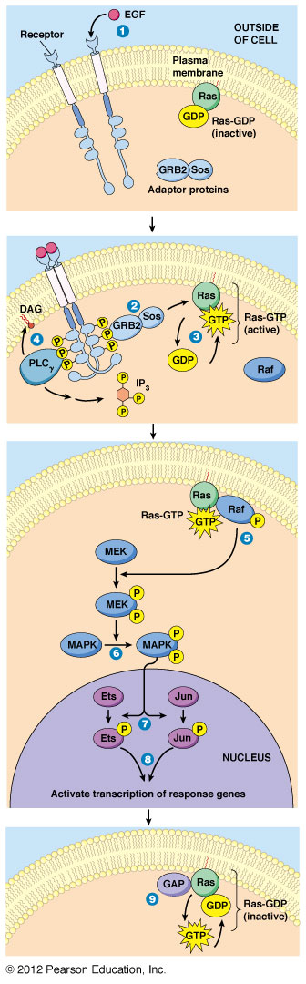
Receptor tyrosine kinases
(RTKs)
Notes:
In this slide it is reported the mechanism of signalling transduction with RTKs receptors
When the receptors aggregate, the tyrosine kinase domains phosphorylate the C terminal tyrosine residue
This produces binding sites for protein with SH2 domains. Grb2 is one of these proteins. Grb2 with Sos adaptor proteins binds to the receptor complex. This causes the activation of Sos
When Ras has GTP bound to it, it becomes in turn active
Activated Ras then causes the activation of a cellular kinase called raf-1
Raf-1 kinase then phosphorilates another cellular kinase called MEK, causing its activation. MEK in turn phosphorylates another protein kinase MAPK causing its activation. This series of phosphorylation process is called Kinase cascade and it results in the amplification of the signal.

Slide 18
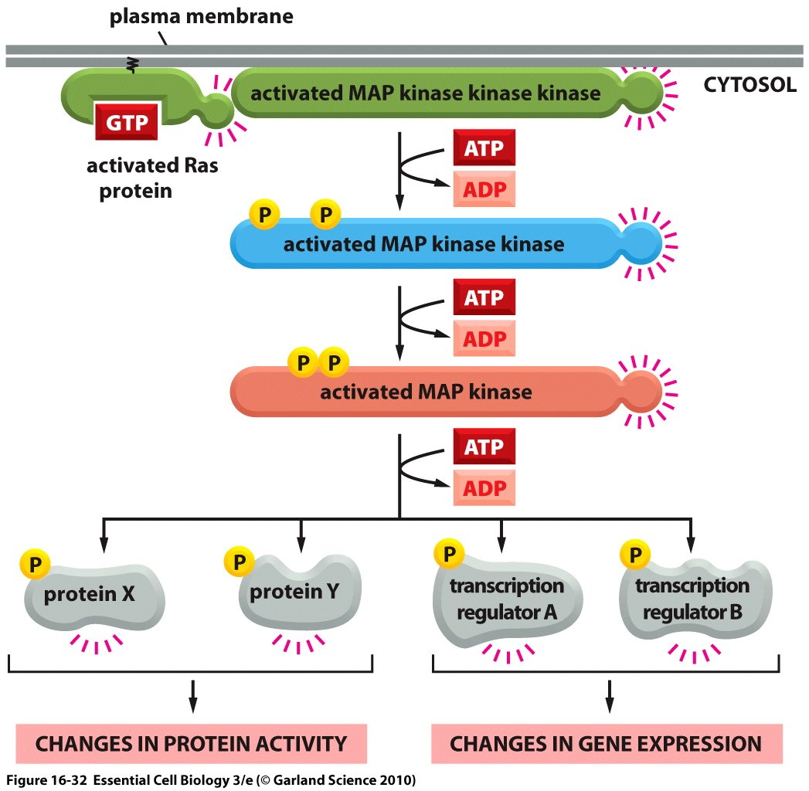
Notes:
What happen after the signal has been amplificated?
The final effect results in changing in protein activity or gene expression , i.s. this cascade is activated by some cytoskeleton components involved in the cell motility.

Slide 19
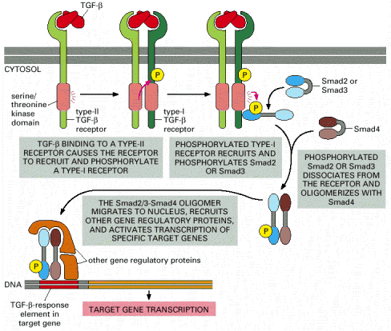
Alberts et al., L’ESSENZIALE DI BIOLOGIA MOLECOLARE DELLA CELLULA, Zanichelli editore S.p.A. Copyright © 2005
Notes:
In the context of RTKs receptors , we ahve to mention the Transforming growth factor beta receptor. This family is the only class of receptors with intrinsic serine/threonine kinase activity.
the TGF beta receptors bind to ligands such as TGF beta, activin, bone morphogenetic proteins and other regulators of proliferation and cell fate. In humans there are 12 distinct receptors in the TGF beta family which can be functionally divided in two classes (tyoe I and type II). Type I and type II receptors exist as homodimers which associate into a heterotetrameric activated complex. In this complex, type II receptor which is constitutively active can phosphotiklate the type I receptor, activating it and incresing its affinity for SMAD proteins called R-SMAD. The type I receptor then phosphorylates the associated R-SMAD leading to its dissociation from the receptor. The phosphorylated R-SMAD can then form heterptrimeric compelxes with SMAD4, called asla co-SMAD, and this complex is then competent to be transported into the nucleus and bind specific chromatin sites where it activates transcription of TGFbeta reponsive genes.
If we compare the TGF beta signaling mechanism with that used by receptors that couple to tyrosine kinases, it is very interesting to note the parallelism.
In fact, despite the dissimilarity of the individual components, in both cases ligand binding induces receptor dimerization/oligomerizatiomn, leading to transsphosphorylation. This,in turn, activates the intrinsic kinase activity of the receptors and recuits downstream effectors, which can then be phosphorylated and thus activated by the receptor. In plants, transmembrane receptor with intracellular serine/threonine kinase domains are highly abundant and diverse.
Suppression of transforming growth factor-beta signaling enhances spermatogonial proliferation and spermatogenesis recovery following chemotherapy.
STUDY QUESTION:
Could small molecules (SM) which target (or modify) signaling pathways lead to increased proliferation of undifferentiated spermatogonia following chemotherapy?
SUMMARY ANSWER:
Inhibition of transforming growth factor-beta (TGFb) signaling by SM can enhance the proliferation of undifferentiated spermatogonia and spermatogenesis recovery following chemotherapy.
WHAT IS KNOWN ALREADY:
Spermatogonial stem cells (SSCs) hold great promise for fertility preservation in prepubertal boys diagnosed with cancer. However, the low number of SSCs limits their clinical applications. SM are chemically synthesized molecules that diffuse across the cell membrane to specifically target proteins involved in signaling pathways, and studies have reported their ability to increase the proliferation or differentiation of germ cells.
STUDY DESIGN, SIZE, DURATION:
In our experimental study, spermatogonia were collected from four brain-dead individuals and used for SM screening in vitro. For in vivo assessments, busulfan-treated mice were treated with the selected SM (or vehicle, the control) and assayed after 2 (three mice per group) and 5 weeks (two mice per group).
PARTICIPANTS/MATERIALS, SETTING, METHODS:
We investigated the effect of six SM on the proliferation of human undifferentiated spermatogonia in vitro using a top-bottom approach for screening. We used histological, hormonal and gene-expression analyses to assess the effect of selected SM on mouse spermatogenesis. All experiments were performed at least in triplicate and were statistically evaluated by Student's t-test and/or one-way ANOVA followed by Scheffe's or Tukey's post-hoc.
MAIN RESULTS AND THE ROLE OF CHANCE:
We found that administration of SB431542, as a specific inhibitor of the TGFb1 receptor (TGFbR1), leads to a two-fold increase in mouse and human undifferentiated spermatogonia proliferation. Furthermore, injection of SB to busulfan-treated mice accelerated spermatogenesis recovery as revealed by increased testicular size, weight and serum level of inhibin B. Moreover, SB administration accelerated both the onset and completion of spermatogenesis. We demonstrated that SB promotes proliferation in testicular tissue by regulating the cyclin-dependent kinase (CDK) inhibitors 4Ebp1 and P57 (proliferation inhibitor genes) and up-regulating Cdc25a and Cdk4 (cell cycle promoting genes).
LIMITATIONS, REASONS FOR CAUTION:
The availability of human testis was the main limitation in this study.
WIDER IMPLICATIONS OF THE FINDINGS:
This is the first study to report acceleration of spermatogenesis recovery following chemotherapy by administration of a single SM. Our findings suggest that SB is a promising SM and should be assessed in future clinical trials for preservation of fertility in men diagnosed with cancer or in certain infertility cases (e.g. oligospermia).

Slide 20
Second messengers
The signals that bind to the cell surface are first messengers
Many signal transduction pathways generate second messengers
Examples
- cAMP
- Ca² ⁺
- Diacylglycerol and inositol triphosphate
Notes:
Much of the info transmitted within the cells is carried by large mecromolecules, sucha s proteins, As I have already mentioned, incoming signals can alter proteins in a number of ways: they can induce conformatiopnal changes, changes in complex formation, or post-translational modifications.
However, some information can also be carried by much smaller and simpleer molecules that include calcium, various lipid mediators such as DAG and IP3, and the cyclic nucleotided cAMP and cGM.
These molecules are called second messengers, a term that derives largely from the hystorical discovery as signals that were produced downstream of hormone stimulation,
where hormone itself was considered the first messenger.
When signaling inputs causde a change in the concentration of a small signaling mediator, that chenge is detected by downstream effector proteins that bind the mediator.
Mediator binding leads to confomrational changes in the effectors and at the end to changes in their activity. Information is then conveined (transmitted) by the concentration
and distribution of these mediators, and how they change over time.
Which are the characteristic of a second messenger?
It can be formed and inactivated by enzymatic reactions;
May be released from stores
Highly diffusable; Can act at greater distances than macromolecular signaling molecules
Activate signalling enzymes
Changes in their concentration can be quite rapid
Determine an enormous amplification of an input signal
Are produced and become active in a timely and locally controlled way
Small signaling mediators are controlled by a balance of synthesis and degradation.
In fact, The concentration and distribution of signaling mediators are orchestrated by opposing activities: the enzyme that synthesizes the mediator and the enzyme that removes it.
In the case of calcium, levels are controlled in a similar fashion by the opposing activites of channels and pumps.

Slide 21
Signal transduction via cAMP
Cyclic adenosine monophosphate
The signal that binds to GPCR activates the G-protein which binds GTP dissociating from it
A subunit binds to adenilate cyclase stimulating cAMP synthesis
One effect of cAMP is to activate the protein kinase A (PKA)
The catalytic subunits activated of PKA phosphorylate specific cellular proteins
When the signaling molecules are not longer produced the effects of PKA are reversed
Notes:
The cyclic nucleotides cAMP and cGMP are used as signaling mediators by a wide variety of organisms ranging from bacteria to vertebrates.
In contrast to the specificity of the receptor binding, second messengers such as cyclic AMP allow a cell to respond to a single event at the plasma membrane with many events inside the cell.

Slide 22
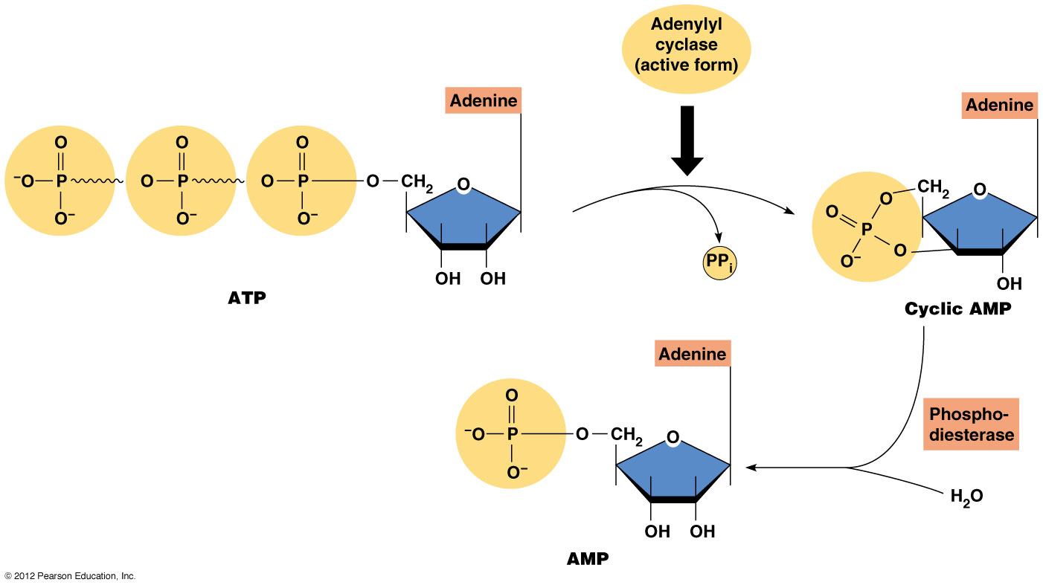
Notes:
cAMP is synthesized by cyclase enzyme (in particular adenylil cyclase which acts on ATP) that are in vertebrate large transmembrane protein that contain evolutionarily conserved cytoplasmatic domains.
These cyclases are activated via a G protein ligand receptor, for instance epinephrine
cAMo is degraded by phosphodiesterase enzymes which convert the active molecules to the inactive form 5’-AMP.

Slide 23
Signal transduction via cAMP: advantages
  Amplification of the signal
  Speed
Notes:
cAMP has two advantages:
Amplification of the signal - the binding of a signal to a single receptor can result in the synthesis of many cAMP that activate PKA, each PKA may phosphorylate many proteins.
Speed - in an experiment in 20 seconds from the addition of the signal has been produced a substantial amount of cAMP
In addition, a second messenger is often involved in crosstalk between different signaling pathways.
Receptor 1 signaling pathway 1
Receptor 2 second messenger signalling pathway 2

Slide 24
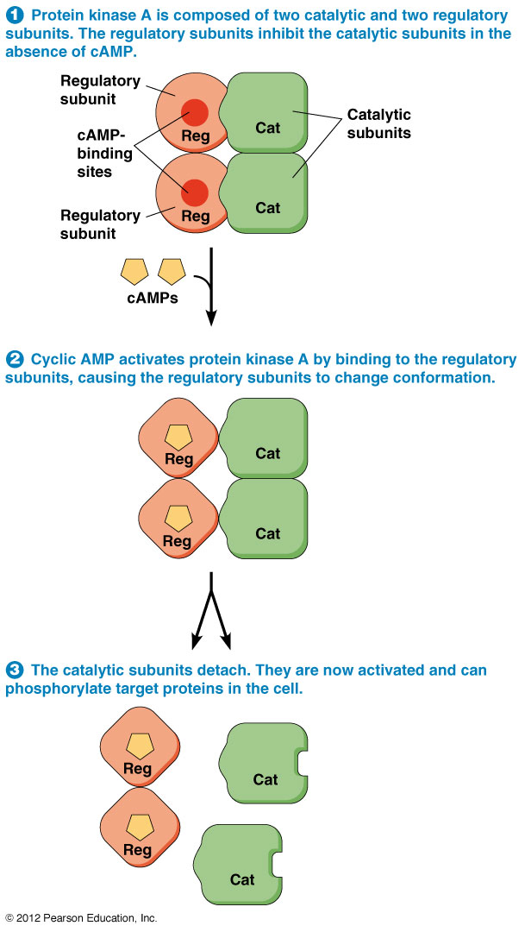
Signal transduction via cAMP: advantages
Notes:
In this slide it is schematically represented the mechanism of protein kinase A
P142

Slide 25
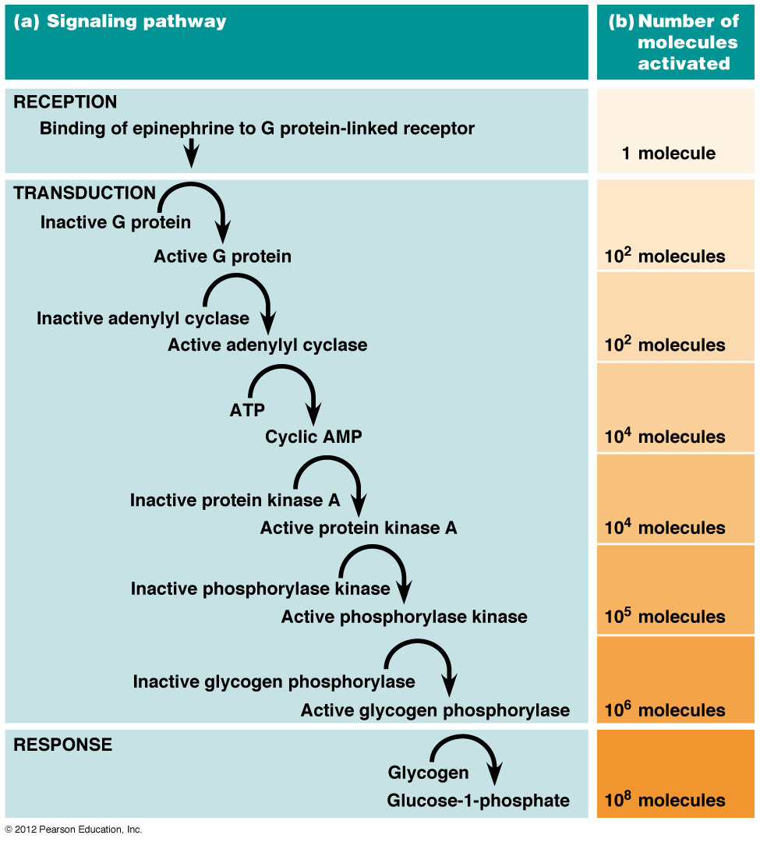
Signal transduction via cAMP
Notes:
The signal transduction in which it is Involved the adenilato cyclase includes various stages of amplification of hormonal initial message
Ex: Glycogen phosphorylase is activated in liver cells after epinephrine binds to a membrane receptor through a cascade mechanism that involves cyclic AMP and protein kinase A.

Slide 26
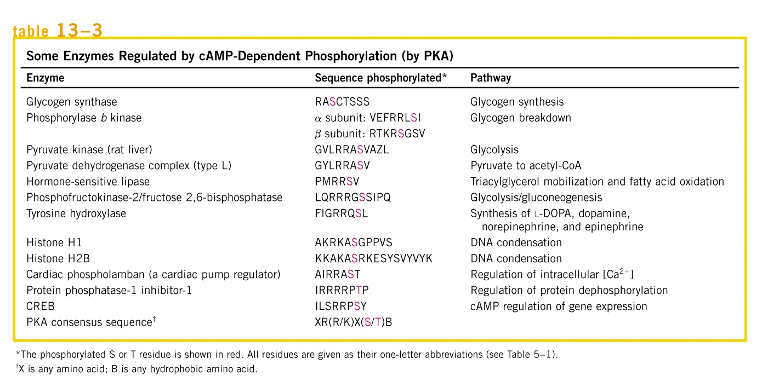
Signal transduction via cAMP
Notes:
Cyclic AMP acts as a second messenger for many regulatory molecules

Slide 27
Signal transduction via inositol triphosphate and diacylglycerol
A subunit can activate the phospholipase C
Diacylglycerol and inositol triphosphate are produced from membrane phospholipids
The Ca²⁺ channels in the ER open
Various effects of Ca²⁺ on cell behavior
Notes:
In addition to their role as structural components of the plasma membrane, phospholipids are also involved in signal transduction when certain phospholipids are hydrolyzed into their components by enzyme called phospholipases, second messengers are formed.
P.143

Slide 28
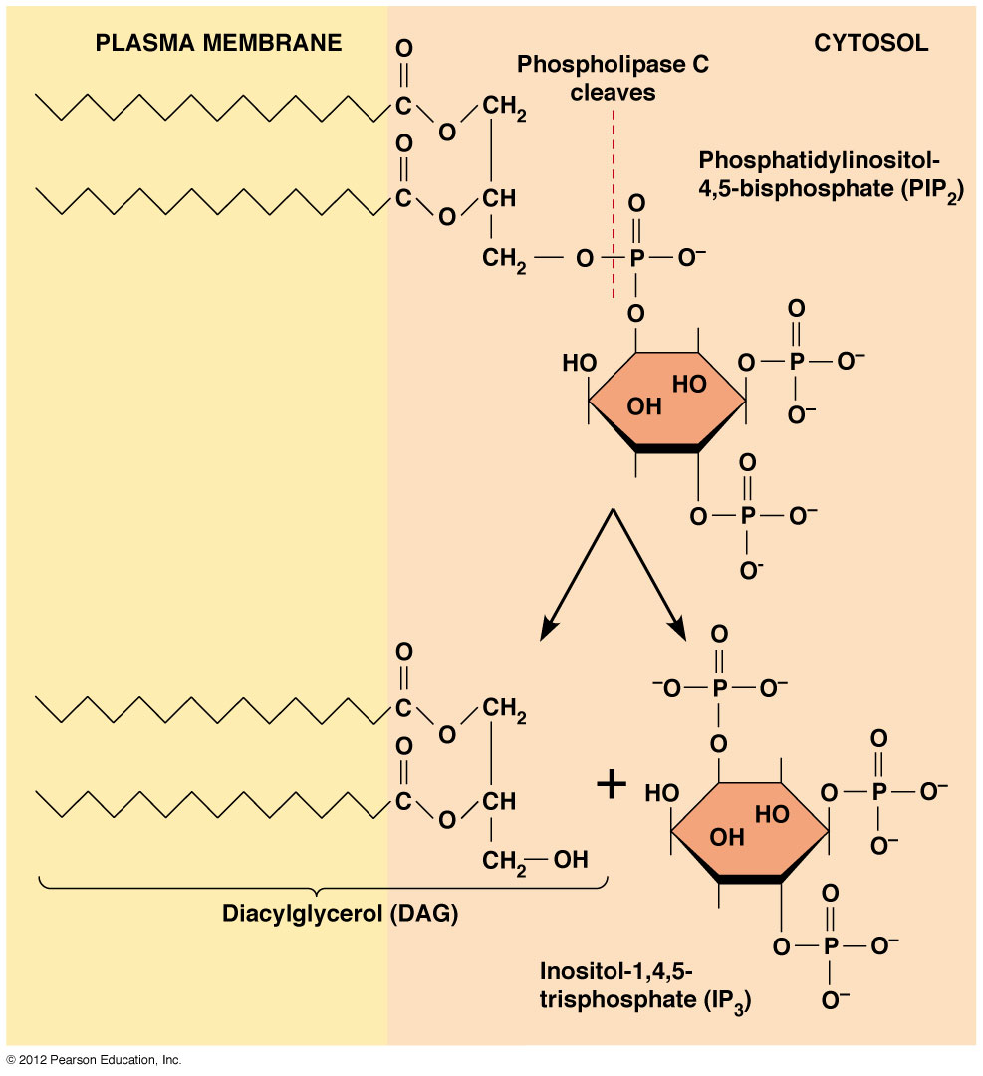
Signal transduction via inositol triphosphate and diacylglycerol
Notes:
Like all phospholipids PIP has a hydrophobic portion embedded in the plasma membrane:two fatty acid tails attached to a molecule of glycerol, which together form diacylglycerol or DAG. The hydrophilic oart of PIP is represented by the inositoltriphosphate or IP3 which projects into the cytoplasm.

Slide 29
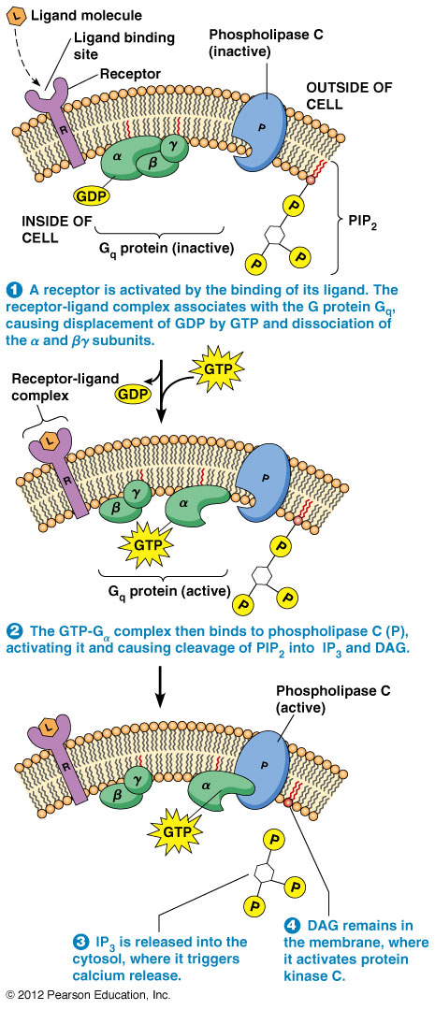
Signal transduction via inositol triphosphate and diacylglycerol
Step n.1
Step n.2
Step n.3
Step n.4
DAG
Notes:
Similarly to cAMP, the receptors involved in this second messenger system are often G-protein linked receptors.
A receptor is activated by the binding of ot ligand. The receptor-ligand complex associates with the G protein Gq causing displacement of GDP by GTP and dissociation of the alpha and beta gamma subunits.
The GTP-Gq complex then binds to phospholipase C activating it and causing cleavage of PIP2 and DAG
IP3 is release into cytosol where it triggers calcium release
DAG remains in the membrane where it activates protein kinase C:

Slide 30
Signal transduction via Ca²⁺
The cells retain a gradient of Ca²⁺ which is very extensive
Two types of pumps for Ca²⁺
When Ca²⁺ channels are opened, the entry of Ca²⁺ acts as a second messenger
Plants - phototropism, opening and closing of stomata, gravitropism
Animals - nerve transmission, muscle contraction, secretion of digestive enzymes
Notes:
Calcium ions are among the most intracellular signaling mediators. Calcium signaling depends on membrane calcium pumps that generate and maintain a gradient of calcium across cell membranes. The cytosol has very low concentrations of calcium comnpared to the concentration outside the cell or in the intracellular stores such as endoplasmatic reticulum where it is approximately 1 micromolar.
Calcium –ATPase pumps drive calcium into the extracellular environment and the endoplasmatic reticulum keeping this difference between the compartments.
It is important to underline that calcium cannot be synthesized to increase the intracellular concentration of the same ion. Its levels are regulated via the opening and closing of ion channels and the action of membrane pumps.

Slide 31
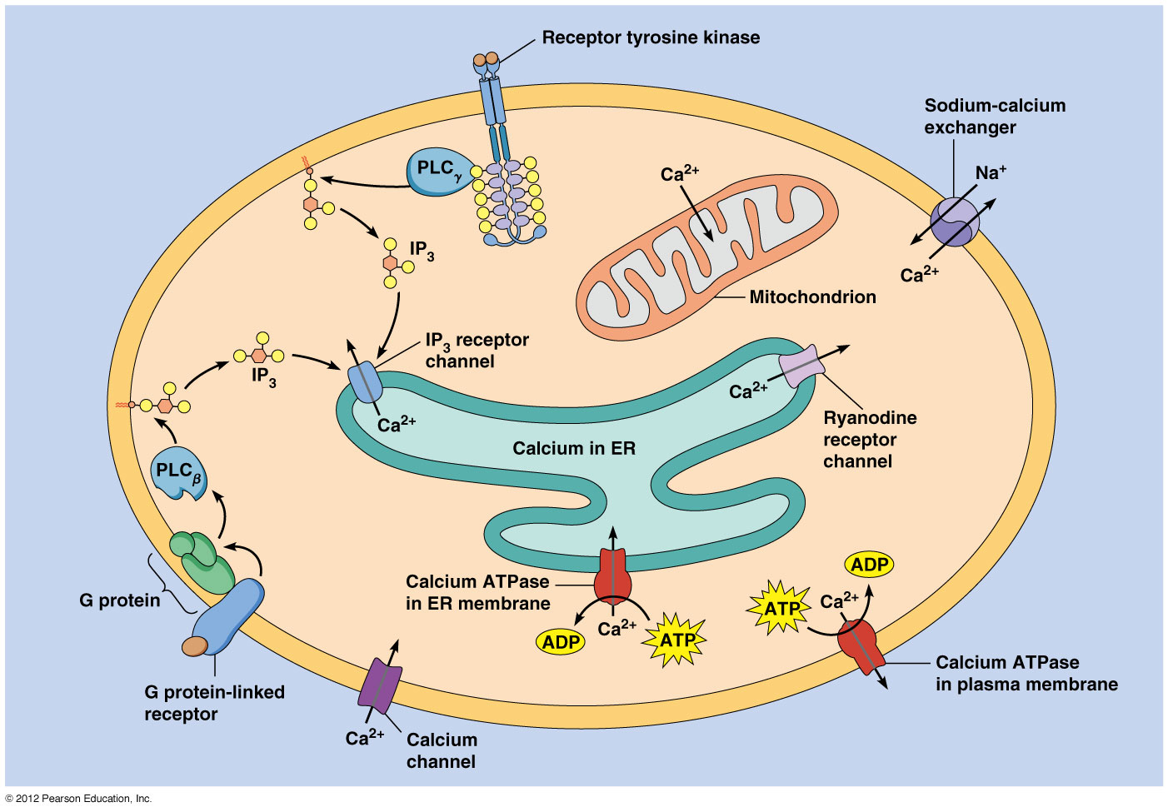
Signal transduction via Ca²⁺
Notes:
In signaling, changes in intracellular Ca2+ channels that allow Ca2+ channels is a common means of regulation levels are initiated by chan-nel opening (Figure 6.10). In the plasma membrane, there are diverse Ca2+
cytosol. Most of these are “gated”; this means that they only open to allow passage of ions under certain conditions. Some Ca2+
to pass through the membrane into the channels
are gated by the binding of specific ligands (ligand-gated channels), while others can be gated by environmental changes such as tempera-ture, pH, or voltage across the membrane (for example, voltage-gat-ed channels). These different channels allow diverse signals to be converted into the common currency of increased Ca2+ concentrations.
Another physiologically important site of Ca2+ storage is the endoplasmic
reticulum (or the analogous sarcoplasmic reticulum in muscle cells). The endoplasmic reticulum membranes are rich in IP3 (IP3
-gated Ca2+ receptors). Local increases in the level of IP3 channels (caused by PLC-medi-ated cleavage of PIP2—see above) will activate these receptors, leading to Ca2+ itself. Intermediate levels of Ca2+ , however, inhibit the channel, leading to negative signaling, such as Ca2+ release from the endoplasmic reticulum into the cytoplasm.
In this slide the IP3/DAG second messengers are reported
The ligand binds to the receptor
2) The activated phospholipase C through two different types of receptors produces the second messengers DAG and IP3 from PIP2.
3) IP3 opens Calcium channels loading to an increase in cytosolic calcium. It should be noted that the calcium cytosolic levels are regulated also by other system transport localized on plasm and ER membrane.
DAG and calcium activate protein kinase c that phosphorylate enzymes and other proteins

Slide 32
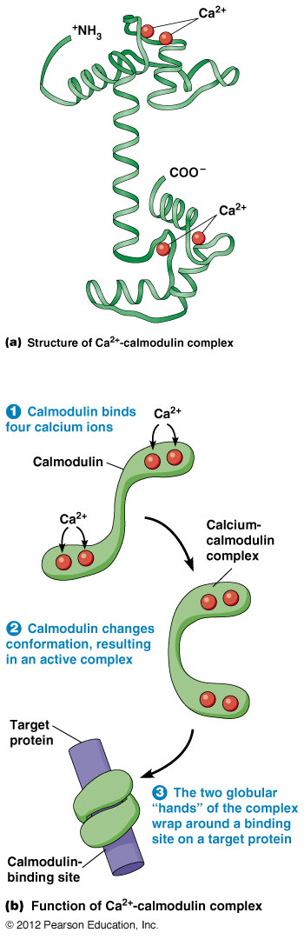
Ca²⁺ -calmodulin complex
Notes:
The protein calmodulin is an example of calcium binding sensor. Upon binding calcium, this protein undergoes conformational changes that allow it to regulate the activity of a range of downstream effector proteins. Such a mechanism is useful for coupling a single input signal (for instance calcium concentration) to widespread and rapid changes in many different cellular activities that include enzyme action and opening and closing of membrane channels.
The affinity of calcium for the EF hand sites in calmodulin ranges from 5 × 10–7 to 5 × 10–6 calcium above the resting intracellular level (~10–7
M, ideally suited for sensing increases in M). The conformation of CaM changes dramatically upon calcium binding (Figure 6.11). These conformational changes expose a new peptide-binding surface, which allows CaM to interact favorably with a wide range of binding partners that include protein kinases and phosphatases, adenylyl cyclases, tran-scriptional regulators, and membrane channels and pumps. Figure 6.11c shows how Ca2+–CaM can wrap around a recognized peptide, using the
newly exposed binding surface. In the most familiar cases, unliganded CaM (termed apo–CaM) cannot bind the downstream target, but calcium-bound CaM (Ca2+ to regulate Ca2+ of Ca2+–CaM) binds with high affinity. This mechanism operates /CaM-dependent protein kinases (CaM-Ks). Binding –CaM to the CaM-K induces activating conformational changes in
its catalytic domain, allowing the enzyme to phosphorylate substrates on serine and threonine residues. The modes of CaM regulation can be dif-ferent for different effectors. For example, in some cases, binding of CaM to the effector leads to its inhibition, not activation. Moreover, there are a few targets that bind constitutively to apo–CaM but are then released by calcium binding.

Slide 33
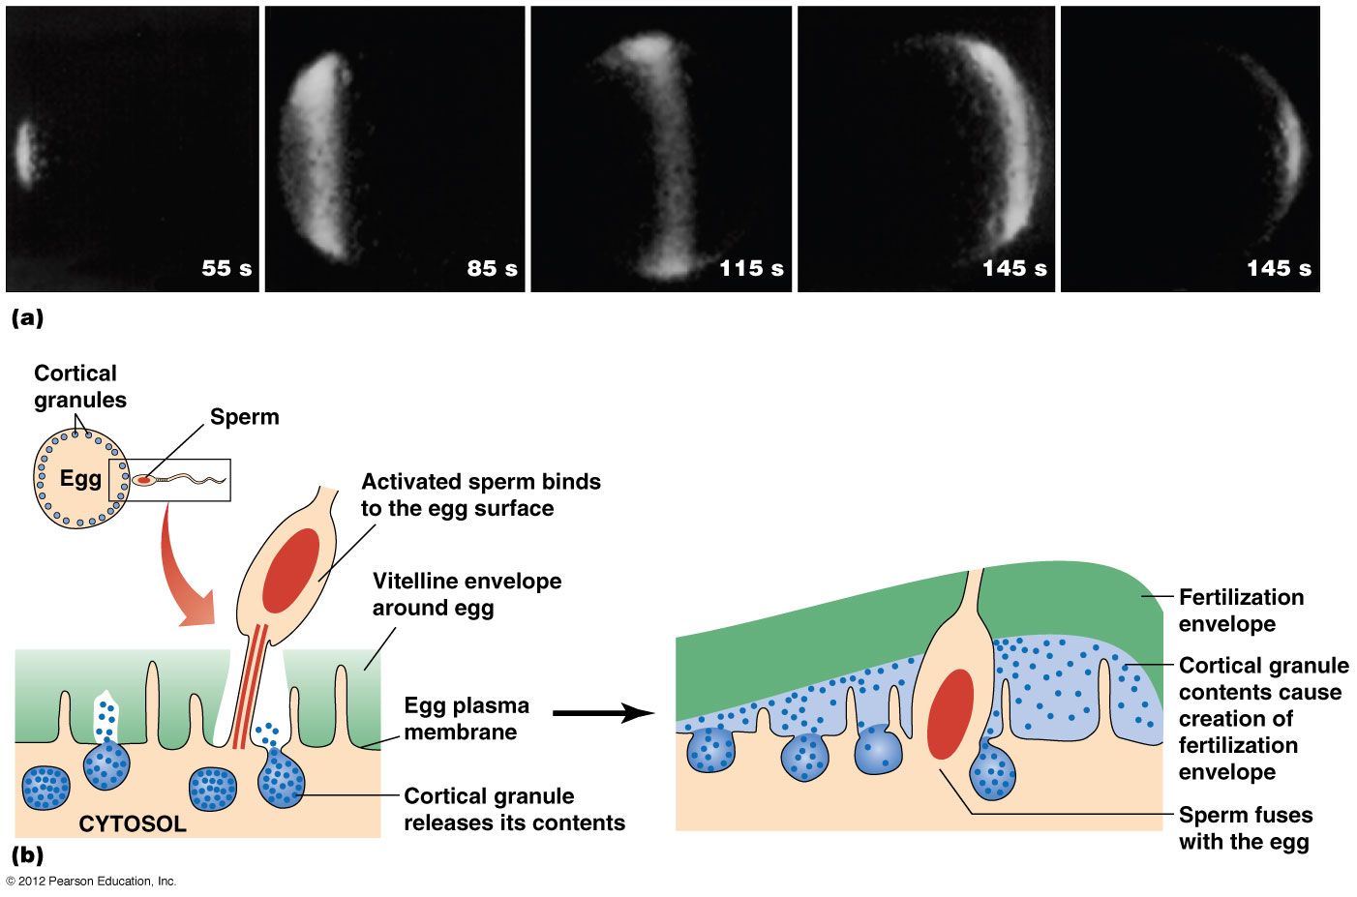
Two main events in fertilization
Notes:
Calcium is usually measured by a fluorescent dye that emits fluorescence when it binds to the ion.
The entry of a sperm into an egg is a very important signal that causes a massive opening of calcium channels, resulting in numerous and drammatic changes that prepare thenow fertilized egg for cell division and development
The opening of calcium channels results in an increase in cytosolic calcium concentration which can increase up to 100 fold within a fracton of a second.

Slide 34
Nitric oxide
It is produced in the endothelium upon the stimulation of G protein-coupled receptors on endothelial cells.
It diffuses to muscle determining the relaxation of smooth muscles of blood vessels.
It is released by neurons induces vasodilation → penile erection.
Sildenafil (Viagra): phosphodiesterase inhibitor of cyclic GMP (cGMP) that so it remains concentrated for longer time.
Notes:
The simple gas nitric oxide (NO) is a major paracrine signaling molecule in the nervous, immune, and circulatory systems. Like the steroid hormones, NO is able to diffuse directly across the plasma membrane of its target cells. The molecular basis of NO action, however, is distinct from that of steroid action; rather than binding to a receptor that regulates transcription, NO alters the activity of intracellular target enzymes.
Nitric oxide is a simple diatomic gas that is synthesized from the amino acid arginine by the enzyme nitric oxide synthase. Once synthesized, NO diffuses from vascular endothelial cells to adjacent vascular smooth cells. Its action is restricted to such local effects because the chemical reactivity of NO with heme or oxygen is very high and thus NO is extremely unstable, with a half-life of only a few seconds and a short range of action.
1)One well-characterized example of NO action is signaling the dilation of blood vessels. The first step in this process is the release of neurotransmitters, such as acetylcholine, from the terminus of nerve cells in the blood vessel wall. These neurotransmitters act on endothelial cells to stimulate NO synthesis. NO then diffuses to neighboring smooth muscle cells where it reacts with iron bound to the active site of the enzyme guanylyl cyclase. This increases enzymatic activity, resulting in synthesis of the second messenger cyclic GMP which induces muscle cell relaxation and blood vessel dilation.
It is also interesting to note that the medical use of nitroglycerin in treatment of heart disease is based on its conversion to NO, which dilates coronary blood vessels and increases blood flow to the heart.
2) Another example of NO involvement is during sexual stimulation. In fact, NO acts a signal causing an increase in cGMP and subsequent relaxation of the smooth muscle surrounding the arteries in the corpus cavernosum of the penis. As a result of this signal, the penis fills with blood producing erection.
Sildenafil acts by inhibiting a phosphodiesterase that breaks down cGMP, resulting in more c-GMP and better erection.

Slide 35
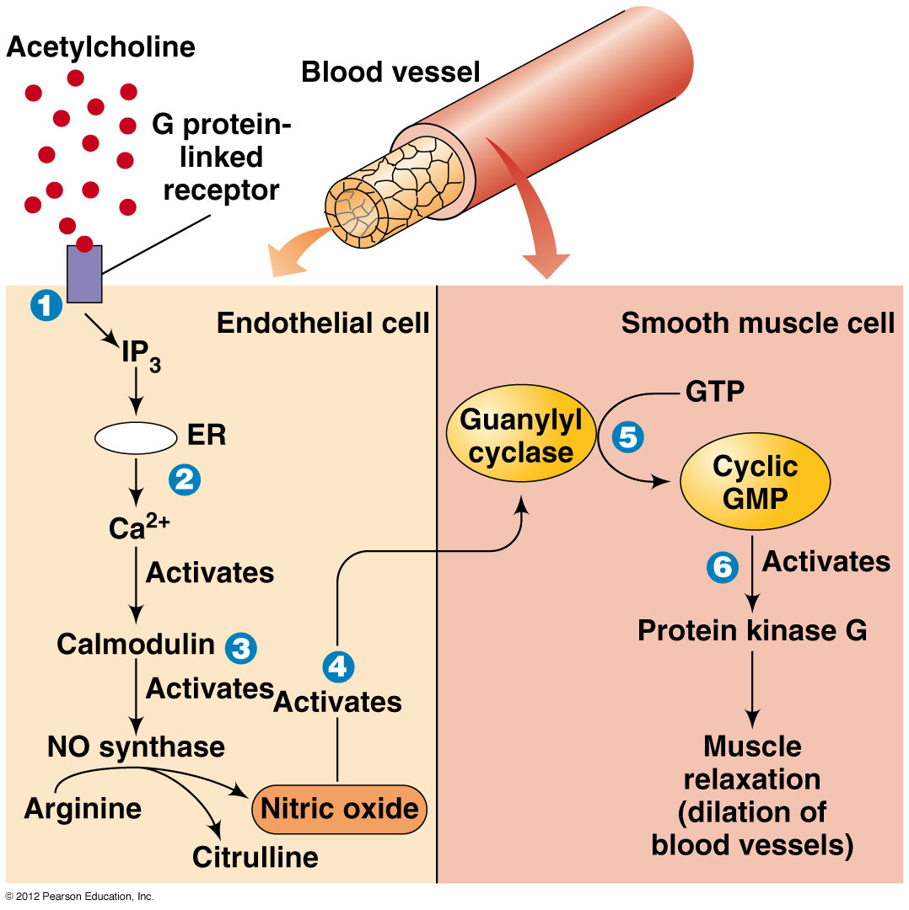
Notes:
The first step in this process is the release of neurotransmitters, such as acetylcholine, from the terminus of nerve cells in the blood vessel wall.
These neurotransmitters act on endothelial cells to stimulate NO synthesis. NO then diffuses to neighboring smooth muscle cells where it reacts with iron bound to the active site of the enzyme guanylyl cyclase. This increases enzymatic activity, resulting in synthesis of the second messenger cyclic GMP which induces muscle cell relaxation and blood vessel dilation.
1) Acetylcholine binds to receptors on endothelial cells of blood vessels. The activation of the receptor causes the production of IP3
2) IP3 opens calcium channels on the ER membrane, releasing Calcium into the cytosol
3) Calcium ions stimulate the activity of NO synthase, which is responsible for the production of NO
4) NO diffuses to the smooth muscle cells where it can activate soluble guanylyl cyclase by hundredfold, thus couplin increases in cytosolic NO levels to increases in cytosolic cGMP.
5) cGMP acts as a small, soluble signalling mediator to regulate the activity of a variety of downstream targets, such as proteine kinase isoforms. It is these downstream effectors of cGMP that ultimately mediate the cellular responses to NO promoting muscle relaxation
Carbon monoxide has similar chemical properties to NO and can also bind to and activate sGC although the affinity is much lower and the maximal activation of sGC is much less (two ro fourfold respect to hundredfolf of NO). The physiological significance of CO signaling is not yet fully established but CO levels can rise in tissues in response to stress.
Torna indietro per effetto NO su erezione

Slide 36
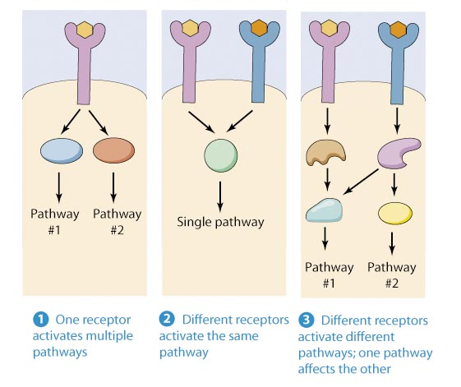
Different ways in which signals can be integrated
Notes:
The various signaling pathways, started by different receptors may converge and talk to each other.
Linear signalling pathway: Signal flows in a linear manner through (in order) organized signalling components
Branching: signalling protein has multiple downstream proteins
Crosstalk: linkage of different pathways; allow for coordination of pathway

Slide 37
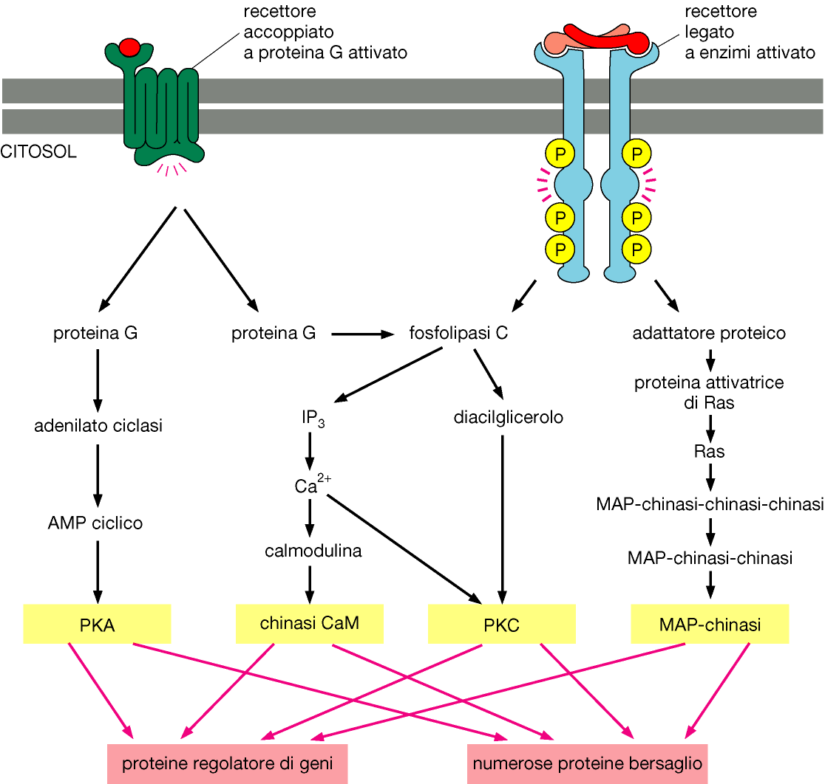
Connection between signalling pathways
Alberts et al., L’ESSENZIALE DI BIOLOGIA MOLECOLARE DELLA CELLULA, Zanichelli editore S.p.A. Copyright © 2005
Notes:
The various signaling pathways, started by different receptors may converge and talk to each other.
Cells receive information from many different growth factors receptors (or other receptors).
Cellular signaling pathways are not isolated from each other but are interconnected to form a complex signaling networs. They must then integrate this information to regulate different processes, such as protein synthesis and cell growth, motility, differentiation and programmed cell death.

Slide 38
Summary
Key words
Explore more
Review

Slide 39
SIGNAL TRANSDUCTION occurs when a ligand binds its receptor and alters intracellular conditions
Often the signal is a transducer from the outside of the cell to the inside
This process usually involves G-protein receptors and cyclic AMP
Key points

Slide 40
Answer the following questions:
Describe a general signal transduction pathway
What is meant by a phosphorylation cascade?
How is adenyl cyclase activated? What is the role of adenyl cyclase?
Describe the role of cAMP
How is protein kinase activated? What is the role of protein kinase?
Explore more

Slide 41
Define G-protein
Describe the process of signal transduction, focusing on the roles of G-protein linked receptors and cyclic AMP
Review

Slide 42
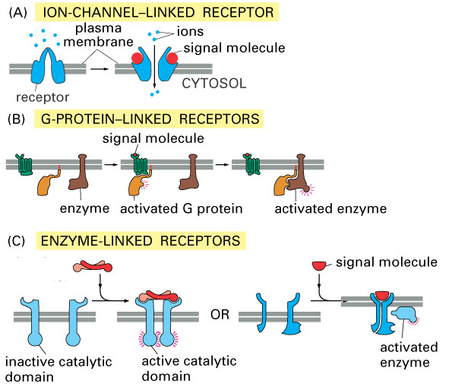
Summary
Notes:
Let’s summarize

