Slide 1
European Economy
Principles of corporate finance
Audrey de dominicis
adedominicis@unite.it

Slide 2
The most basic principle in finance
«a dollar today is worth more than a dollar tomorrow»

Slide 3
PRESENT VALUE AND FUTURE VALUE
Present Value
Value today of a future cash flow.
Future Value
Amount to which an investment will grow after earning interest

Slide 4
The Interest rate
We call it r
The interest rate is our «time machine».

Slide 5
FUTURE VALUE
Future Value (FV)
FV = PV*${\text{(1+}\text{r}\text{)}}^{t}$

Slide 6
FUTURE VALUE
Example FV
What is the future value of $100 if the interest is compounded annually at a rate of 7% for two years?
FV= 100 * ${\text{(1+}\text{0.07}\text{)}}^{2}$
Or
FV= 100 * (1+0.07)*(1+0.07)= 114.49

Slide 7
FUTURE VALUE
What is the future value of $1,522 if the interest is compounded annually at a rate of 7.5% for five years?
FV = 1,522*(${1+0.075)}^{5}$= 2,185.028

Slide 8
FUTURE VALUE
If you invest $100 at an interest rate of 15%, how much will you have at the end of eight years?
C_{t} = PV × (1 + r)^{t}
C₈ = $100 × 1.15⁸
C₈ = $305.90

Slide 9
PRESENT VALUE
Present value = PV
PV = $\frac{1}{{(1+r)}^{t}}\text{×}FV$
Discount Factor (DF)

Slide 10
PRESENT VALUE
What is the present value of $114.49 if the interest is compounded annually at a rate of 7% for two years?
PV= $\frac{1}{{(1+0.07)}^{2}}\text{×}$114.49
PV=100

Slide 11
PRESENT VALUE
If the cost of capital is 9%, what is the PV of $374 paid in year 9?
PV = FV / (1 + r)^{t}
PV = $374 / 1.09⁹
PV = $172.20

Slide 12
PRESENT VALUE
If the PV of $139 is $125, what is the discount factor?
PV = FV / DF_{t}
DF_{t} = PV/ FV
DF_{t} = $125 / $139
DF_{t} =0.899
WE START FROM THIS FORMULA
Attention! It is not the r but the
Discount Factor (DF)!

Slide 13
PRESENT VALUE
If the PV of $139 is $125, what is the interest rate?
PV = FV/${\text{(1+}\text{r}\text{)}}^{t}$
${\text{(1+}\text{r}\text{)}}^{t}$ = FV/ PV
${\text{(1+}\text{r}\text{)}}^{t}$ = $139 / $125
r=1.112–1= 0.112=11.2%
WE START FROM THIS FORMULA

Slide 14
PRESENT VALUE
The cost of a new automobile is $10,000. If the interest rate is 5%, how much would you have to set aside now to provide this sum in five years?
PV = FV / (1 + r)^{t}
PV = $10,000 / 1.05⁵
PV = $7,835.26

Slide 15
SUMMARY
Future Value
FV = PV${\text{×}\text{(1+}\text{r}\text{)}}^{t}$
$${\text{(1+}\text{r}\text{)}}^{t}= \frac{FV}{PV}$$
so
$r^{t}$= $\frac{FV}{PV}$ - 1
Present Value
PV = $\frac{FV}{{(1+r)}^{t}}$
Another way to write the PV formula,
useful to understand the Discount Factor
PV = $\frac{1}{{(1+r)}^{t}}$ $\text{×}$FV
PV= DF $\text{×}$FV
so
Discount Factor
DF = $\frac{PV}{FV}$

Slide 16
SUMMARY
FV = PV${\text{×}\text{(1+}\text{r}\text{)}}^{t}$
PV = $\frac{FV}{{(1+r)}^{t}}$
PV = $\frac{1}{{(1+r)}^{t}}$ $\text{×}$FV
or
DF = $\frac{PV}{FV}$
REMEMBER! DF= $\frac{1}{{(1+r)}^{t}}$
$r^{t}$= $\frac{FV}{PV}$ - 1

Slide 17
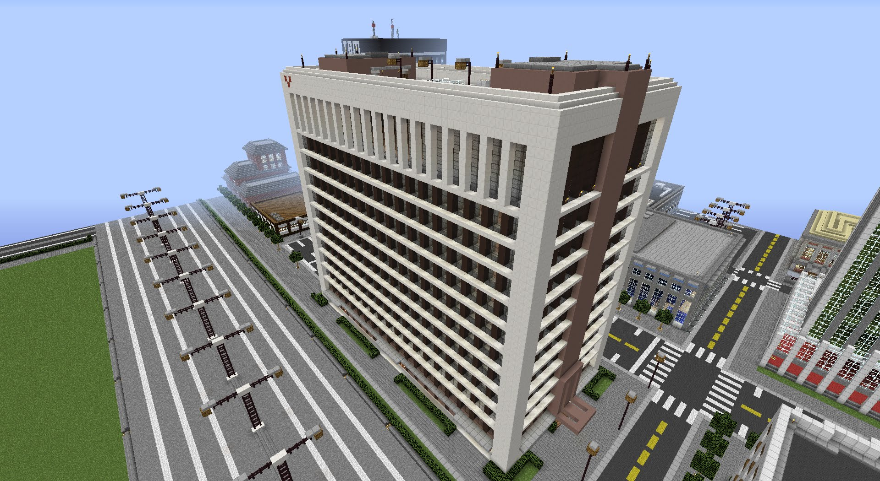
THE NET PRESENT VALUE (NPV)
Suppose you own a small company
The construction of an office block
that is contemplating

Slide 18
THE NET PRESENT VALUE (NPV)
Cost of buying the land and constructing the building is € 700,000.
Your real-estate adviser forecasts a shortage of office space and predicts that you will be able to sell it next year for € 800,000 (assume it as true).
In order to have r, we apply the formula ${\text{(1+}\text{r}\text{)}}^{t}$ = FV/ PV so we will have
r = 800,000/700,000 – 1 = 1.143 -1= 0.143 = 14.3%
YOUR COMPANY CAN CHOOSE!
We need a term of comparison!
What is the term of comparison for shareholders to know if this project is good or not?
PV
FV

Slide 19
THE NET PRESENT VALUE (NPV)
Shareholders can:
First kind of investment: earn a 7% profit by investing for one year in safe assets (e.g. Treasury bond securities);
Second kind of investment: Invest in the stock market, which is risky but offers an avarege return of 15%.
But for our project what is the term of comparison?
In a nutshell:
WHAT IS THE OPPORTUNITY COST OF CAPITAL? (7% or 15%?)
The answer is 7%: that’s the rate of return that your company’s shareholder could get by investing on their own at the same level of risk as the proposed project!
Remember, we are assuming, for the time being, that the FV of the office block is known with certainty. So, the level here is of 0 risk.

Slide 20
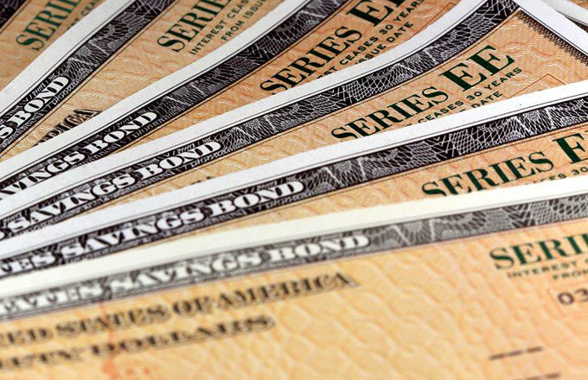
THE NET PRESENT VALUE (NPV)
We know that the opportunity cost of capital is 7%.
We can compare this opportunity cost of capital with the return of our project, which is 14.3%.
14.3% > 7%
Our project
Treasury bonds

Slide 21
THE NET PRESENT VALUE (NPV)
Valuing an Office Building
Step 1: Forecast cash flows
Cost of building = PV = C₀ = 700,000
Sale price in Year 1 = FV =C₁ = 800,000
Step 2: Estimate opportunity cost of capital
If equally risky investments in the capital market
offer a return of 7%, then
Cost of capital = r = 7%

Slide 22
NPV (Valuing an Office Building)
Step 3: Discount future cash flows
In order to have next year 800,000 € (the same FV of our project) with Treasury bonds, we have to invest 747,664.(more than our project)! In a nutshell: investing in Treasury Bonds is more expensive than our project!
Step 4: Go ahead if PV of payoff exceeds investment

Slide 23
NPV (NET PRESENT VALUE)
NPV = $C_{0}+\frac{C_{1}}{(1+r)}$
$C_{0}$< 0
Because we payed 700,000 so it is
– 700,000

Slide 24
NPV (NET PRESENT VALUE)
NPV= -700,000 + $\frac{800,000}{1.07}$ = 47,664

Slide 25
NPV (NET PRESENT VALUE)
Use the original example. Should we accept the project given a 10% expected return?

Slide 26
PERPETUITIES & ANNUITIES
Perpetuity - Financial concept in which a cash flow is theoretically received forever. (e.g. British Consol)
PV= $\frac{C}{r}$

Slide 27
PERPETUITY
We can have the first payment of perpetuity:
Immediately
After x years

Slide 28
PERPETUITY
PERPETUITY (first payment in year 1)
FV ∞
PV
PV = $\frac{C}{r}$

Slide 29
PERPETUITIES & ANNUITIES
Example
What is the present value of $1 billion every year, for all eternity, if you estimate the perpetual discount rate to be 10%?

Slide 30
PERPETUITIES & ANNUITIES
An investment costs $1,548 and pays $138 in perpetuity. If the interest rate is 9%, what is the NPV?
NPV =– investment +C / r
NPV = − $1,548 +138 / .09
NPV = −$14.67

Slide 31
PERPETUITY
PERPETUITY (first payment in year t)
(Ex: We have a perpetuity of 100 which starts at year 4. What is the PV of this perpetuity if the interest rate is 4%?)
100
FV ∞
100
100
100
100
100
100
100
100
PV
$$\frac{1}{{(1+r)}^{t}}$$
$$\frac{C}{r}$$
PV = $\frac{C}{r}$ * $\frac{1}{{(1+r)}^{t}}$
$PV=\frac{100}{0.04}$* $\frac{1}{{(1+0.04)}^{4}}$ = 2137,01

Slide 32
PERPETUITY
If we want to know the PV of a perpertuity which doesn’t start immediatly we have to compute this formula:
PV = $\frac{C}{r}$ * $\frac{1}{{(1+r)}^{t}}$
Remember! t is the number of missing years

Slide 33
PERPETUITIES & ANNUITIES
Example - continued
What if the perpetuity of 1 bil does not start making money for 3 years with an interest rate of 10%?
Perpetuity
We have to discount the perpetuity because during the first 3 years this asset doesn’t make money

Slide 34
PERPETUITIES & ANNUITIES
Annuity - An asset that pays a fixed sum each year for a specified number of years

Slide 35
ANNUITY
ANNUITY The state lottery advertises a jackpot prize of $70,000, paid in 8 installments over 8 years of $ 9,500 per year, at the end of each year. If interest rates are 3.7% what is the true value of the lottery prize?
FV ∞
9,500
9,500
9,500
9,500
9,500
9,500
9,500
9,500
PV
PV = = $\frac{9,500}{0.037}$ - $\frac{9,500}{0.037}$ * $\frac{1}{{(1+0.037)}^{8}}$ = 64,760.911
PV = $\frac{C}{r}$ -
$\frac{C}{r}$ * $\frac{1}{{(1+r)}^{t}}$

Slide 36
PERPETUITIES & ANNUITIES
Annuity - An asset that pays a fixed sum each year for a specified number of years
PV =

Slide 37
PERPETUITIES & ANNUITIES
PERPETUITY:
$\frac{C}{r}$
It starts immediately
$\frac{C}{r}$ * $\frac{1}{{(1+r)}^{t}}$
It starts after t years
ANNUITY:
$\frac{C}{r}$ - $\frac{C}{r}$ * $\frac{1}{{(1+r)}^{t}}$

