Slide 1
BONDS AND STOCKS
Suppose your Company wants to invest in new plant and equipment.
These investments require money – often a lot of money!
WHAT CAN YOUR COMPANY DO?
You can sell additional shares of stock
You can issue bonds, which are simply long-term loans

Slide 2
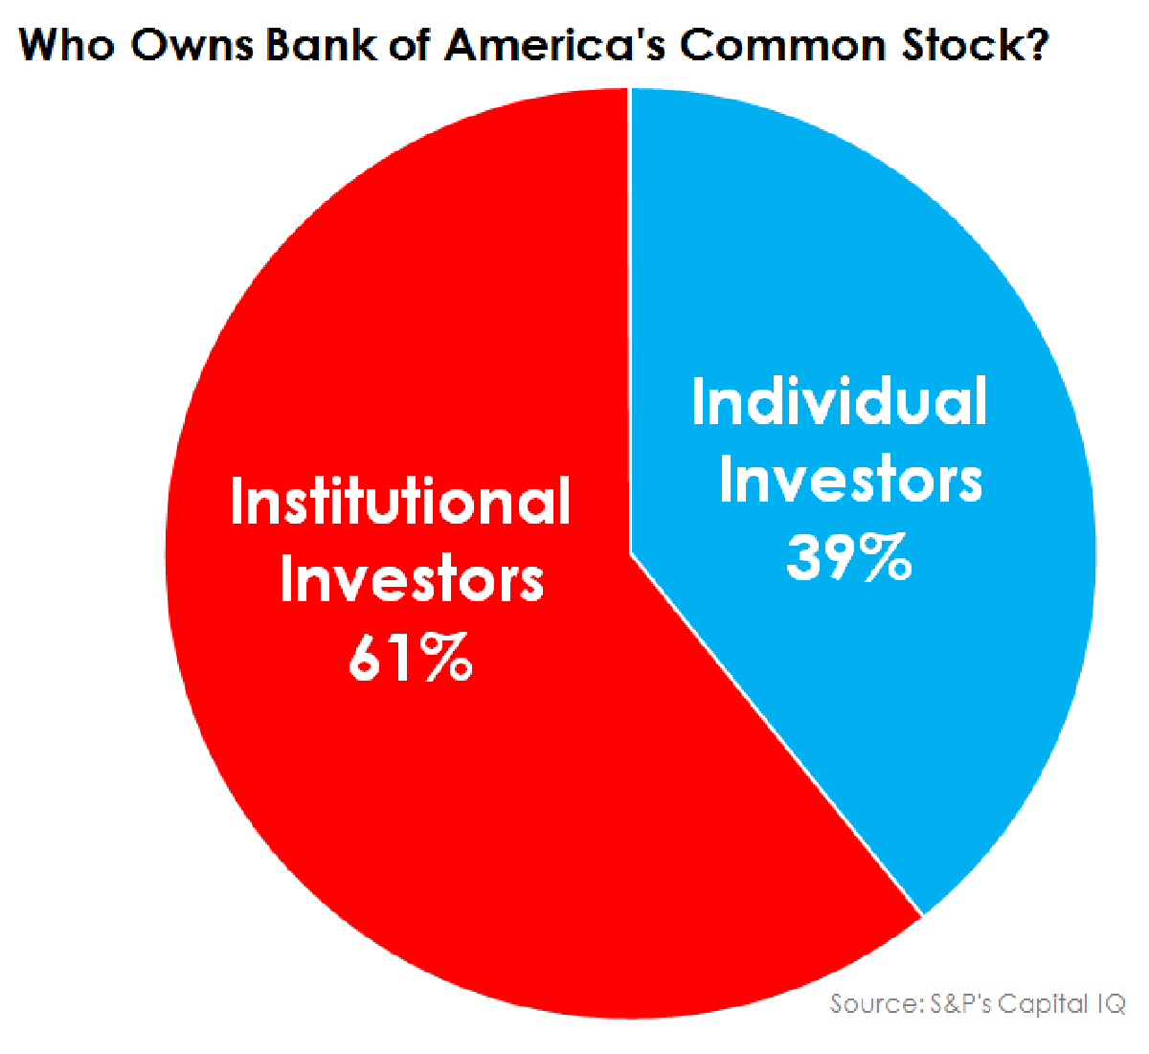
DIFFERENCE BETWEEN BONDS AND STOCKS
It means in italian «Titolo»
Stock: a security representing ownership of a corporation
If you buy a stock you are one «owner» of the corporation

Slide 3
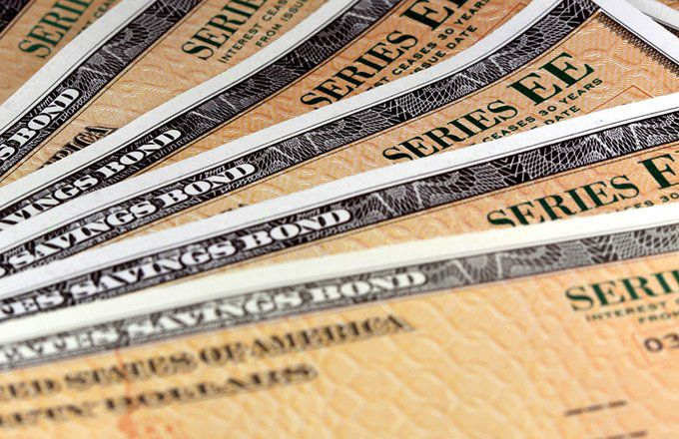
DIFFERENCE BETWEEN BONDS AND STOCKS
Bond: Long-term debt
Companies are not the only bond issuers.
Municipalities also raise money by selling bonds. So do national goverments.
If you buy a bond you are a creditor
Issues Bonds
Which are
part of their debt

Slide 4
VALUING BONDS
Terminology
Bond - Security that obligates the issuer to make specified payments to the bondholder.
Face value (par value or principal value) - Payment at the maturity of the bond.
Coupon - The interest payments made to the bondholder.

Slide 5
VALUING BONDS
The price of a bond is the present value of all cash flows generated by the bond (i.e. coupons and face value) discounted at the required rate of return
In this case it equals the rate of return offered by other government debt issues

Slide 6
VALUING BOND
$$\frac{1}{{(1+r)}^{1}}$$
$$\frac{1}{{(1+r)}^{2}}$$
$$\frac{1}{{(1+r)}^{3}}$$
$$\frac{1}{{(1+r)}^{4}}$$
2014
2015
2016
2017
2018
-100€
cpn
cpn
cpn
Cpn + face value
+4.25% of 100€
So
4.25 €
+4.25% of 100€
So
4.25 €
+4.25% of 100€
So
4.25 €
+4.25% of 100€ + 100€ (the face value)
So
104.25 €

Slide 7
VALUING BONDS
Example - France
In October 2014 you purchase 100 euros of French bonds (OATs Obligations Assimilables du Trésor) which pay a 4.25% coupon every year. If the bond matures after 4 years the YTM is 0.15%, what is the value of the bond?
4.25% of 100 is 4.25
100 + 4.25

Slide 8
VALUING BONDS
A 10-year German government bond (bund) has a face value of €100 and a coupon rate of 5% paid annually. Assume that the interest rate (in euros) is equal to 6% per year. What is the bond's PV?
PV= $\frac{5}{(1+0.06)}+$ $\frac{5}{{(1+0.06)}^{2}}$ + … + $\frac{5+100}{{(1+0.06)}^{10}}=$92.69

Slide 9
VALUING STOCKS
Dividend Discount Model - Computation of today’s stock price which states that share value equals the present value of all expected future dividends
Div is affected by earnings!
H - Time horizon for your investment.

Slide 10
VALUING STOCKS
Company X is expected to pay an end-of-year dividend of $5 a share. After the dividend its stock is expected to sell at $110. If the market capitalization rate is 8%, what is the current stock price?
P₀ = (Div₁ + P₁) / (1 + r)
P₀ = ($5 + 110) / 1.08
P₀ = $106.48

Slide 11
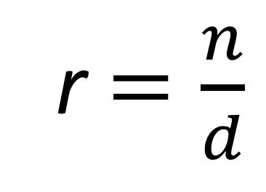
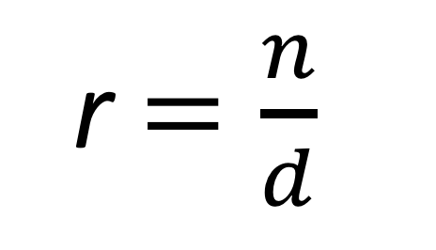
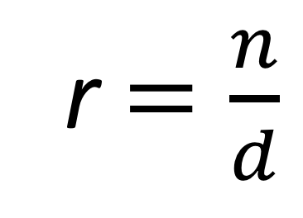
REMEMBER!
ex
3 =
$$\frac{12}{4}$$
r $=\frac{n}{d}$
r $=\frac{n}{d}$
$\frac{12}{3}$ = 4
$\frac{16}{4}$ = 4
r $=\frac{n}{d}$
r $=\frac{n}{d}$
$\frac{12}{6}$ = 2
$\frac{8}{4}$ = 2
r means result
n means numerator
d means denominator

Slide 12
VALUING STOCKS AND BOND
We can write the previous formulas as:
$P_{t}^{S}$= $\frac{{Div}_{t+1}^{e}}{{1+i}_{t}}+\frac{{Div}_{t+2}^{e}}{{(1+i}_{t})(1+i_{t+1}^{e})}$ + $\frac{{Div}_{t+n}^{e}+P^{f}}{{(1+i}_{t})\left(1+i_{t+1}^{e}\right)…(1+i_{t+n−1}^{e})}$
$P_{t}^{B}$= $\frac{{cpn}_{t+1}^{e}}{{1+i}_{t}}+\frac{{cpn}_{t+2}^{e}}{{(1+i}_{t})(1+i_{t+1}^{e})}$ + $\frac{{cpn}_{t+n}^{e}+P^{f}}{{(1+i}_{t})\left(1+i_{t+1}^{e}\right)…(1+i_{t+n−1}^{e})}$

Slide 13
Unexpected- Expected- already expected
M/F POLICY
Unexpected
Change in i
M/F POLICY
Expected
Change in $i^{e}$
M/F POLICY
We already knew that
already expected
No impact

Slide 14
MACROFINANCE
What happens to the price of Stock and to the price of Bond if …
the Central Bank applies an unexpected Expansionary Monetary Policy?
i
LM
↑$M^{s}$⇒ ↓i ; ↑Y
LM’
i*
i’
Stock
↓i
↑Div ⇒ ↑price
IS
Bond
↓i
⇒ ↑price
Y*
Y’
Y
The bond price is affected only by the interest rate because the cpn is fixed

Slide 15
MACROFINANCE
What happens to the price of Stock and to the price of Bond if …
the Central Bank applies an expected (in the future) Expansionary Monetary Policy?
i
LM
↑$M^{s}$⇒ ↓ $i^{e}$; ↑Y
LM’
i*
i’
Stock
↓$i^{e}$
↑Div ⇒ ↑price
IS
Bond
$$i^{e}$$
↓
⇒ ↑price
Y*
Y’
Y
The bond price is affected only by the interest rate because the cpn is fixed

Slide 16
MACROFINANCE
What happens to the price of Stock and to the price of Bond if …
the Central Bank applies an unexpected Restrictive Monetary Policy?
i
LM’
${\text{↓}M}^{s}$⇒ ↑ i ; $\text{↓}$Y
LM
i’
i*
Stock
↑ i
$\text{↓}$Div ⇒ $\text{↓}$price
IS
Bond
↑ i
⇒ $\text{↓}$price
Y’
Y*
Y

Slide 17
MACROFINANCE
What happens to the price of Stock price and to the Bond price if …
the Central Bank applies an expected Restrictive Monetary Policy?
i
LM’
${\text{↓}M}^{s}$⇒ ↑ $i^{e}$ ; $\text{↓}$Y
LM
i’
i*
Stock
↑ $i^{e}$
$\text{↓}$Div ⇒ $\text{↓}$price
IS
Bond
↑ $i^{e}$
⇒ $\text{↓}$price
Y’
Y*
Y

Slide 18
MACROFINANCE
What happens to the price of Stock and to the price of the Bond if …
the Central Bank applies an unexpected Espansionary Fiscal Policy?
Observation
i
LM
$\text{↓}$T ⇒ ↑ i ;↑ Y
i’
i*
⇒
Bond
↑ i
$\text{↓}$price
IS’
Stock
$\text{↑}$Div ; ↑$i$
IS
Y*
Y’
Y
What will the result be?
It depends on how flat the curve LM is!

Slide 19
MACROFINANCE
What happens to the price of Stock if …
the Central Bank applies an expected Espansionary Fiscal Policy?
Observation
i
LM
$\text{↓}$T ⇒ ↑ $i^{e}$;↑ Y
i’
i*
↑
Bond
$i^{e}$⇒
$\text{↓}$price
IS’
Stock
$\text{↑}$Div ; ↑$i^{e}$
IS
Y*
Y’
Y
What will the result be?
It depends on how flat the curve LM is!

Slide 20
MACROFINANCE
What happens to the price of Stock if …
the Central Bank applies an unexpected Espansionary Fiscal Policy?
Observation: LM almost flat
i
$\text{↓}$T ⇒i ↑ < ↑ Y
LM
Bond
↑$i$
⇒
$\text{↓}$price
i’
i*
Stock
$\text{↑}$Div > ↑$i$
IS’
IS
What will the result be?
Y*
Y’
Y
In this case we have an increase in the stock price because the increase of Div is higher than the increase of i.

Slide 21
MACROFINANCE
What happens to the price of Stock if …
the Central Bank applies an expected Espansionary Fiscal Policy?
Observation: LM almost flat
i
$\text{↓}$T ⇒ ↑ $i^{e}$ < ↑ Y
LM
Bond
↑$i^{e}$
⇒
$\text{↓}$price
i’
Stock
$\text{↑}$Div > ↑$i^{e}$
i*
IS’
IS
What will the result be?
Y*
Y’
Y
In this case we have an increase in the stock price because the increase of Div is higher than the increase of $i^{e}$.

Slide 22
MACROFINANCE
What happens to the price of Stock if …
the Central Bank applies an unexpected Espansionary Fiscal Policy?
Observation: LM not flat
i
$\text{↓}$T ⇒ ↑ i > ↑ Y
i’
LM
i*
Bond
↑ i
⇒
$\text{↓}$price
Stock
$\text{↑}$Div < ↑$i$
IS’
In this case we have a decrease in the stock price because the increase of Div is lower than the increase of i.
IS
Y*
Y’
Y

Slide 23
MACROFINANCE
What happens to the price of Stock if …
the Central Bank applies an expected Espansionary Fiscal Policy?
Observation: LM not flat
i
$\text{↓}$T ⇒ ↑ $i^{e}$ > ↑ Y
i’
LM
i*
Bond
↑ $i^{e}$
⇒
$\text{↓}$price
Stock
$\text{↑}$Div < ↑$i^{e}$
IS’
In this case we have a decrease in the stock price because the increase of Div is lower than the increase of i.
IS
Y*
Y’
Y

Slide 24
MACROFINANCE
What happens to the price of Stock if …
the Central Bank applies an unexpected Restrictive Fiscal Policy?
Observation
i
LM
↑ T ⇒ $\text{↓}$ i ; $\text{↓}$Y
i*
i’
Bond
$$\text{↓}$$
⇒
↑
price
i
IS
Stock
$\text{↓}$Div ;$\text{↓}i$
IS’
Y’
Y*
Y
What will the result be?
It depends on how flat the curve LM is!

Slide 25
MACROFINANCE
What happens to the price of Stock if …
the Central Bank applies an expected Restrictive Fiscal Policy?
Observation
i
LM
↑ T ⇒ $\text{↓}$ $i^{e}$ ; $\text{↓}$Y
i*
i’
Bond
$$\text{↓}$$
⇒
↑
price
$$i^{e}$$
IS
Stock
$\text{↓}$Div ;$\text{↓}i^{e}$
IS’
Y’
Y*
Y
What will the result be?
It depends on how flat the curve LM is!

Slide 26
MACROFINANCE
What happens to the price of Stock if …
the Central Bank applies an unexpected Restrictive Fiscal Policy?
Observation: LM almost flat
i
↑ T ⇒ $\text{↓}$i ; $\text{↓}$ Y
LM
Bond
$$\text{↓} i$$
⇒
↑
price
i*
Stock
$\text{↓}$Div > $\text{↓} i$
i’
IS
In this case we have an decrease in the stock price because the decrease of div is higher than the decrease of i.
IS’
Y’
Y*
Y

Slide 27

MACROFINANCE
What happens to the price of Stock if …
the Central Bank applies an expected Restrictive Fiscal Policy?
Observation: LM almost flat
i
↑ T ⇒ $\text{↓}i^{e}$; $\text{↓}$ Y
LM
Bond
$$\text{↓}i^{e}$$
⇒
↑
price
i*
Stock
$\text{↓}$Div > $\text{↓}i^{e}$
i’
IS
In this case we have an decrease in the stock price because the decrease of div is higher than the decrease of $i^{e}$.
IS’
Y’
Y*
Y

Slide 28
MACROFINANCE
What happens to the price of Stock if …
the Central Bank applies an unexpected Restrictive Fiscal Policy?
Observation: LM not flat
i
↑ T ⇒ $\text{↓}$ i ; $\text{↓}$ Y
LM
i*
i’
↑
price
Bond
$\text{↓} i$
⇒
Stock
$\text{↓}$Div < $\text{↓} i$
IS
IS’
In this case we have an encrease in the stock price because the decrease of div is lower than the decrease of i.
Y’
Y*
Y

Slide 29
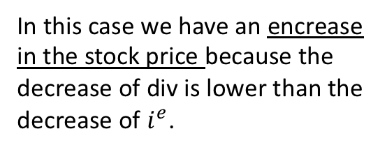
MACROFINANCE
What happens to the price of Stock and the price of Bond if …
the Central Bank applies an expected Restrictive Fiscal Policy?
Observation: LM not flat
i
↑ T ⇒ $\text{↓}$ $i^{e}$ ; $\text{↓}$ Y
LM
i*
i’
↑
price
Bond
$$\text{↓}i^{e}$$
⇒
Stock
$\text{↓}$Div < $\text{↓}i^{e}$
IS
IS’
In this case we have an encrease in the stock price because the decrease of div is lower than the decrease of $i^{e}$.
Y’
Y*
Y

