Slide 2
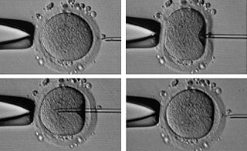
«ICSI Procedure and advanced techniques
in medically-assisted procreation»
Second-Cycle Degree Course in “REPRODUCTIVE BIOTECHNOLOGIES”
A.Y. 2022- 2023
Ilaria Listorti
Head of Villa Mafalda ART lab
ilistorti@unite.it

Slide 3
MAIN TOPICS
- ASSISTED REPRODUCTIVE TECHNIQUES
Basic semen analisys;
Selection of spermatozoa for ICSI;
The oocyte retrieval (Pick-Up);
In-vitro insemination;
Intracytoplasmatic Sperm Injection (ICSI);
Assisted zona hatching;
Blastocyst biopsy;
Pre-implantation genetic diagnosis and embryo screening;
Vitrification of oocytes and embryos.
1° THEROICAL LESSON
HUMAN EMBRYO CULTURE: TIPS AND TRICKS
- QUALITY CONTROL INSIDE A.R.T. LABORATORY
2° THEROICAL LESSON

Slide 4
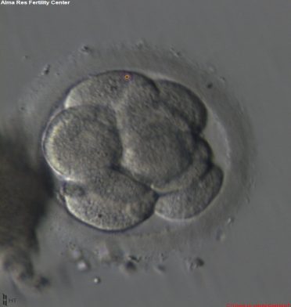
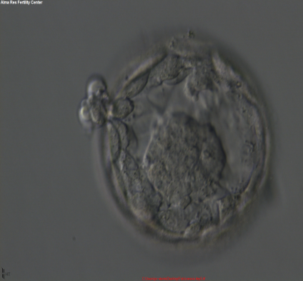
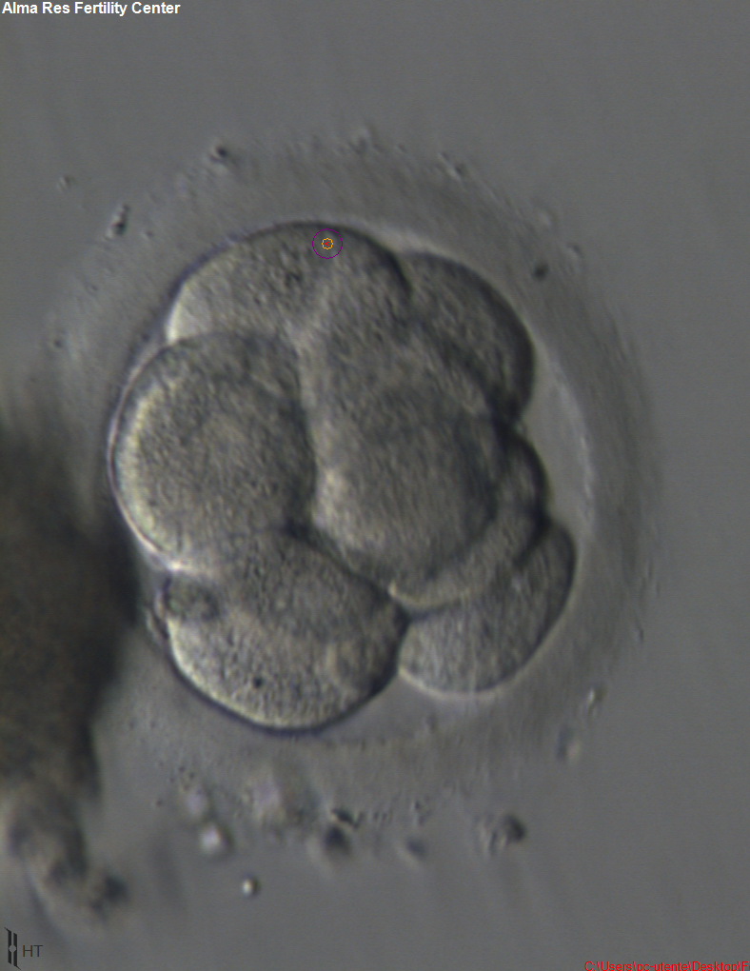
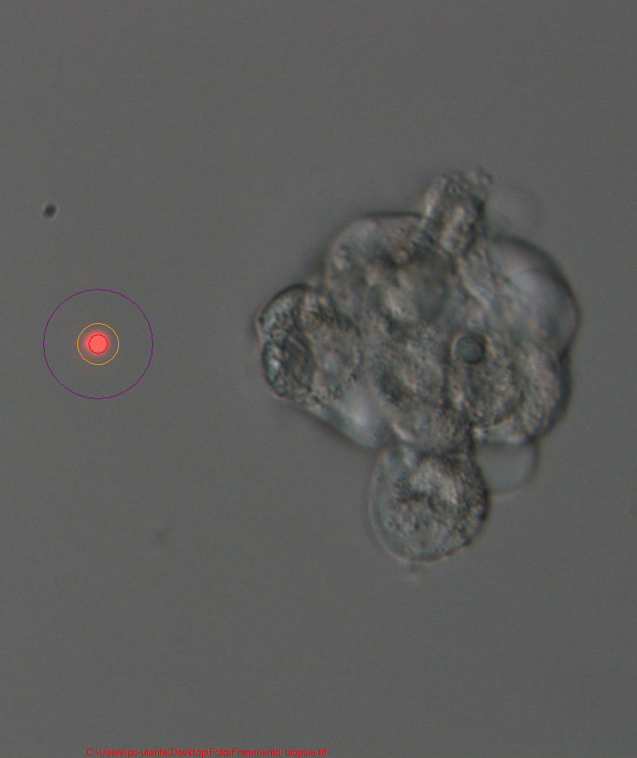
MAIN TOPICS
“ATLAS OF HUMAN EMBRYOS”
……YOU HAVE TO CHOOSE!!!.......
3° INTERACTIVE LESSON
Embryo culture
ICSI
4° PRATICAL LESSON
Preimplantation Genetic Test
Blastocyst biopsy

Slide 5
Recommended books:
Pratical Manual of in Vitro Fertilization. Advanced Methods and Novel Devices
Editors: Nagy, Zsolt Peter, Varghese, Alex C., Agarwal, Ashok
In Vitro Fertilization. A Practical Approach
Editor: Gardner David K.
Eshre Atlas of Human Embriology
http://atlas.eshre.eu/

Slide 6
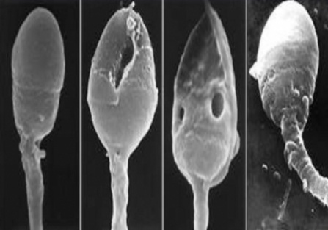
MAIN TOPICS
- BASIC SEMEN ANALISYS
- SELECTION OF SPERMATOZOA FOR ICSI
THEROICAL LESSON
“ATLAS OF HUMAN SPERMATOZOA”
……YOU HAVE TO CHOOSE!!!.......
INTERACTIVE LESSON

Slide 7
INFERTILITY WORK - UP
History, Physical examination
Semen analysis x2
Normal
Abnormalormal
Female evaluation
Hormone evaluation
Eliminate gonadotoxins
Abnormalormal
Normal
Further evaluation based on semen analysis
Not Improved
Improved
Treat
female factor
Low volume
Oligospermia
Asthenospermia
Azoospermia
Treat male factor
Unexplained infertility:
Antisperm antibodies
Sperm chromatin structure
Sperm penetration or hemizona assay

Slide 8
INFERTILITY WORK - UP
When the diagnosis is completed, the individual or couple treatment must to be based on three principal options:
1. Medical treatment in order to restore the fertility. (hormonal therapy; infections therapy).
2. Surgical treatment in order to restore the fertility. (tubal function restoring; myoma or fibroid removal; varicoceles).
3. Access to the medically-assisted techniques.

Slide 9
THE MODERN ANDROLOGY
In 1902, Edward Martin, the founder of the modern andrology, proposed that an analysis of a semen sample, should be incorporated into all infertility assessments.
In 1956, John MacLeod advanced the basic semen analysis from beyond a mere observation and introduced the importance of certain sperm parameters such as morphology and motility.

Slide 10
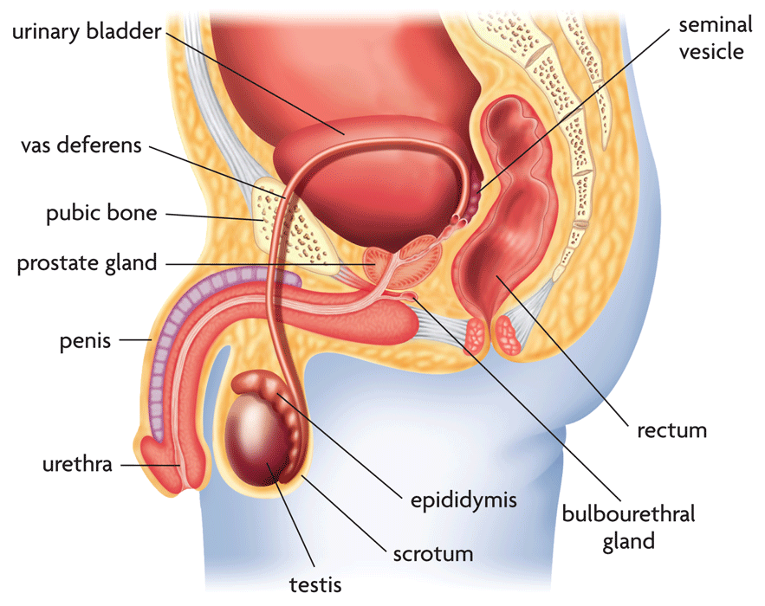
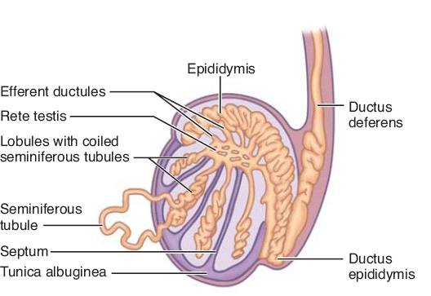
MALE REPRODUCTIVE SYSTEM
During ejaculation, semen is produced from a concentrated suspension of spermatozoa, stored in the paired epididymides, mixed with, and diluted by, fluid secretions from the accessory sex organs. About 90% of semen volume is made up of secretions from the accessory organs (Weiske,1994), mainly the prostate and seminal vesicles, with minor contributions from the bulbourethral (Cowper’s) glands and epididymides.

Slide 11
SEMEN ATTRIBUTES
The total number of spermatozoa: this reflects sperm production by the testes and the patency of the post-testicular duct system;
The total fluid volume contributed by the various accessory glands: this reflects the secretory activity of the glands.
The nature of the spermatozoa (their vitality, motility and morphology) and the composition of seminal ﬂuid are also important for sperm function.

Slide 12
Laboratory measurements
The results of laboratory measurements of semen quality will depend on:
1. Whether a complete sample is collected. During ejaculation the first semen fractions voided are mainly sperm-rich prostatic fluids, whereas later fractions are dominated by seminal vesicular fluid .
Björndahl & Kvist, 2003
2. The activity of the accessory sex glands, the fluids of which dilute the concentrated epididymal spermatozoa at ejaculation .
Eliasson, 2003
3. The time since the last sexual activity. In the absence of ejaculation, spermatozoa accumulate in the epididymides, then overflow into the urethra and are flushed out in urine. Sperm vitality and chromatin are unaffected by increased length of abstinence unless epididymal function is disturbed.
Cooper et al., 1993; De Jonge et al., 2004; Tyler et al.,1982b; De Jonge et al., 2004; Correa- Perez et al., 2004
4. The size of the testis, which influences the total number of spermatozoa per ejaculate.
Handelsman et al., 1984; WHO, 1987; Behre et al., 2000; Andersen et al., 2000

Slide 13
Intra- individual variation in semen composition
It is impossible to characterize a man’s semen quality from evaluation of a single semen sample.
It is helpful to examine two or three samples to obtain baseline data.
Poland et al., 1985; Berman et al., 1996; Carlsen et al., 2004; Castilla et al., 2006; Keel, 2006.

Slide 14
In response to a growing need for the standardization of procedures for the examination of human semen, this manual is offered as a resource for scientists, technicians and managers undertaking semen analysis in clinical and research laboratories.

Slide 15
Pre-examination procedures
1.
2.
patient information
sample collection
3.
4.
sample reception
initial sample evaluation

Slide 16
Sample collection
The sample should be collected in a private room near the laboratory, in order to limit the exposure of the semen to fluctuations in temperature and to control the time between collection and analysis.
The sample should be collected after a minimum of 2 days and a maximum of 7 days of sexual abstinence.
The man should be given clear written and spoken instructions concerning the collection of the semen sample. These should emphasize that the semen sample needs to be complete and that the man should report any loss of any fraction of the sample.
The sample should be obtained by masturbation and ejaculated into a clean,wide-mouthed container. The specimen container should be kept at ambient temperature, between 20 °C and 37 °C.

Slide 17
Semen examination
Liquefaction
Viscosity
Volume
pH
Macroscopic examination
concentration
motility
morphology
sperm aggregation or agglutination
spermatozoa
Microscopic investigation
epithelial cells
Leukocytes
germ cells
isolated sperm heads or tails
Notes:
the presence of cells other than spermatozoa

Slide 18
macroscopic examination
Immediately after ejaculation into the collection vessel, semen is typically a semi-solid coagulated mass. Within a few minutes at room temperature, the semen usually begins to liquefy. The complete sample usually liquefies within 15 minutes at room temperature, although rarely it may take up to 60 minutes or more.
Occasionally samples may not liquefy, making semen evaluation difficult.
Semen analysis should begin with a simple inspection soon after liquefaction, preferably at 30 minutes, but no longer than 1 hour after ejaculation, to prevent dehydration or changes in temperature from affecting semen quality.

Slide 21
Appearance of the ejaculate
A normal liquefied semen sample has a homogeneous, grey-opalescent appearance.
Less opaque
If the sperm concentration is very low
Red-brown
when red blood cells are present (haemospermia)
Yellow
in a man with jaundice or taking certain vitamins or drugs
Notes:
It may appear
the colour may also be different,

Slide 22
Semen viscosity
After liquefaction, the viscosity of the sample can be estimated by gently aspirating it into a wide-bore (approximately 1.5 mm diameter) plastic pipette, allowing the semen to drop by gravity and observing the length of any thread. A normal sample leaves the pipette in small discrete drops. If viscosity is abnormal, the drop will form a thread more than 2 cm long.
High viscosity can interfere with determination of sperm motility and sperm concentration.

Slide 23
Semen volume
The volume of the ejaculate is contributed mainly by the seminal vesicles and prostate gland, with a small amount from the bulbourethral glands and epididymides.
Precise measurement of volume is essential, because it allows the total number of spermatozoa and non-sperm cells in the ejaculate to be calculated.
reference limit for semen volume ≤ 1.4 ml
Manuale WHO 2021

Slide 24
Volume
Low semen volume is characteristic of obstruction of the ejaculatory duct or congenital bilateral absence of the vas deferens (CBAVD)
de la Taille et al.; 1998; Daudin et al., 2000; von Eckardstein et al., 2000; Weiske et al., 2000
Low semen volume can also be the result of collection problems (loss of a fraction of the ejaculate), partial retrograde ejaculation or androgen deficiency.
High semen volume (> di 6 ml) may reflect active exudation in cases of active inflammation of the accessory organs.

Slide 25
Semen pH
Acidic prostatic secretion
Alkaline seminal vesicular secretion
Reference limit for semen pH are 7.2 – 8.0
Manuale WHO 2021
The pH should be measured after liquefaction, at a uniform time, preferably after 30 minutes, because it is influenced by the loss of CO₂ that occurs after production. So, semen pH increases with time.

