Slide 1
Sperm DNA fragmentation
sDF may affect embryo development, implantation, and pregnancies in both natural and assisted reproduction. It is also known that sDF is prevalent among men with abnormal ejaculate parameters, and it has been proposed to be related to cases of infertility in normozoospermic individuals. Since sDF is only partially related to semen quality, it could represent an important addition in the work-up of male infertility.

Slide 2
Terminal deoxynucleotidyl transferase (dUTP)
nick end labelling (TUNEL)
Directly assess the presence of single and/or double strand breaks in the DNA
(b) Normal-shaped sperm with a large vacuole (an arrow) was not fluorescent. A sperm head where the posterior area emitted a positive fluorescent signal.
(c). Fluorescence was relatively intense, suggesting that sperm DNA was seriously damaged by the chemical.
(d) An example of a tapered sperm head where intensive fluorescence was detected.

Slide 3
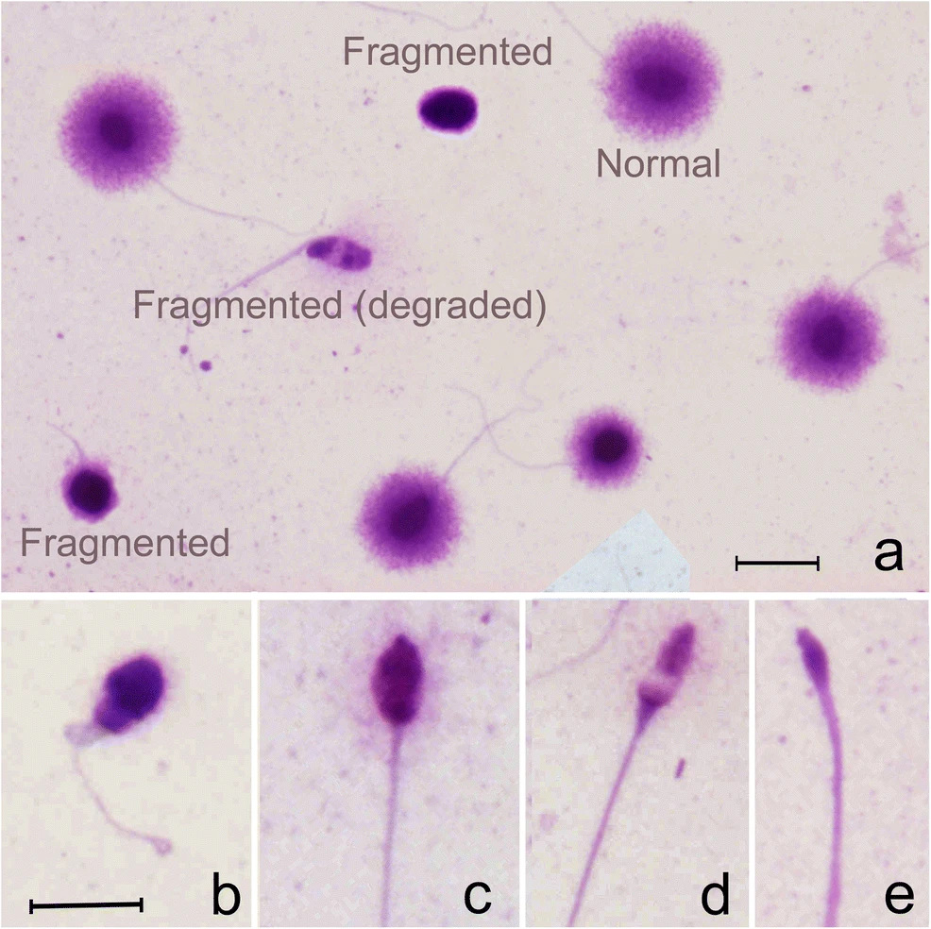
Sperm chromatin dispersion test
The sperm chromatin dispersion (SCD) test is a light microscopy method to evaluate the susceptibility of sperm DNA to acid denaturation. SCD is based on the principle that intact DNA loops expand following denaturation and extraction of nuclear proteins, whereas when DNA is fragmented, dispersion does not develop or is minimal.
a Sperm chromatin dispersion test resulting in the differentiation of three main sperm nuclear morphotypes: (1) normal sperm free of sperm DNA fragmentation and displaying large or moderate sized haloes around a compact core; (2) fragmented sperm displaying small or absence of haloes and (3) fragmented (degraded) sperm showing varying size of the faintly stained nuclear core (b–e).

Slide 4
Semen analysis
Semen analysis involves the following steps :
Placing the specimen container on the bench or in an incubator (37 °C) for liquefaction.
Assessing liquefaction and appearance of the semen.
Measuring semen volume.
Measuring semen pH (if required).
Preparing a wet preparation for assessing microscopic appearance, sperm motility and the dilution required for assessing sperm number.
Calculating the concentration in spermatozoa per ml and the total number of spermatozoa per ejaculate with appropriate chambers.
Mix the semen sample well
Remove an aliquot of semen immediately after mixing, approximately 20 µm deep. Wait for the sample to stop drifting (within 60 seconds).
Examine the slide with phase-contrast optics at ×200 or ×400 magnification.

Slide 5
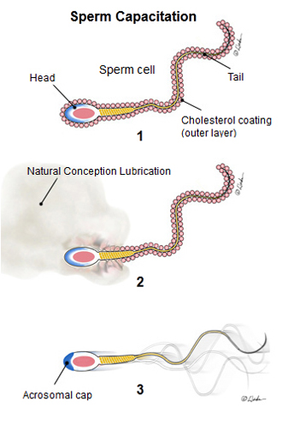
the (-in vivo) capacitation
In vivo, separation of motile sperm most capable of fertilizing oocytes from immotile sperm, seminal plasma or leukocytes is taking place in the female genital tract by active migration through the cervical mucus.
This process also prepares male germ cells for fertilization process by means of fundamental changes called capacitation.
The capacitation involevs changes in the motility pattern, metabolism and the removal of cholesterol from the plasma membrane leadind changed fluidity of the sperm plasam membrane, enabling the sperm to undergo acrosome reaction.

Slide 6
Sperm preparation techniques
In order to select functional sperm or preserve sperm functions, criteria for a good sperm selection are as follows:
Elemination of seminal plasma and debrids
Elimination/ reduction of dysfunctional and ROS-producing sperm
Elimination/ reduction of leukocytes
Elimination/ reduction of bacteria
Enrichment of functional sperm in term of motility, DNA integrity, acrosome reaction and normal sperm morphology
Easy and quick to perform
Cost- effectiveness

Slide 7
Sperm preparation techniques
The choice of sperm preparation technique is dictated by the nature of the semen sample:
If we have a sample with normal count, motility and morphology of sperms (normozoospermia) we choose a sperm washing or a swim up method.
By contrast, with a suboptimal quality sample (severe oligozoospermia, teratozoospermia or asthenozoospermia) we usually prefer a density gradient centrifugation.

Slide 8
Swim up method
By this technique, the sperms are selected on their motility and the capability to swim into the culture medium.
Is performed with the centrifugation of the semen followed by the stratification of the medium over the resuspended pellet.
The liquefied semen is divided in fractions of 1 ml into each tubes, the medium is added (1:1) and after the centrifugation the supernatant is gently removed. Over the resuspended pellet, 0,2- 1 ml of medium is replaced with caution and the tubes is put into the incubator from 30 to 60 min at 37° C (inclined at 45° ); after the migration of the sperms, the volume of the semen to perform the IVF tecnique is removed.

Slide 9
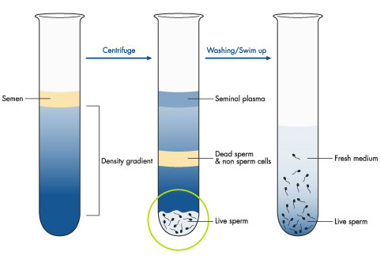
Density discontinuous gradient method
Cells with different density and motility can be selected during the centrifugation by the colloidal silica coated with silane of the gradient; The most applied discontinuous density-gradient is a two layers density-gradient, formed by a top layer of 45% (v/v) and a lower layer of 90% (v/v).
After the fluidification, 1 ml of the semen is layered over the upper layer (45%) and centrifuged.
At the end of the centrifugation, the supernatant is removed and 1 ml of new medium are added. The centrifugation is repeated again in order.
0.2/ 1 ml of medium is replaced with caution on the final pellet and the tubes is put into the incubator from 30 to 60 min at 37° C (inclined at 45°).

Slide 10
ART mechanism
Assisted reproductive technology increases the pregnancy by a double mechanism:
It facilitates the interaction between spermatozoa and oocytes;
it bypasses seminal abnormalities, such as a reduced number, motility or increased morphological defects of spermatozoa.

Slide 11
Indications for intracytoplasmic sperm injection (ICSI)
Oligo-astheno-teratozoosermia
No or poor fertilization in previous attempts of IVF
Frozen-thawed spermatozoa with poor survival
Epididymal/testicular spermatozoa
The microinjection techniques allow to obtain an "in vitro" fertilization also in the presence of severe male factor infertility.

Slide 12
The role of spermatozoa in fertilization and embryo development
The role of spermatozoa in fertilization and embryo development was minimized to being a carrier that transports DNA to the oocyte.
It is now proved that human spermatozoa play an extensive role that extends even beyond the early stages of fertilization to include abnormal embryogenesis leading to implantation failure (Barroso et al., 2009).
Several studies have demonstrated a positive correlation between sperm morphology and positive ICSI outcomes.

Slide 13
Influence of sperm morphology
Sperm morphology was suggested to play an important role in determining fertility and was proven to be closely related to fertilization rate, embryo morphology and pregnancy rate

Slide 14
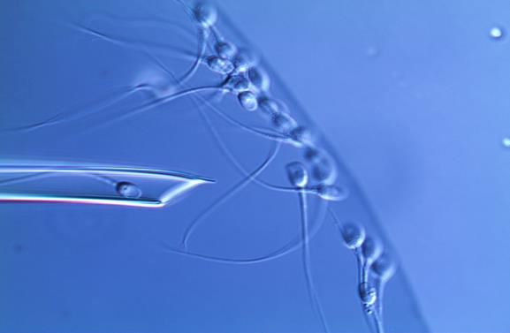
Importance of sperm selection
Routine sperm preparation techniques such as density gradient centrifugation and swim-up are currently used as main components of ART procedures. These routine techniques appear to be equally effective in selecting motile, morphologically normal sperm (Le Lannou and Blanchard, 1988).
However, other sperm characteristics such as apoptosis and apoptosis-like manifestations, DNA integrity, membrane maturation and ultrastructure are not directly targeted by routine sperm preparation techniques. These characteristics could be influenced by sperm selection and concomitantly be important determinants of fertility.
Which shall I choose?!?!!

Slide 15
New sperm selection methods
Several advanced sperm selection methods have been developed with the objective of improving sperm preparation protocols used during ART.
These methods aim at isolating mature, structurally intact and non-apoptotic spermatozoa with high DNA integrity.
While ICSI has revolutionized ART and offered an effective treatment option for severe male factor infertility, its application, if using spermatozoa with defective DNA, may result in serious consequences for the offspring.
(Ji et al., 1997; Aitken et al., 2003; Aitken and De Iuliis, 2007).

Slide 16
Sperm selection
Transmission electron microscopy and scanning electron microscopy: ultramorphological analysis of subcellular organelles
SCSA, Tunel assay, SCD test: Nuclear integrity analysis
FISH test: chromosomal integrity
These techniques do not allow a real-time analysis of the sample. Therefore they are to be considered only for screening.

Slide 17
Sperm selection
Selection based on sperm birefringence
Selection based on sperm surface charge : Microflow® CS- 10, potenziale elettrico.
Non–apoptotic sperm selection: Magnetic Activated Cell Sorting (MACS).
Selection based on sperm membrane maturity: Physiological ICSI (PICSI).
Selection based on sperm ultramorphology: Intracytoplasmatic Morphologically Selected Sperm Injection (IMSI).
These techniques provide a real-time selection of spermatozoa for ICSI

