Slide 1
Sperm selection based on birefringence
The presence of birefringence is the expression of an organized and very compact texture that characterizes normal sperm nuclei, acrosomes, and motile tails.
On the basis of these considerations, the application of polarization microscopy to the ICSI technique has been proposed as a novel tool for sperm selection, based on the properties of birefringence that human spermatozoa naturally possess.

Slide 2
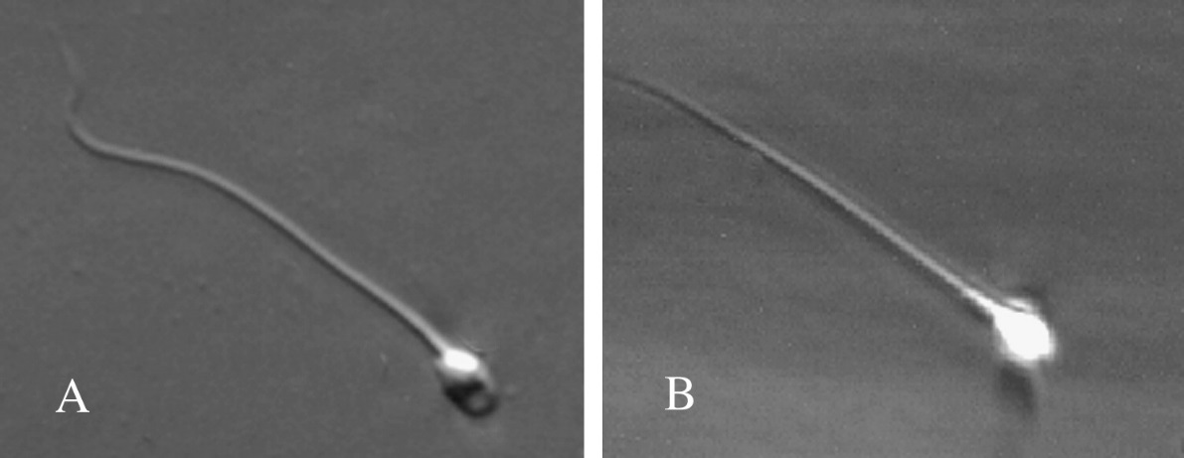
Sperm selection based on birefringence
Gianaroli. Selection of reacted spermatozoa for ICSI. Fertil Steril 2010
(A) The localization of birefringence in the postacrosomal region indicates that the acrosome reaction has already occurred. (B) The presence of birefringence in both compartments of the head, acrosome, and nucleus, identifies an intact acrosome in a nonreacted spermatozoo.
It is well known that the acrosome reaction includes a series of events that sperm cells need to undergo to naturally achieve fertilization of the oocyte.

Slide 3
Sperm selection based on birefringence
Recent studies document an association between sperm head birefringence and DNA integrity:
Damage in DNA structure could negatively affect the sperm capacity to undergo the acrosome reaction and the consequent steps following its entry into the oocyte.
Petersen et al., 2011
The polarized light also permitted easily visualization of irregularities such as vacuoles in the sperm head.
Magli et al., 2012

Slide 4
Sperm selection based on birefringence
Total birefringence
Partial birefringence
Abnormal birefringence
Analysis of birefringence type was used to distinguish spermatozoa on the basis of their acrosome integrity, to evaluate whether some differences could derive from the injection of either reacted or nonreacted sperm cells. Apparently there was no effect on the fertilizing capacity of either type of sperm, nor on the initial cleavage divisions of the fertilized oocytes and consequent embryo quality. Nevertheless, the viability of the generated embryos was significantly different, suggesting that spermatozoa that have undergone the acrosome reaction seem to be more prone to supporting the development of viable embryos.

Slide 5
Selection based on sperm surface charge
Microflow® Cell Sorter – 10 An electrophoresis-based technology has been developed to separate spermatozoa based on size and electronegative charge.
The size criterion ensures that only spermatozoa are included, while leukocytes and immature germ cells are excluded.
An electronegative surface charge indicates that the sperm is normally differentiated and has CD52 on its surface: CD52 expression was found to be correlated with normal sperm morphology and capacitation (Giuliani et al., 2004).
Ainsworth et al., 2005

Slide 6
Selection based on sperm surface charge
Potenziale ζ electric potential between the sperm membrane and its surroundings measuring - 16 to -20 mV in mature sperm.
The zeta potential further decreases with capacitation (Della Giovampaola et al., 2001). The method entails pipetting washed sperm into a positively charged centrifuge tubes. Thereafter, adhering (negatively charged, mature) sperm can be retrieved by rinsing the tube with serum-supplemented media.
Mature sperm
Immature sperm
Chan et al., 2006

Slide 7
Non-apoptotic sperm selection
The externalization of phosphatidylserine (PS) to the outer surface of the sperm membrane, a feature of early apoptosis, has been used as a basis for selection of non-apoptotic spermatozoa.
Microbeads
Apoptotic sperm
Non apoptotic sperm
Said TM et al., 2008
A heterogeneous sperm cell suspension is incubated with Annexin-V-conjugated microbeads, which bind to only apoptotic sperm with externalized PS. Thereafter, the bead/sperm mixture is allowed to run through the MACS column, which is placed inside a magnet. The magnetic force will cause the retention of the cells labeled with microbeads inside the column, while the nonlabeled cells will freely ﬂow (Manz et al., 1995).

Slide 8
Effects on sperm quality
Non-apoptotic sperm selection is simple, fast, inexpensive and highly speciﬁc.
However, the combination of DGC and MACS will involve repeated steps of centrifugation and re-suspension, which might be detrimental when applied to semen samples characterized by limited sperm counts, as low sperm recovery may be expected.
In addition, the technique still requires special laboratory equipment, which may not be feasible or available in all settings.
Said et al., 2008

Slide 9
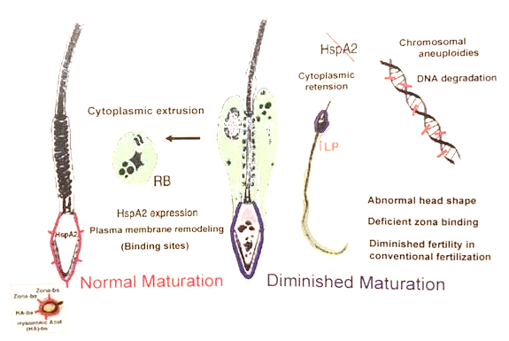
Selection based on sperm membrane maturity
The formation of hyaluronic-acid (HA)-binding sites on the sperm plasma membrane is one of the signs of sperm maturity.
Huszar et al., 1997
There is a relationship between the levels of hyaluronic-acid (HA)-binding sites in elongated spermatids and the related spermiogenetic events, such as cytoplasmatic extrusion, formation of the normal sperm shape or the sperm plasma membrane remodeling.

Slide 10
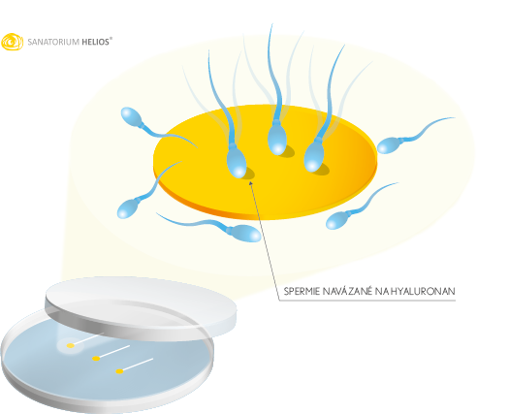
Selection based on sperm membrane maturity (PICSI)
The formation of hyaluronic-acid (HA)-binding sites on the sperm plasma membrane has been used as a basis for sperm selection.
Huszar et al., 1997
(A) A sperm drop is placed at the periphery of a HA drop, mature sperm binds to the HA-spot, while immature sperm moves freely. (B) Bound sperm could be picked up with the ICSI pipette.
Jakab et al., 2005

Slide 11
Effects on sperm quality
When compared with spermatozoa prepared by DGC, HA-bound spermatozoa have displayed:
a greater degree of maturity
a positive correlation with motility
less DNA fragmentation
But it does not provide any additional information about the sperm morphology.
Tamer et al., 2011

Slide 12
ULTRA-HIGH MAGNIFICATION (IMSI)
SPERM SELECTION
Sperm morphology has been described as one of the major determinants of male in vivo and in vitro fertility.
A new sperm selection method has been developed based on the inclusion of only normal sperm assessed using real-time motile sperm organelle morphology examination (MSOME) at a magniﬁcation of ×6300.
Bartoov et al., 2002
(A) Semen observed by conventional magnification (400X); (B. C. D) Semen observed by MSOME (x 6300).

Slide 13
ULTRA-HIGH MAGNIFICATION (IMSI)
SPERM SELECTION
During MSOME, a micro-droplet of motile sperm suspension prepared by a routine sperm preparation technique is examined under oil immersion, with an inverted light microscope ﬁtted with high power Nomarski optics (differential interference contrast optics) with digital enhancement. Multiplying the lens magnification, with that of selector, camera and monitor, the final magnification will be equal to 6600 X.

Slide 14
ULTRA-HIGH MAGNIFICATION (IMSI)
SPERM SELECTION
MSOME assesses ﬁve sperm organelles (acrosome, postacrosomal lamina, neck, tail and mitochondria) that can be classiﬁed as either normal or abnormal. The sixth organelle (the nucleus) is evaluated for both shape and chromatin content (vacuolar area).
Head: the shape has to be smooth, symmetric and oval. The chromatin mass has to be homogeneous and contain no extrusion or invaginations with a maximum of one vacuole involving less than 4% of the nuclear area.
Acrosome and post acrosomal lamina: they were considere abnormal if absent, partial or vesiculated.
neck: an abaxial neck with disorderes or cytoplasmatic droplets was considered abnormal.
Tail: was considered abnormal if broken, short or double.

Slide 15
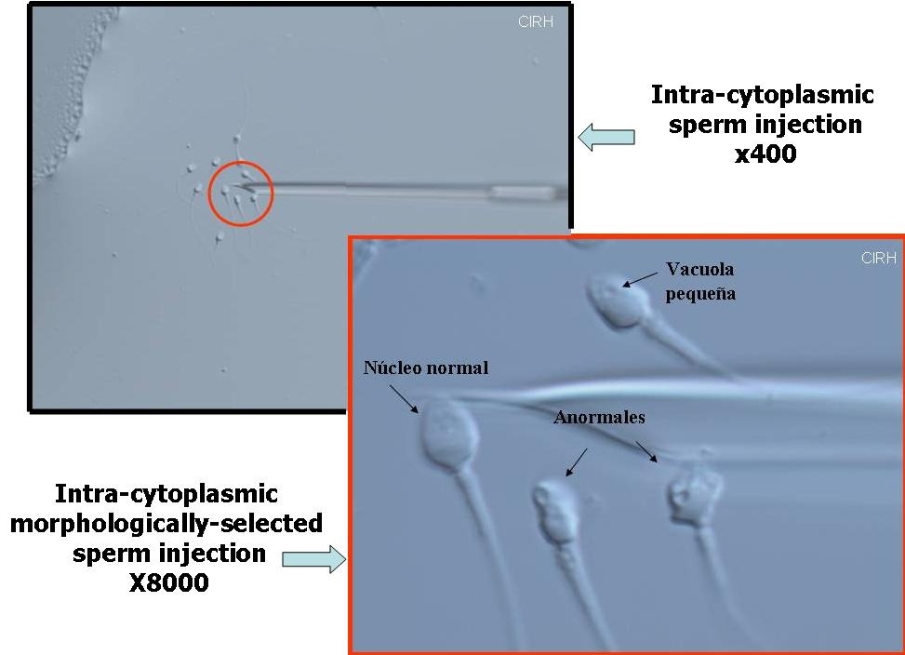
Imsi Bartoov et al., 2003
This approach is of particular beneﬁt when used in situations where identiﬁcation of speciﬁc sperm organelles is required, such as the acrosomal components in cases of globozoospermia .
Check et al., 2007

Slide 16
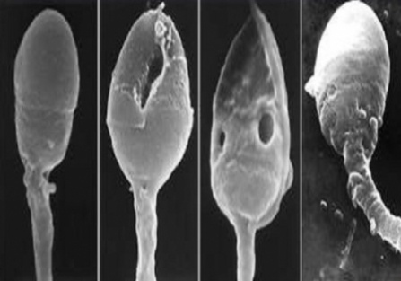
MAIN TOPICS
- BASIC SEMEN ANALISYS
- SELECTION OF SPERMATOZOA FOR ICSI
THEROICAL LESSON
“ATLAS OF HUMAN SEMEN”
……YOU HAVE TO CHOOSE!!!.......
INTERACTIVE LESSON

