Slide 1

INTRA- CYTOPLASMATIC
SPERM INJECTION
(ICSI)
ICSI must be performed after 3 hours of incubation: during washing of sperm and capacitation, the COC’s are able to reach also the cytoplasmic maturity. But, differently to fivet, we must to remove the cumulus cells and check for the nuclear maturity of each oocytes harvested. Immediately, we have to perform ICSI only on MII oocytes.
3 hours
after retrieval
MII
MI
NAME AND I.D. NUMBER
GV
Keep attention: oocyte denuding can be performed in HTF without hepes for skilled embryologist. During training, it’s better to use HTF with hepes in ordet to avoid the pH rise outside incubator.

Slide 2
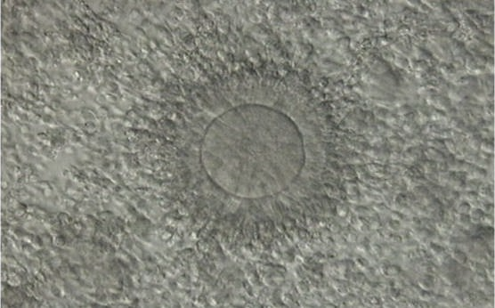
CUMULUS-ENCLOSED OOCYTES
During the preovulatory growth, within the follicle, the oocyte is surrounded by two different somatic cell layers: granulosa and thecal cells that sustain oocyte nutrition and maturation providing essential metabolites, hormones, and growth factors.
The outer CCs separated from each other by extracellular matrix
The corona cells (granulosa) immediately adjacent to the oocyte becoming less compact and radiating away from the ZP.

Slide 3
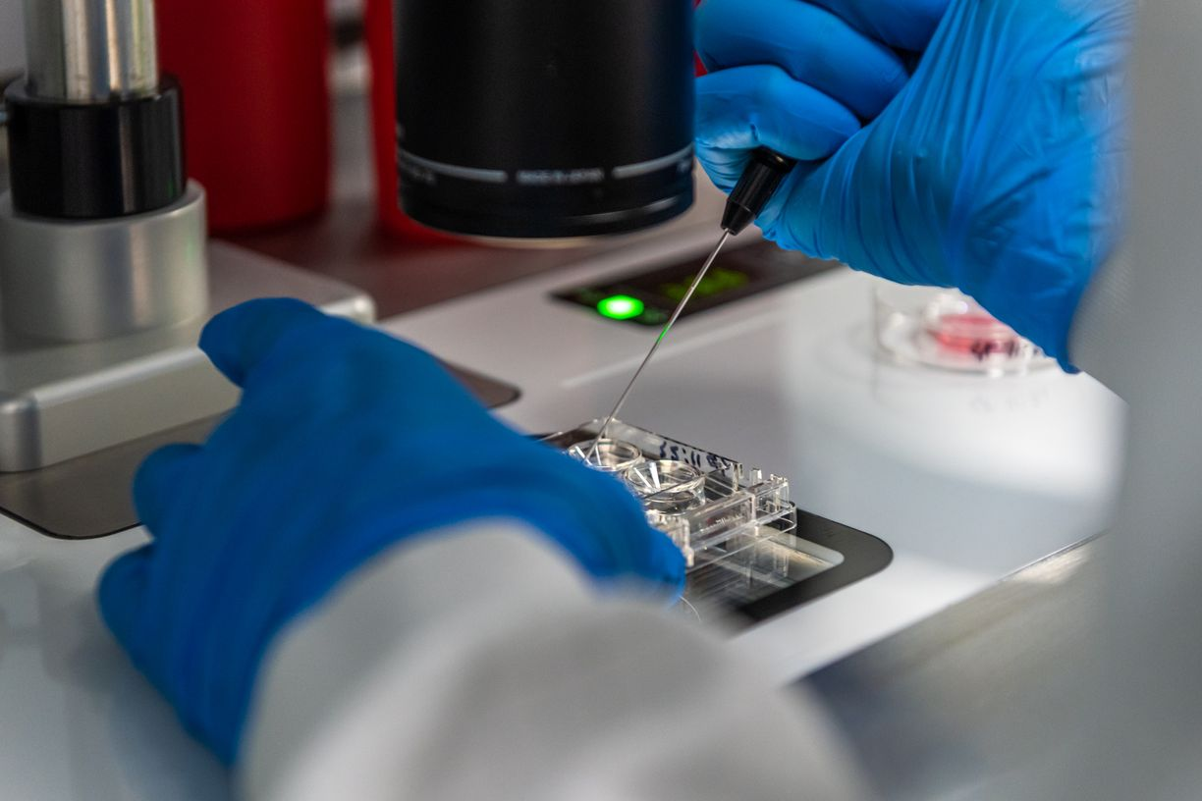
oocyte denuding
https://www.youtube.com/watch?v=xI1Hd8CZxnM

Slide 4
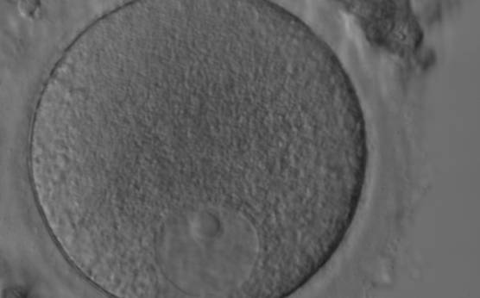
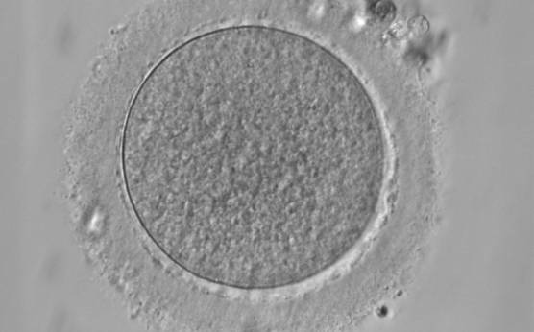
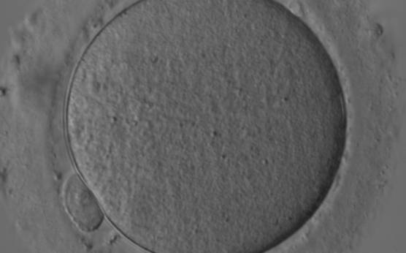
OOCYTE MATURATION STAGE
GV
MI
GV oocyte with an eccentrically placed nucleus and a prominent single nucleolus
MI oocyte. This oocyte has no visible nucleus and has not as yet extruded the PBI
MII
ZPV
Denuded MII oocyte; an intact PBI is clearly visible in the PVS
An empty zona pellucida

Slide 5
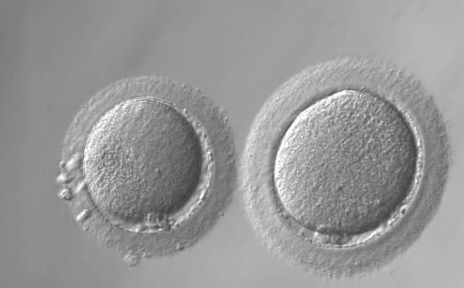
OOCYTE SIZE AND SHAPE
Normal-sized oocyte next to giant oocyte (right)

Slide 6
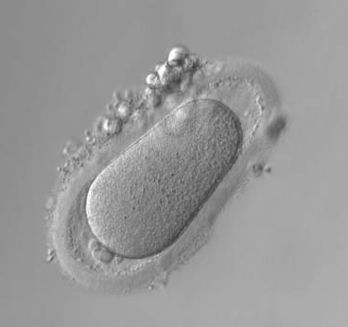
OOCYTE SIZE AND SHAPE
Note the ZP is ovoid in appearance and the PVS is enlarged at both poles
Twin oocytes in a single zona pellucida

Slide 7
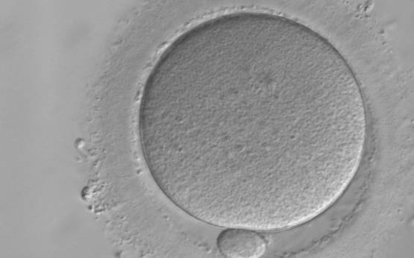
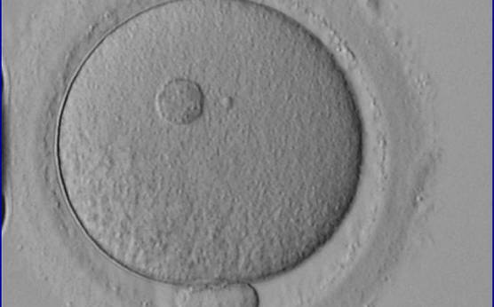
CYTOPLASMIC FEATURES
Normal homogenous cytoplasm in an MII oocyte
MII oocyte showing a large refractile body

Slide 8
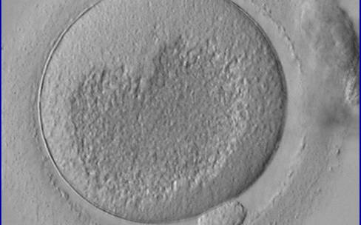
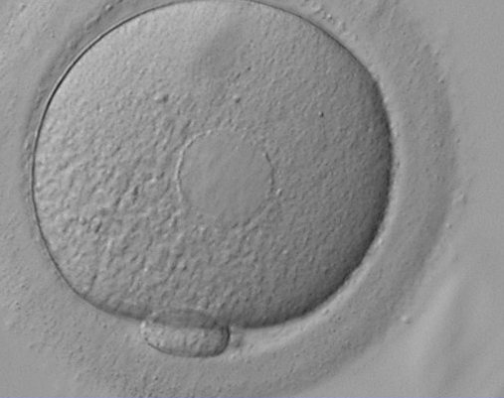
CYTOPLASMIC FEATURES
MII oocyte showing a very large centrally located granular area
MII oocyte showing plaques of dilated SER discs in the cytoplasm

Slide 9
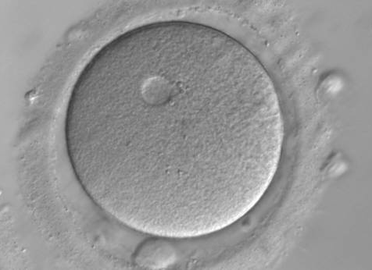
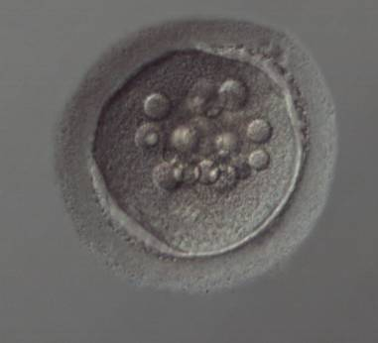
CYTOPLASMIC FEATURES
Vacuolated oocyte
Vacuolated oocyte

Slide 10
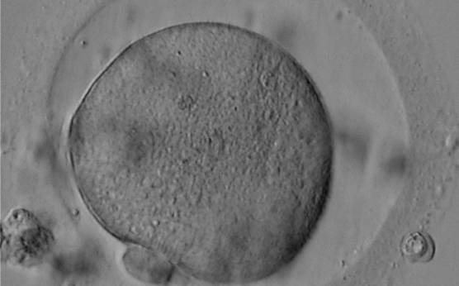
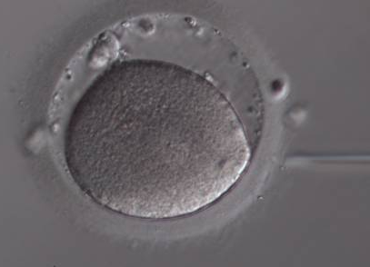
PERIVITELLINE SPACE
Oocyte with a large PVS and a granular cytoplasm.
Oocyte with a large PVS.
Several fragments are present in the PVS.

Slide 11
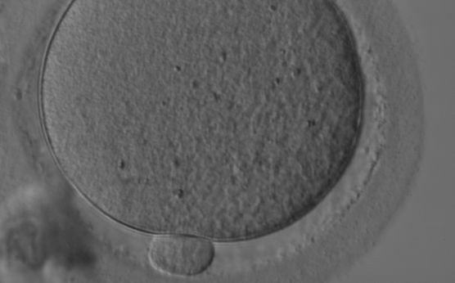
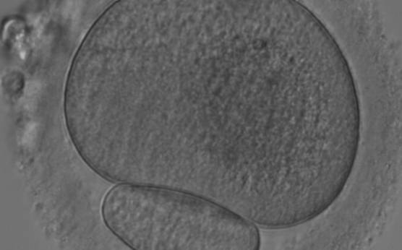
POLAR BODY
A normal-sized PBI.
A giant PBI.

