Slide 1
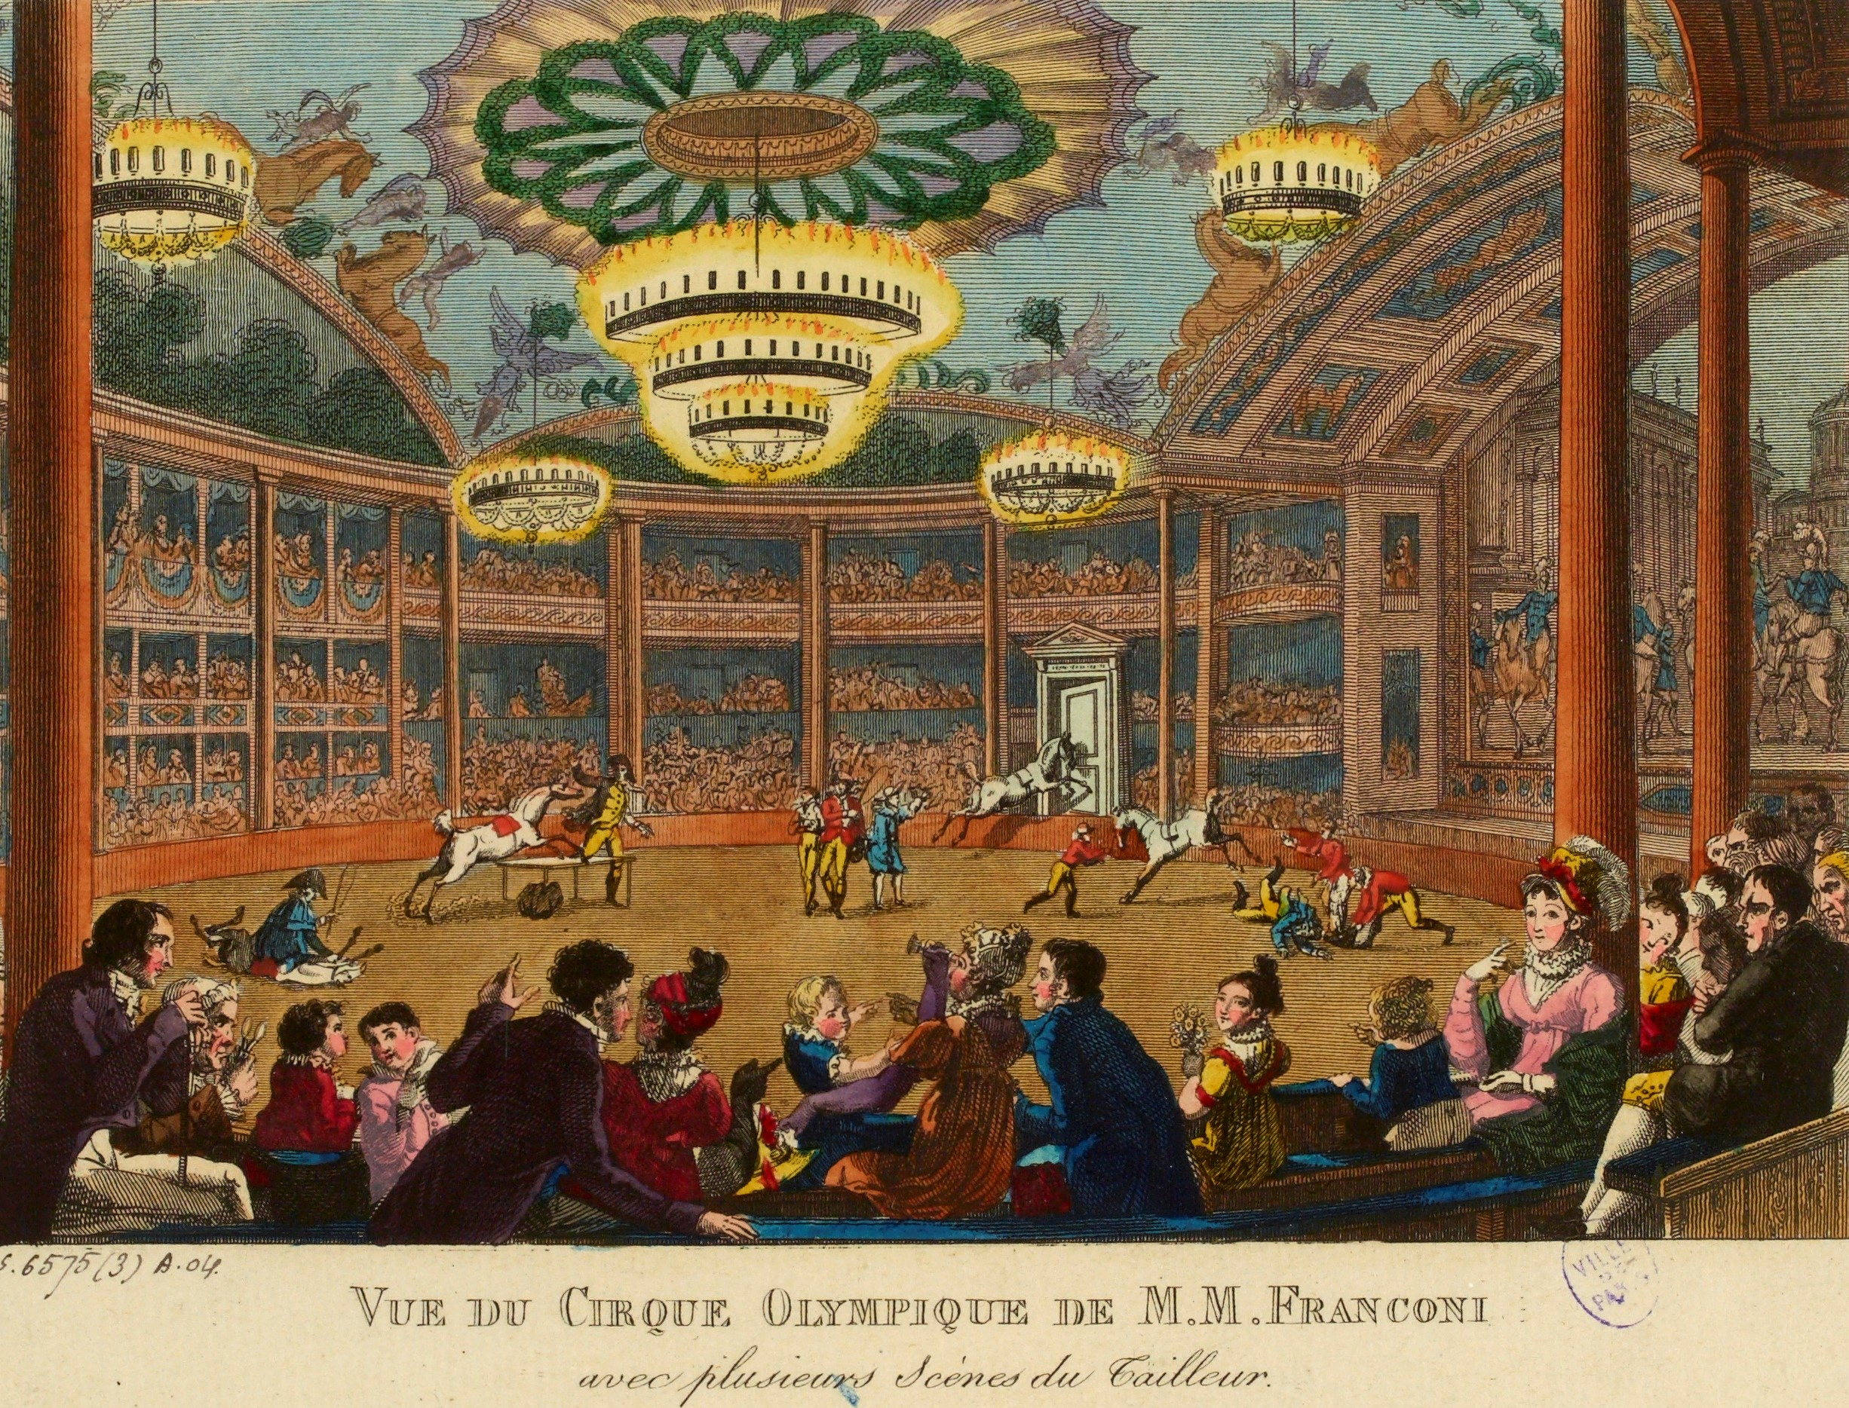
CULTURAL HISTORY AND FASHION
1st-Cycle Degree in Studies in Visual Arts, Music and Performance Artsin – 2° Year
University of Teramo (Italy)
Prof. Daniele Di Bartolomeo

Slide 2
Course Catalogue

Slide 3
E-LEARNING PLATFORM

Slide 4
UNIVERSITY PLANNER

Slide 5
BOOKS EXCERPT

Slide 6
BOOK EXCERPT

Slide 7
CULTURAL HISTORY AND FASHION
1st-Cycle Degree in Studies in Visual Arts, Music and Performance Artsin – 2° Year
University of Teramo (Italy)
Prof. Daniele Di Bartolomeo

