Slide 1

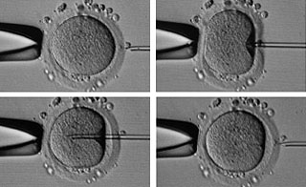
MAIN TOPICS
- ASSISTED REPRODUCTIVE TECHNIQUES
The oocyte retrieval (Pick-Up);
In-vitro insemination;
Intracytoplasmatic Sperm Injection (ICSI);
Assisted zona hatching;
Blastocyst biopsy;
Pre-implantation genetic diagnosis and embryo screening;
Vitrification of oocytes and embryos.
THEROICAL LESSON

Slide 2

FOLLICOLAR GROWTH MONITORING
INTRA-UTERINE
INSEMINATION (IUI)
OOCYTES VITRIFICATION
OOCYTE RETRIEVAL
SURGICAL SPERM RETRIEVAL
(EVENTUALLY CRYOPRESERVATION)
IVF-ICSI
EMBRYO VITRIFICATION
OOCYTES THAWING
PREIMPLANTATION GENETIC
SCREENING OR DIAGNOSIS
EMBRYO TRANSFER
EMBRYO THAWING

Slide 3
“PICK-UP”: THE OOCYTE RETRIEVAL
PERFORMED INSIDE THE THEATRE UNDER ANESTHESIA (PROPOFOL)
IN PRESENCE OF ANESTHESIST, GYNECOLOGYST, NURSE AND BYOLOGYST
ULTRASOUND-GUIDED WITH 17 GAUGE NEEDLE (FOLLICULAR PUNCTURE)
PERFORMED 35 (URINARY HCG) OR 36-38 (RECOMBINANT HCG OR
GNRH-AGONIST) HOURS AFTER HCG ADMINISTRATION
OVARIAN
follicular fluid
COC’s
HEPES OR MOPS BUFFERED MEDIUM
BICARBONATE BUFFERED
MEDIUM
OPERATION THEATRE
WORKSTATION INSIDE LABORATORY
INCUBATOR

Slide 4
“PICK-UP”: THE OOCYTE RETRIEVAL
The cumulus-oocyte-complexes are retrieved from follicular fluid, washed and stored temporary in a clean dish filled of Hepes Buffered Medium. At the end of pick-up, COC’s are sorted by nuclear stage maturity in a new 4 well dish (bicarbonate buffer medium filled) and left in a CO_{2/}O₂ incubator for 3 hours.
PROBABLY GV
WASH TWICE
WASH TWICE
SCREENING DISH
FOLLICULAR FLUID MIXED WITH
HEPES MEDIUM CONTAINING COC’s
TEMPORARY STORAGE
DISH WITH COC’s INSIDE
PROBABLY MI
PROBABLY MII
Medium utilized:
HTF/wHEPES
HTF

Slide 5
Environmental Condition
Incubator Condition
CO₂ 0,04%
O₂ 21 %
CO₂ 6%
O₂ 5%
HEPES/MOPS buffer medium
CHO₃⁻ buffer medium
In order to maintein the pH intracellular

Slide 6

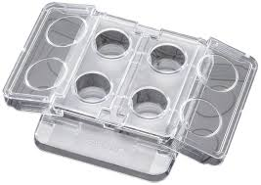
“PICK-UP”: THE OOCYTE RETRIEVAL
COC’s WHASHING
AREA
COC’s STORAGE
AREA
TEMPORARY STORAGE CENTER WELL DISH
FOR COC’s PRIOR TO INCUBATION
4 WELL DISH FOR COC’s INCUBATION
AFTER OOCYTE RETRIEVAL

Slide 7
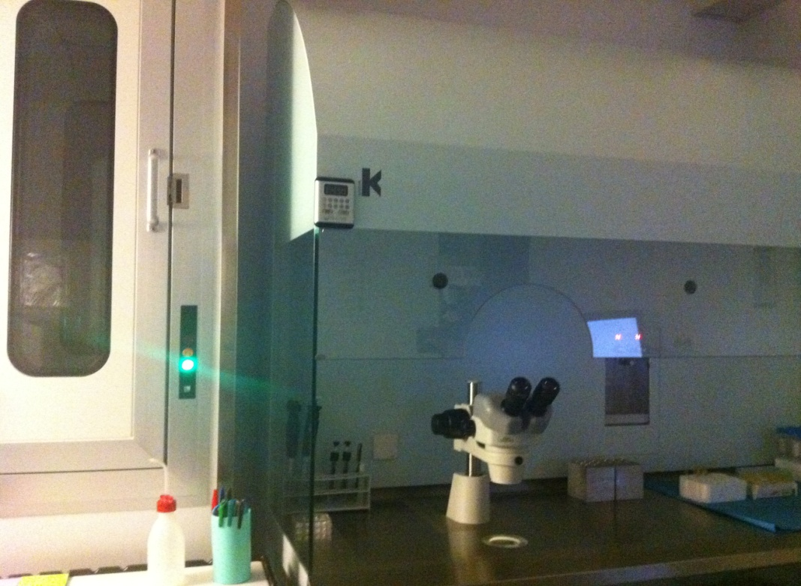
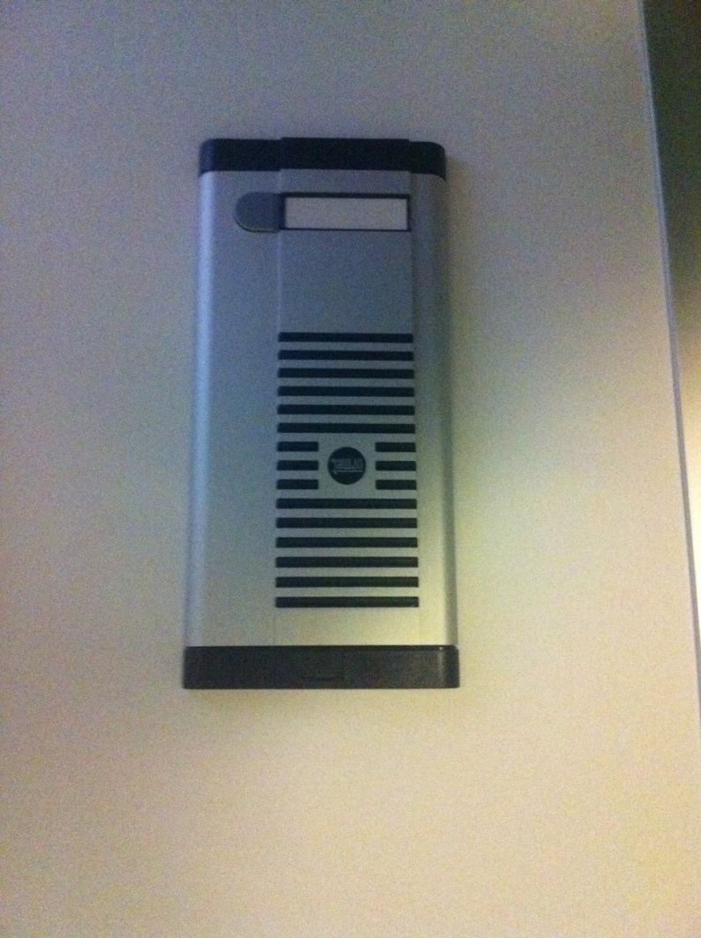
“PICK-UP”: THE OOCYTE RETRIEVAL
Keep attention: working temperature and timing of COC’s outside incubator.
TERMOBLOCK
“PASS BOX” (IN ORDER TO
MAINTAIN ASEPTIC CONDITIONS)
WORKSTATION
HEATED STAGE
(..TO MANTAIN THE CORE BODY TEMPERATURE)

Slide 8
IN-VITRO INSEMINATION
3 hours after retrieval: we have to choose the tecnique!
CONVENTIONAL IN-VITRO INSEMINATION
(FIVET)
- TUBAL OBSTRUCTION
NORMAL TO MODERATE OAT SEMEN SAMPLE
ENDOMETRIOSIS
PREVIOUS FAILURE WITH I.U.I.
INTRACYTOPLASMATIC SPERM INJECTION
(ICSI)
MODERATE TO SEVERE OAT SEMEN SAMPLE
SURGICAL SPERM RETRIEVAL (TESE/TESA/MESA)
OOCYTE THAWING
NO TO LOW FERTILIZAION RATE AFTER FIVET

Slide 9
CONVENTIONAL IN-VITRO INSEMINATION
FIVET must be performed after 3 hours of incubation. The COC’s are able to reach the cytoplasmic and nuclear maturity.
Optimal sperm concentration inside each well is100.000 motile spz/COC.
WASH
WASH
NAME AND I.D. NUMBER
NAME AND I.D. NUMBER
NAME AND I.D. NUMBER
3 hours after retrieval
1 hour after insemination…
until fertilization check (16-18 hours post insem.)
Medium utilized: HTF (“Human Tubal Fluid”) (Quinn, P.)

Slide 10
CONVENTIONAL IN-VITRO
INSEMINATION

Slide 11
CONVENTIONAL IN-VITRO
INSEMINATION

Slide 12
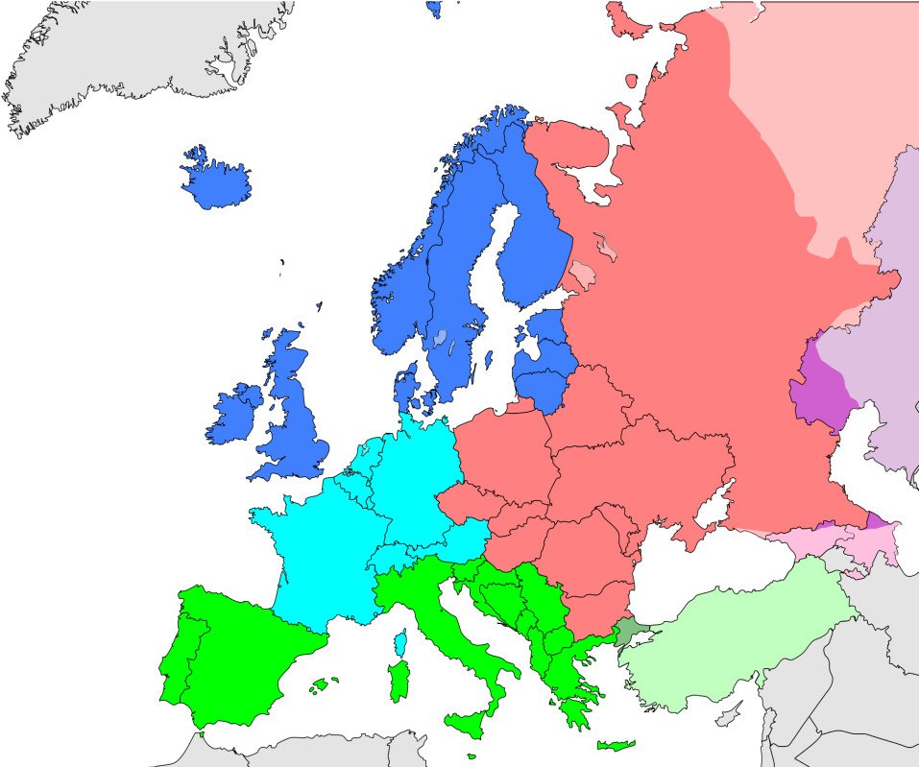

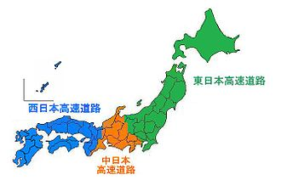
CONVENTIONAL IN-VITRO
INSEMINATION
FIVET TREATMENTS DISTRIBUTION WORLWIDE
10-20%
30-40%
˃ 50%
Due to the mean age of the patients and the mean percentage of oocytes harvested, in Europe biologist perform ICSI also when unnecessary.

Slide 13
CONVENTIONAL IN-VITRO
INSEMINATION
Eftekar et al. (2012). “Comparison of conventional IVF versus ICSI in nonmale factor, normoresponder patients”. J Reprod Med Vol. 10. 131-136

