Slide 1
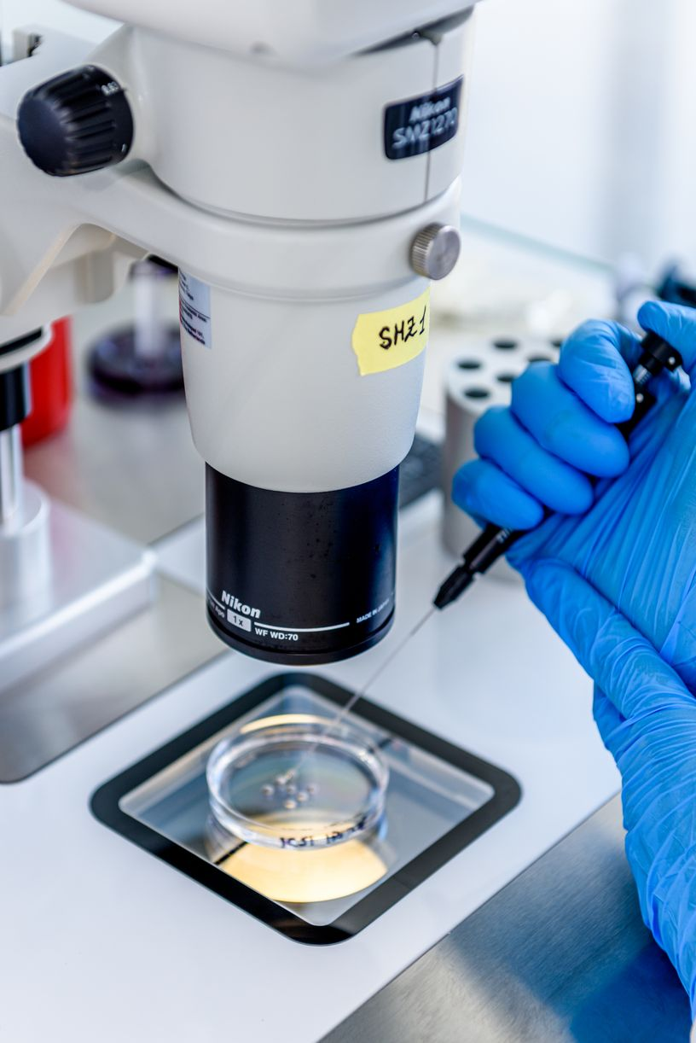

THE ICSI DISH
The drops must to be
covered with 5 ml of
light mineral oil
10 μl HEPES-HTF +
oocyte
5 μl PVP +1-2 μl
of treated sperms
NAME AND
PATIENT I.D.
The lid of a 65 x 10 mm
Petri dish has the optimal
refringence at the inverted
microscope

Slide 2
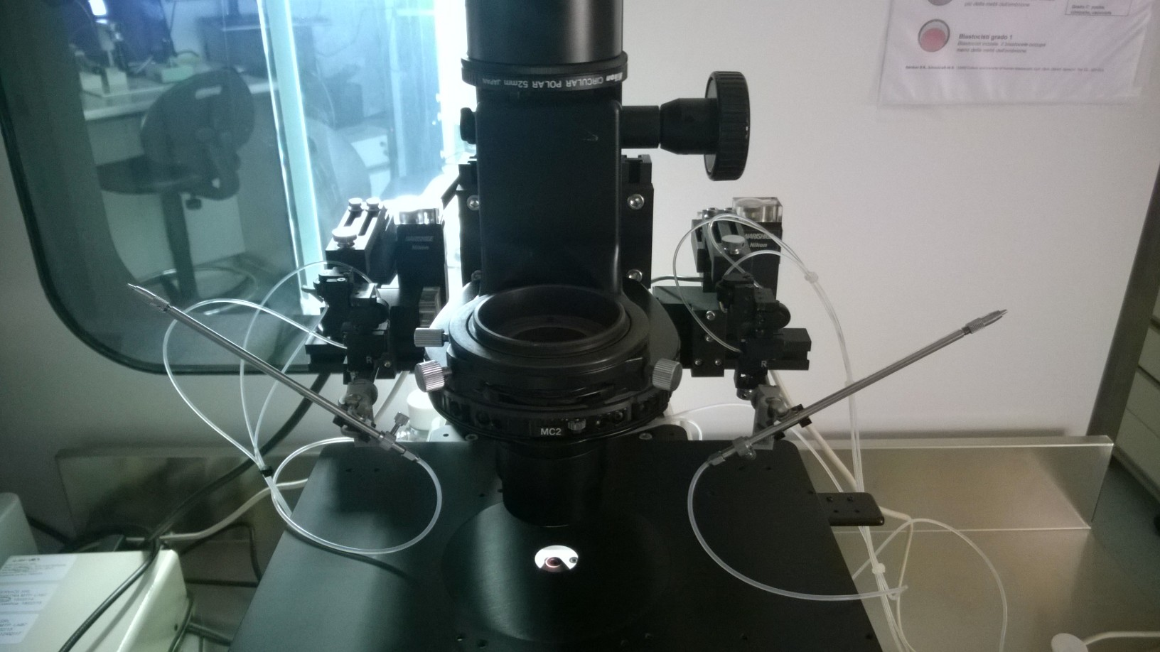
SET UP OF THE MICROMANIPULATION STATION
HOLDING PIPETTE
30-35° BEVEL
PARALLEL WALL
20-25 μM OF ID
INJECTION PIPETTE
30-35° BEVEL
PARALLEL WALL
4-5 μM OF ID
MAGNIFICATION
40 X FOR BETTER SPERM SELECTION

Slide 3
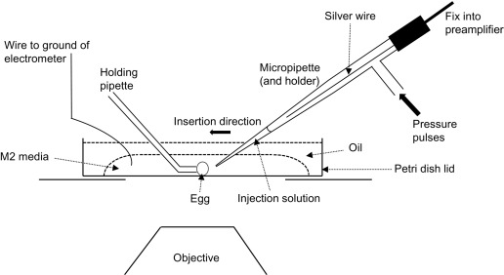
SET UP OF THE MICROMANIPULATION STATION
https://www.youtube.com/watch?v=bd442apDyus

Slide 4
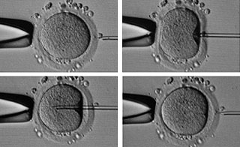
SPERM SELECTION AND IMMOBILIZATION (INSIDE PVP DROP)
Select the sperm and immobilize it going
down to the sperm tail
4. With the sperm inside, move the injection to
the drop of the oocyte
Move the injection to right: the sperm head become
to swirl
Touching the sperm tail, put the sperm orizzontally and
aspire it into the injection
https://www.youtube.com/watch?v=uvmBRTFG7Vo&t=220s

Slide 5
OOCYTE INJECTION (INSIDE OOCYTE DROP)
Hold the oocyte with a
gentle suction putting the
pb at 6 or 12 hrs. Focuse
on the inner layer of ZP
and oolemma. The sperm
is at the tip of injection.
3. Perform a
vigorous cytoplasm
aspiration until the
membrane of the oocyte
brake down. Immediately,
invert the direction in
order to release the sperm.
Release the sperm
inside the cytoplasm and
move back the injection
pipette. Gently, release the
oocyte from the holding
suction.
2. Move the injection
trough the ZP and
oolemma. Stop the
moviment at ¾ of the
oocyte cytoplasm.
https://www.youtube.com/watch?v=uvmBRTFG7Vo&t=220s

Slide 6
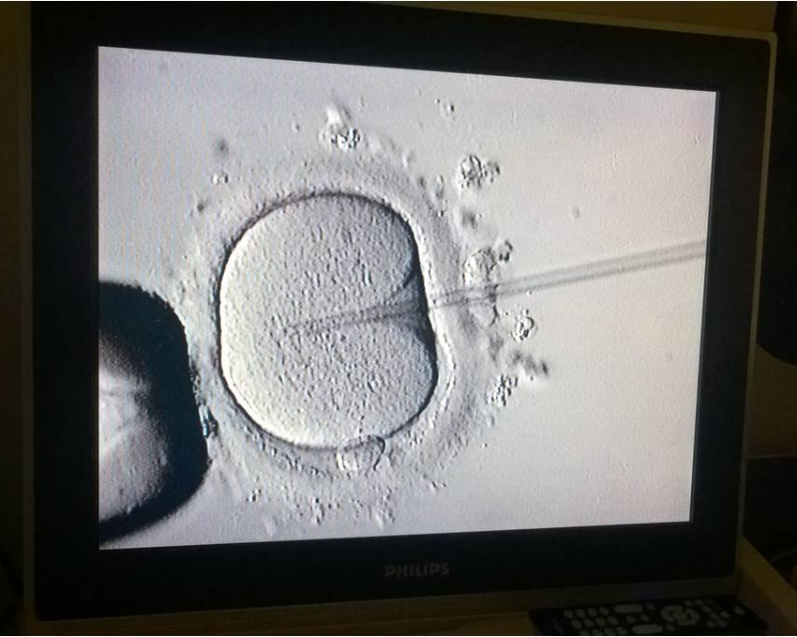
INTRACYTOPLASMATIC SPERM INJECTION (ICSI)
SPERM RELEASE
TIP OF INJECTION
AT ¾ OF THE OOCYTE
INJECTION PIPETTE
30-35° BEVEL
PARALLEL WALL
4-5 μM OF ID
HOLDING PIPETTE
30-35° BEVEL
PARALLEL WALL
20-25 μM OF ID
POLAR BODY
12 OR 6 0’CLOCK
PRESERVE MEIOTIC
SPINDLE

Slide 7
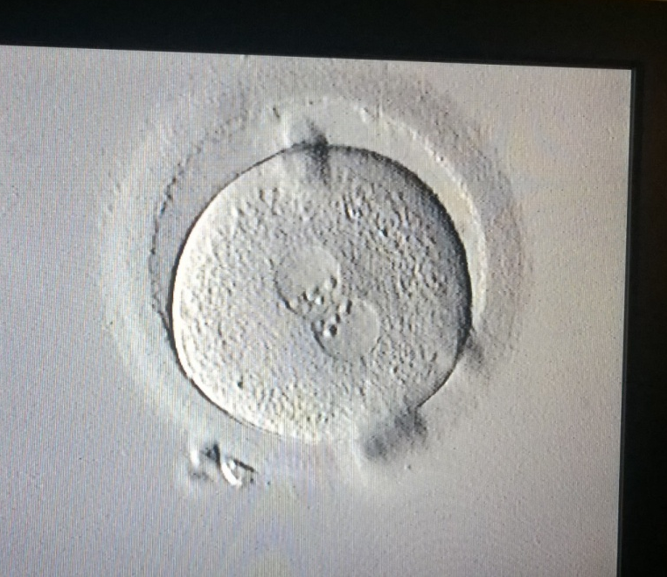
INTRACYTOPLASMATIC SPERM INJECTION (ICSI)
The occurence of fertilization has to be checked
between 16 and 18 hours after insemination
In case of FIVET insemination, the oocyte must be
denuded from the corona cells eventually attached
In case of ICSI, the oocyte has alredy been denuded,
so the check can be done directly at the inverted microscope
CULTURE ONLY FOR 2PN ZYGOTE !!!
DESCARD: 1 PN ZYGOTE; 3 OR MORE PN ZYGOTE; 0 PN
ZYGOTE WITH ONLY 1 CLEARLY VISIBLE PB
Grade 1 zygote: 2 distinct pronucleous with nucleolus aligned and ready to singamy.

Slide 8
ZYGOTE SCORING
Grade 1: aligned, equality in NPB’s
Grade 3: non equality in alignement
Grade 2: scattered, eqaulity in NPB’s
Grade 4: non eqaulity in numbers
Scott, L., Finn, A.,”Morphologic parameters of early cleavage-stage embryos that correlate with fetal development and delivery.” 2007. Human Reproduction, 22 pp. 230–240.

