Slide 1

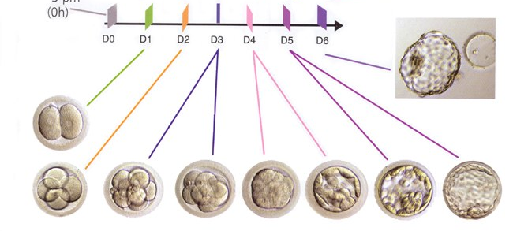
EMBYO DEVELOPMENT
A deﬁning moment in embryonic development is when ﬂuid starts to accumulate between cells at the morulae stage of development. As the ﬂuid’s volume increases, a cavity appears gradually forming the blastocoel.

Slide 2
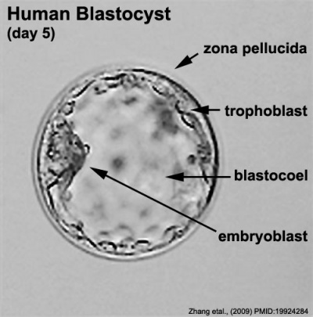
BLASTOCYST DEVELOPMENT
As the ﬂuid inside the newly formed blastocyst increases, so does the number of cells, and the combination of these two features causes a progressive enlargement of the blastocyst and it’s cavity with a consequent progressive thinning of the zona pellucida (ZP).

Slide 3
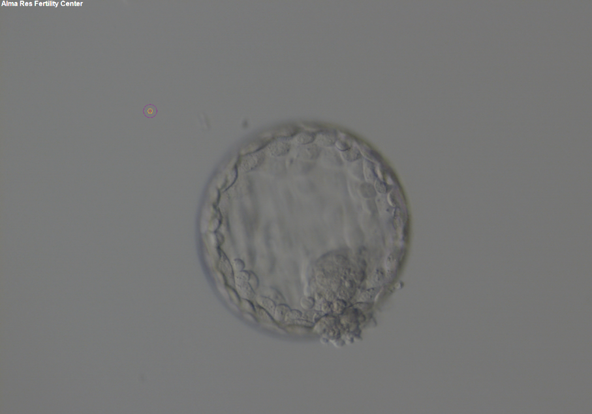
BLASTOCYST DEVELOPMENT
Finally, the blastocyst breaks free of the ZP through a process called hatching.

Slide 4
Gardner
blastocyst grading system
The Gardner blastocyst grading system assigns 3 separate quality scores to each blastocyst embryo:
Blastocyst development stage - expansion and hatching status
Inner cell mass (ICM) score, or quality
Trophectoderm (TE) score, or quality

Slide 5
Gardner
blastocyst grading system
Expansion grade | Blastocyst development and stage status
1 | Blastocoel cavity less than half the volume of the embryo
2 | Blastocoel cavity more than half the volume of the embryo
3 | Full blastocyst, cavity completely filling the embryo
4 | Expanded blastocyst, cavity larger than the embryo, with thinning of the shell
5 | Hatching out of the shell
6 | Hatched out of the shell
1
2
3
4
5
6

Slide 6
Gardner
blastocyst grading system
Once the blastocyst has reached an expansion grade of 3 or more, a clear distinction can be made between the two newly formed cell populations:
The outer cells of the blastocyst, forming the blastocyst structure itself are called the TE cells. The destiny of the TE is to become associated extra-embryonic structures.
The cells located inside the blastocoel, often forming a cell clump at one pole of the blastocyst, are called the ICM cells. The destiny of the ICM is to become the embryo proper.

Slide 7
Gardner
blastocyst grading system
ICM grade | Inner cell mass quality
A | Many cells, tightly packed
B | Several cells, loosely grouped
C | Very few cells
TE grade | Trophectoderm quality
A | Many cells, forming a cohesive layer
B | Few cells, forming a loose epithelium
C | Very few large cells

Slide 8
